Slide 1
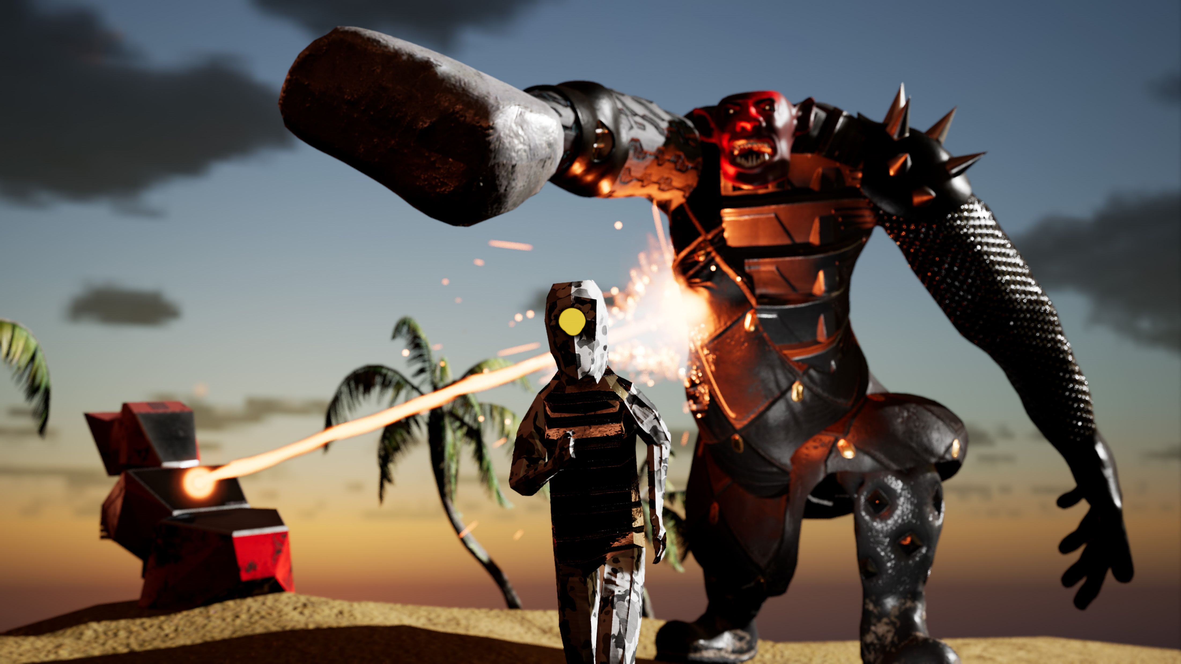
TAKE COVER!
real-time dynamic cover system

Slide 2
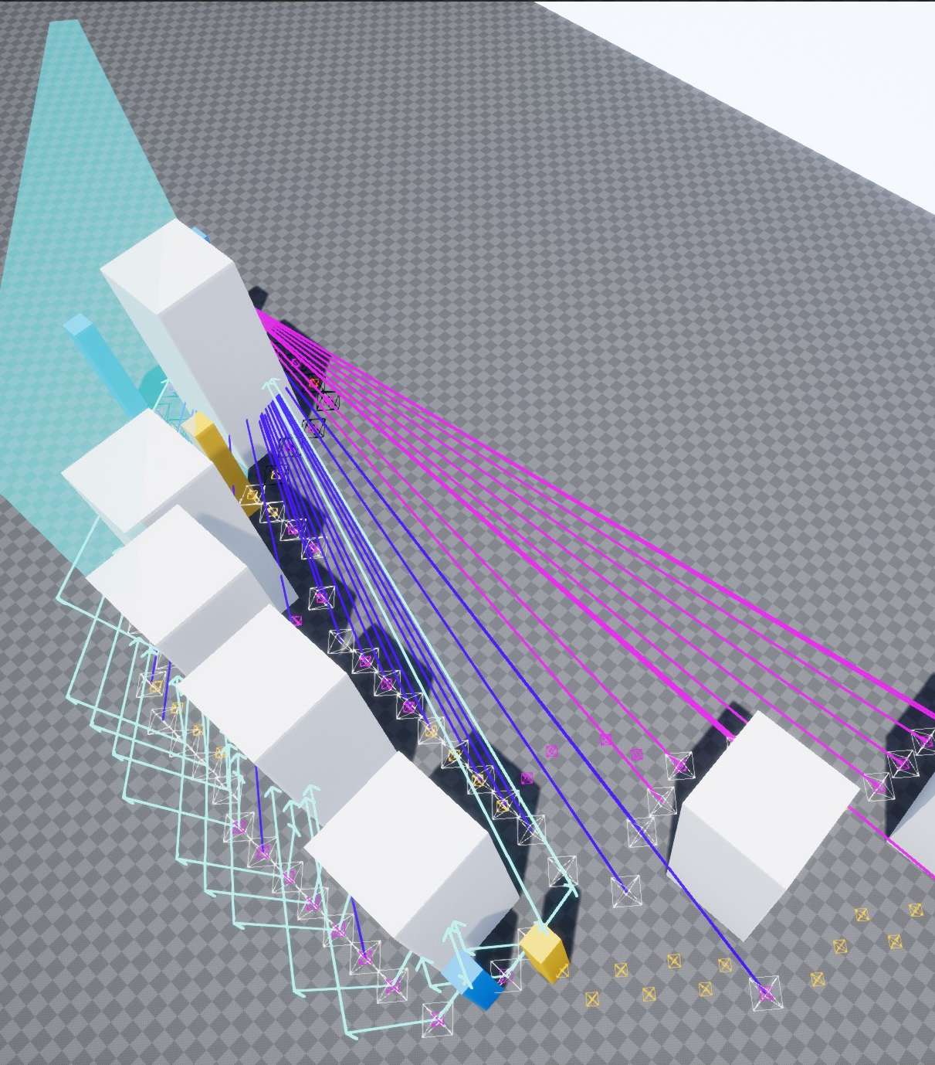
Why?
Adds tactical depth
Adds realism
Easy to implement
Saves you time
Fun mechanic
Notes:
Saved level designers from having to manually place cover points

Slide 3
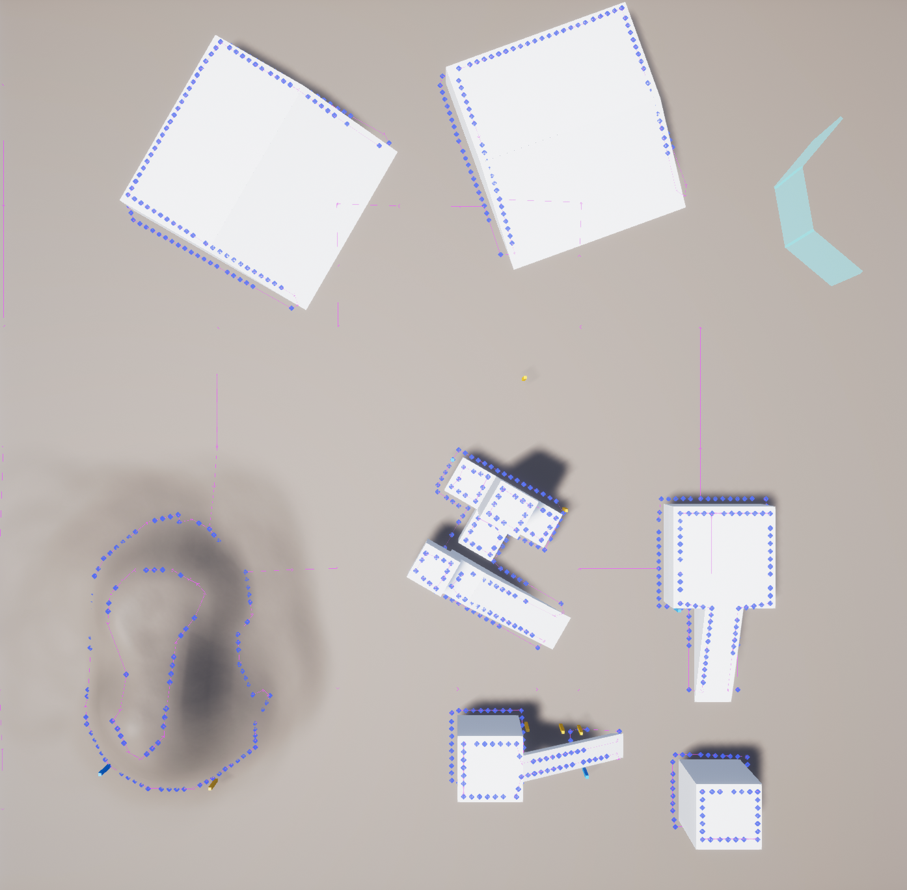
OVERVIEW
Data generation: navmesh and object-based
Data persistence: octree, cover data
Error-handling
Multi-threaded, asynchronous cover generation
Real-time dynamic updates
Finding cover
Collision & general setup
AI integration
Profiling & stats
Future of the demo project

Slide 4
HŌRU
Don't build bases - build entire battlefields.
https://horugame.com
Notes:
Custom, highly detailed battle tiles.
Using the cover system extensively w/ HORU’s AI.
In pre-production, KS and Unreal Dev Grant later this year.
Delivered first commit to repo exactly 2 years ago.

Slide 5
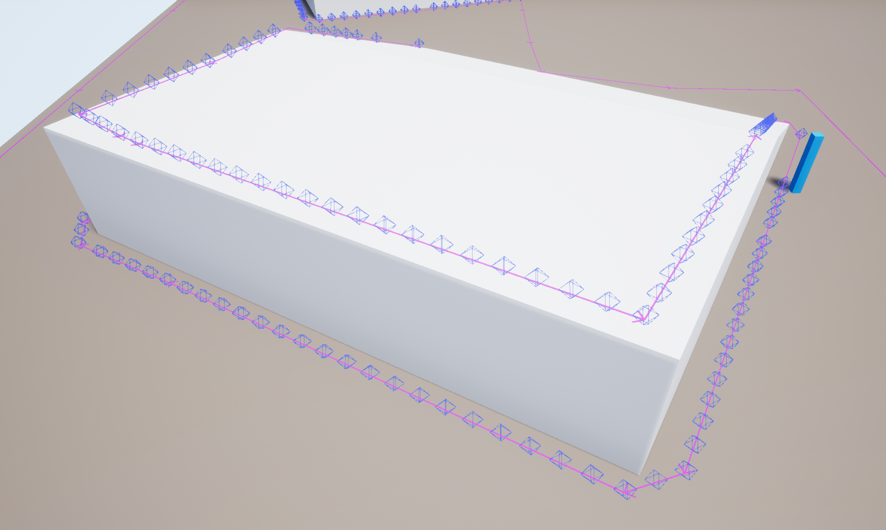
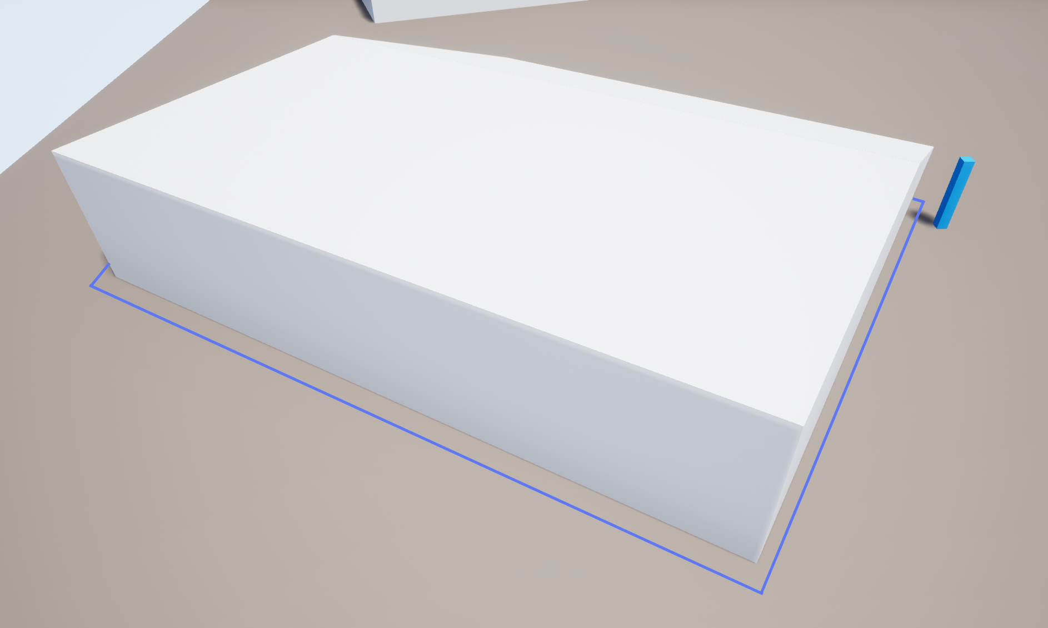
COVER SYSTEMS
Cover Points
Cover Rails

Slide 6
DATA DATA DATA
Data generation
Data persistence
Data access

Slide 7
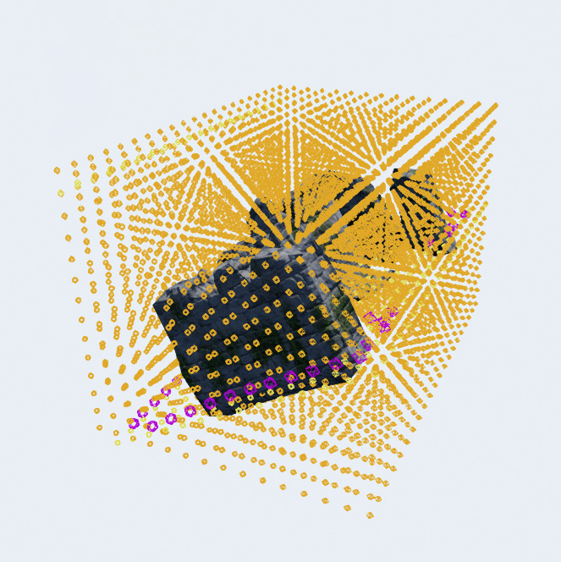
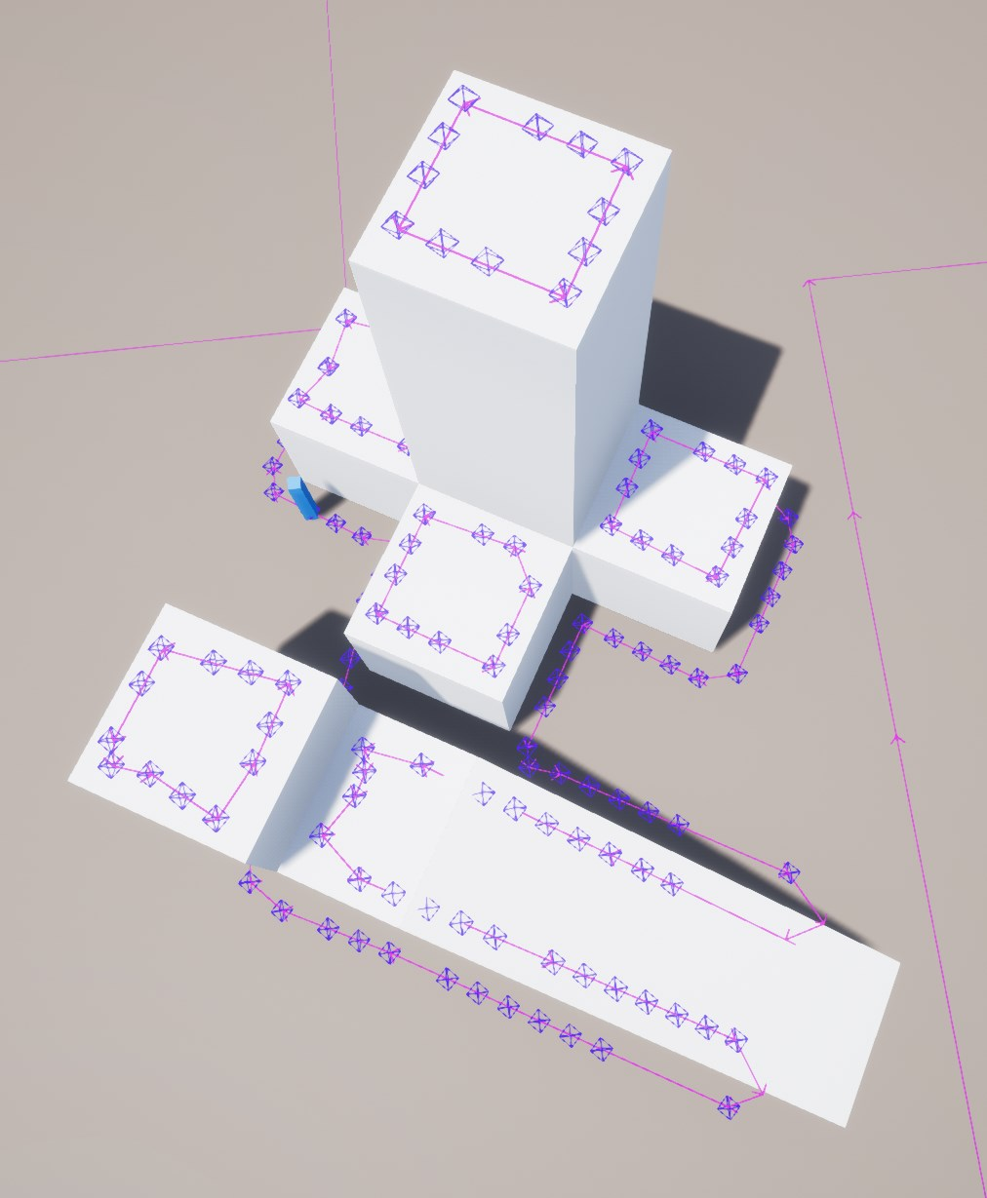
DATA GENERATION
Object-based
Navmesh-based

Slide 8
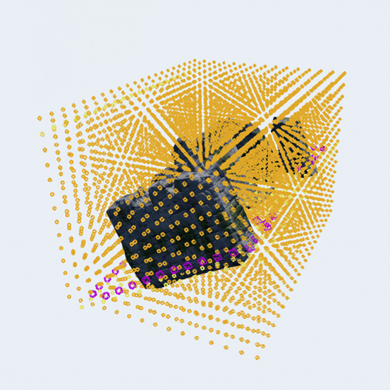
OBJECT-BASED GENERATION
Characteristics
3D scanning/slicing of the model’s AABB
Uniform cover point distribution
Supports force fields
Reduced chance of errors
Slower (lots of grid points)
No landscapes
Attached to actors via component

Slide 9
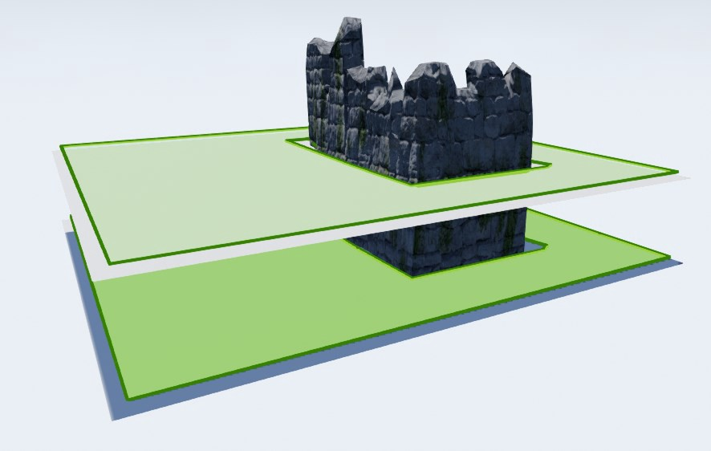
OBJECT-BASED GENERATION
Challenges
Multistory navmeshes

Slide 10
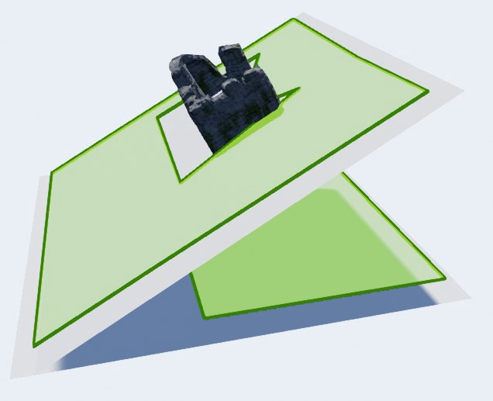
OBJECT-BASED GENERATION
Challenges
Multistory navmeshes
Rotated objects on slanted ground

Slide 11
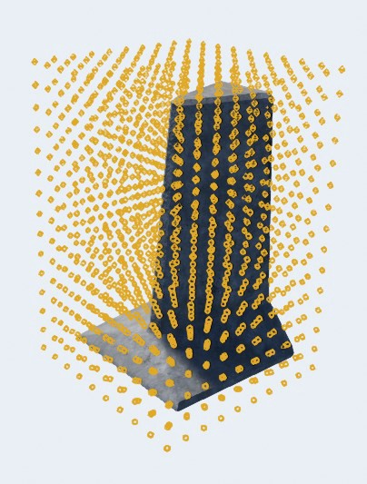
OBJECT-BASED GENERATION
Steps
3 for-loops, one per axis (X, Y, Z) inside the object’s AABB

Slide 12
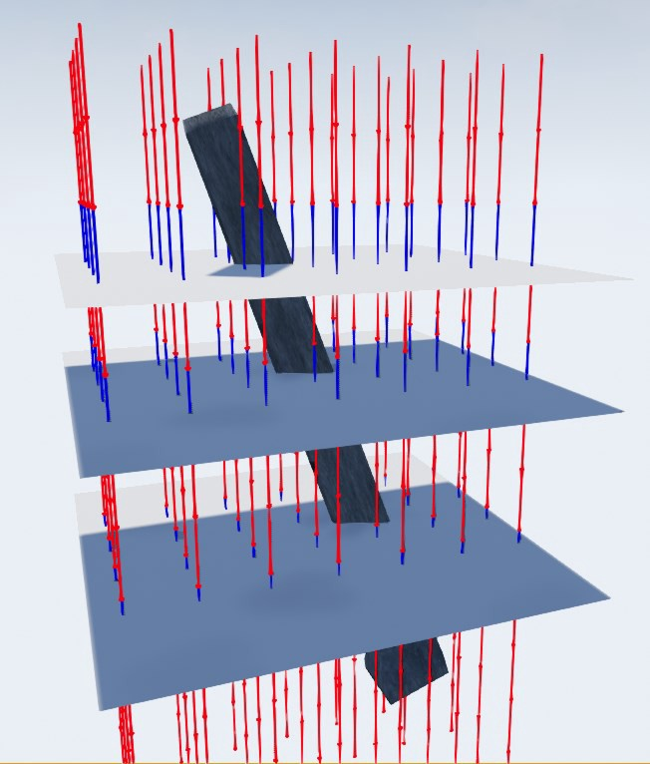
OBJECT-BASED GENERATION
Steps
3 for-loops, one per axis (X, Y, Z) inside the object’s AABB
Find ground plane(s) with raycasts
Blue rays: closer to a ground plane than the ray below.
Red rays: farther from a ground plane than the ray below

Slide 13
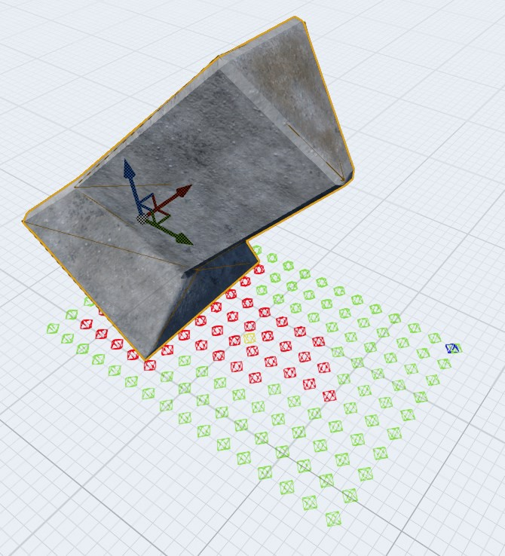
OBJECT-BASED GENERATION
Steps
3 for-loops, one per axis (X, Y, Z) inside the object’s AABB
Find ground plane(s) with raycasts
Check minimum clearance
Red points: not enough space for our smallest unit
Green points: enough space

Slide 14
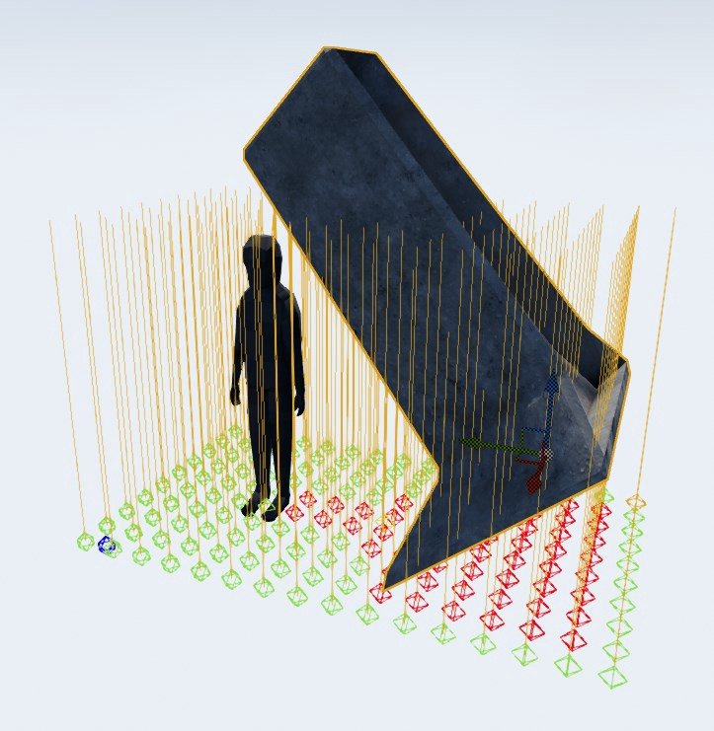
OBJECT-BASED GENERATION
Steps
3 for-loops, one per axis (X, Y, Z) inside the object’s AABB
Find ground plane(s) with raycasts
Check minimum clearance
Red points: not enough space for our smallest unit
Green points: enough space
Yellow lines: desired minimum clearance

Slide 15
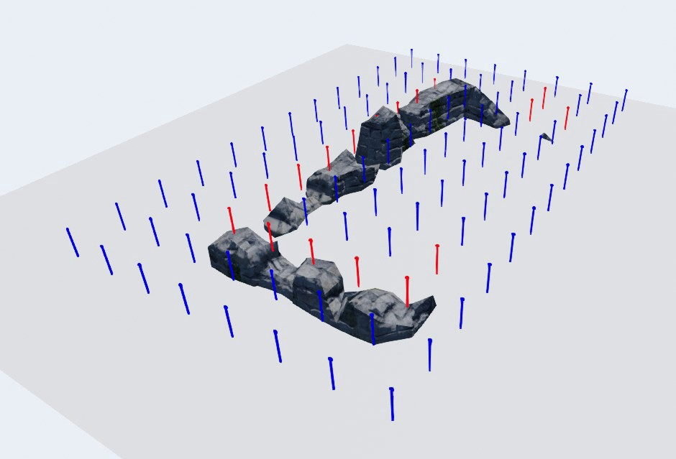
OBJECT-BASED GENERATION
Steps
3 for-loops, one per axis (X, Y, Z) inside the object’s AABB
Find ground plane(s) with raycasts
Check minimum clearance
Check minimum cover height
Red lines: cover is too short
Blue lines: cover is high enough

Slide 16
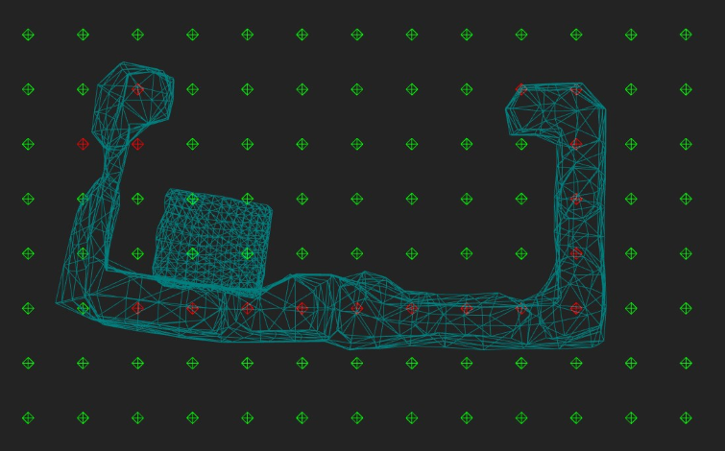
OBJECT-BASED GENERATION
Steps
3 for-loops, one per axis (X, Y, Z) inside the object’s AABB
Find ground plane(s) with raycasts
Check minimum clearance
Check minimum cover height
Filter out blocked points
Red: blocked grid points
Green: free grid points

Slide 17
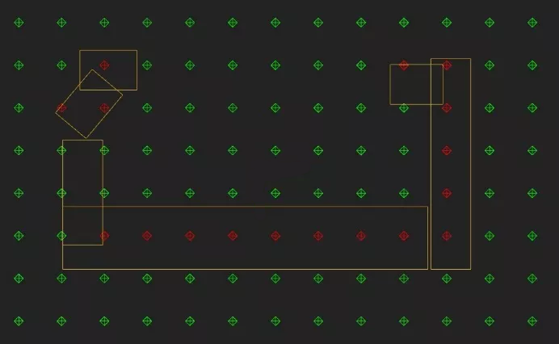
OBJECT-BASED GENERATION
Steps
3 for-loops, one per axis (X, Y, Z) inside the object’s AABB
Find ground plane(s) with raycasts
Check minimum clearance
Check minimum cover height
Filter out blocked points
Red: blocked grid points
Green: free grid points

Slide 18
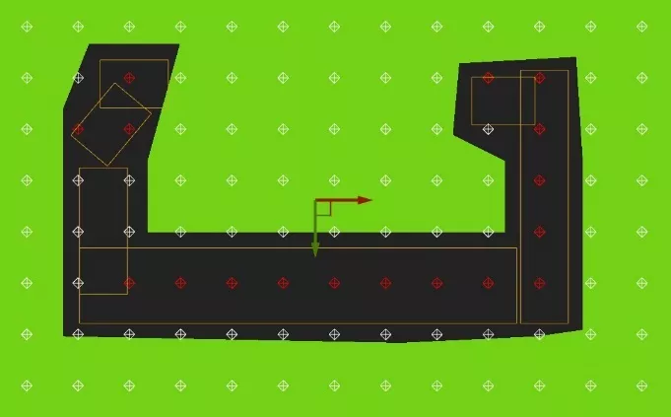
OBJECT-BASED GENERATION
Steps
3 for-loops, one per axis (X, Y, Z) inside the object’s AABB
Find ground plane(s) with raycasts
Check minimum clearance
Check minimum cover height
Filter out blocked points
Overlay the navmesh
Red: blocked grid points
White: free grid points

Slide 19
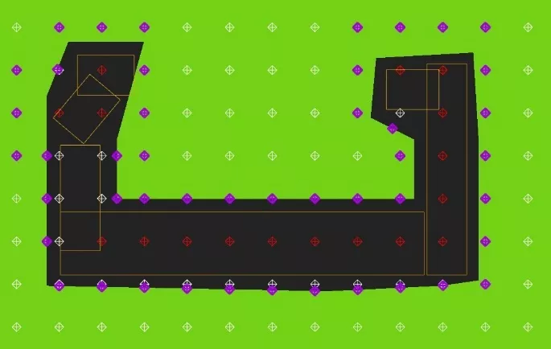
OBJECT-BASED GENERATION
Steps
3 for-loops, one per axis (X, Y, Z) inside the object’s AABB
Find ground plane(s) with raycasts
Check minimum clearance
Check minimum cover height
Filter out blocked points
Overlay the navmesh
Filter out points not on navmesh
Red: blocked grid points
White: free grid points
Purple: final grid points

Slide 20
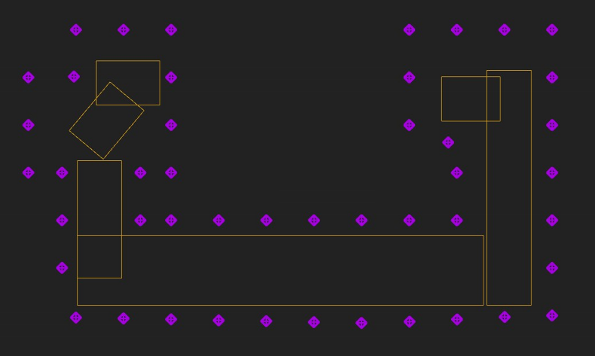
OBJECT-BASED GENERATION
Steps
3 for-loops, one per axis (X, Y, Z) inside the object’s AABB
Find ground plane(s) with raycasts
Check minimum clearance
Check minimum cover height
Filter out blocked points
Overlay the navmesh
Filter out points not on navmesh

Slide 21
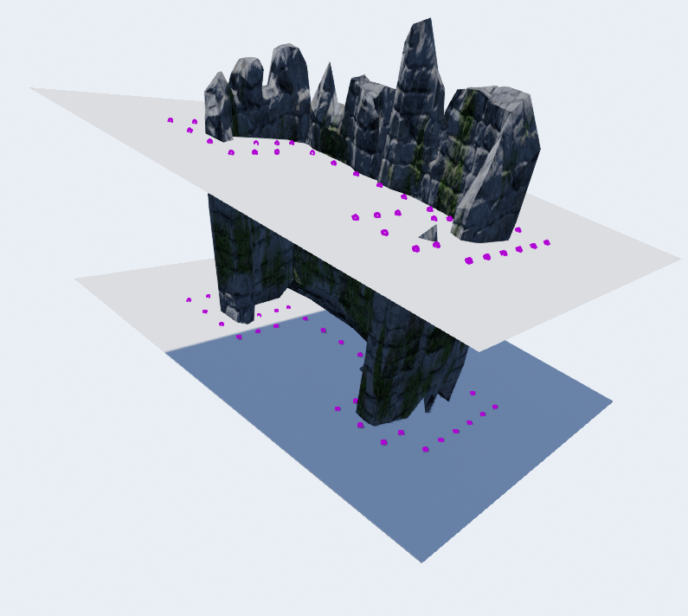
OBJECT-BASED GENERATION
>
Results

Slide 22
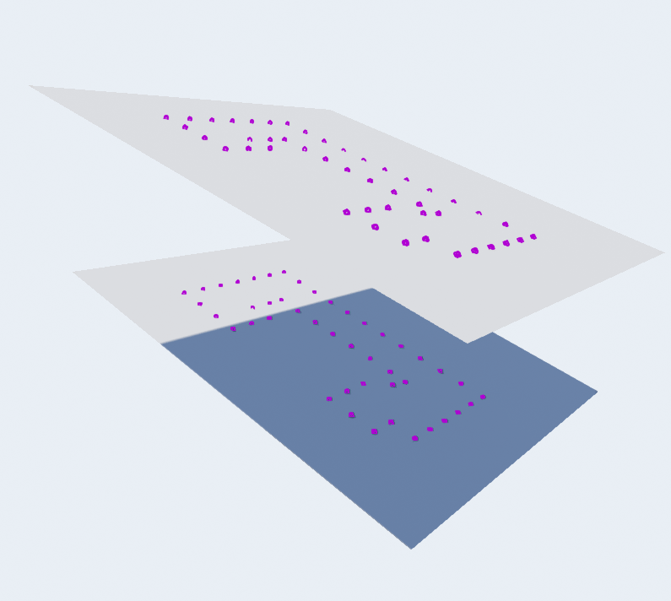
OBJECT-BASED GENERATION
>
Results

Slide 23
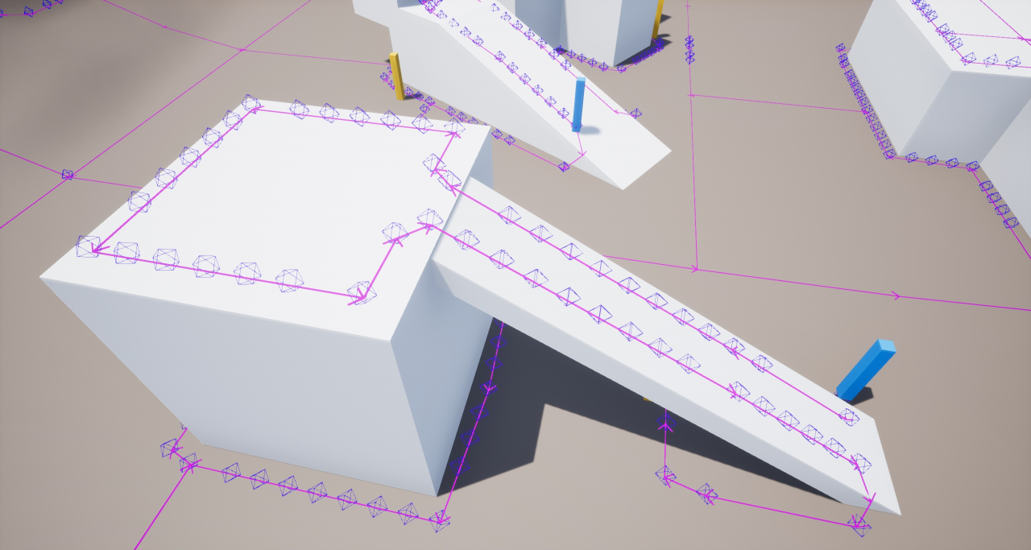
NAVMESH-BASED GENERATION
Characteristics
Very fast
Great with landscapes
No force fields
More error-prone: tile boundaries, etc.

Slide 24
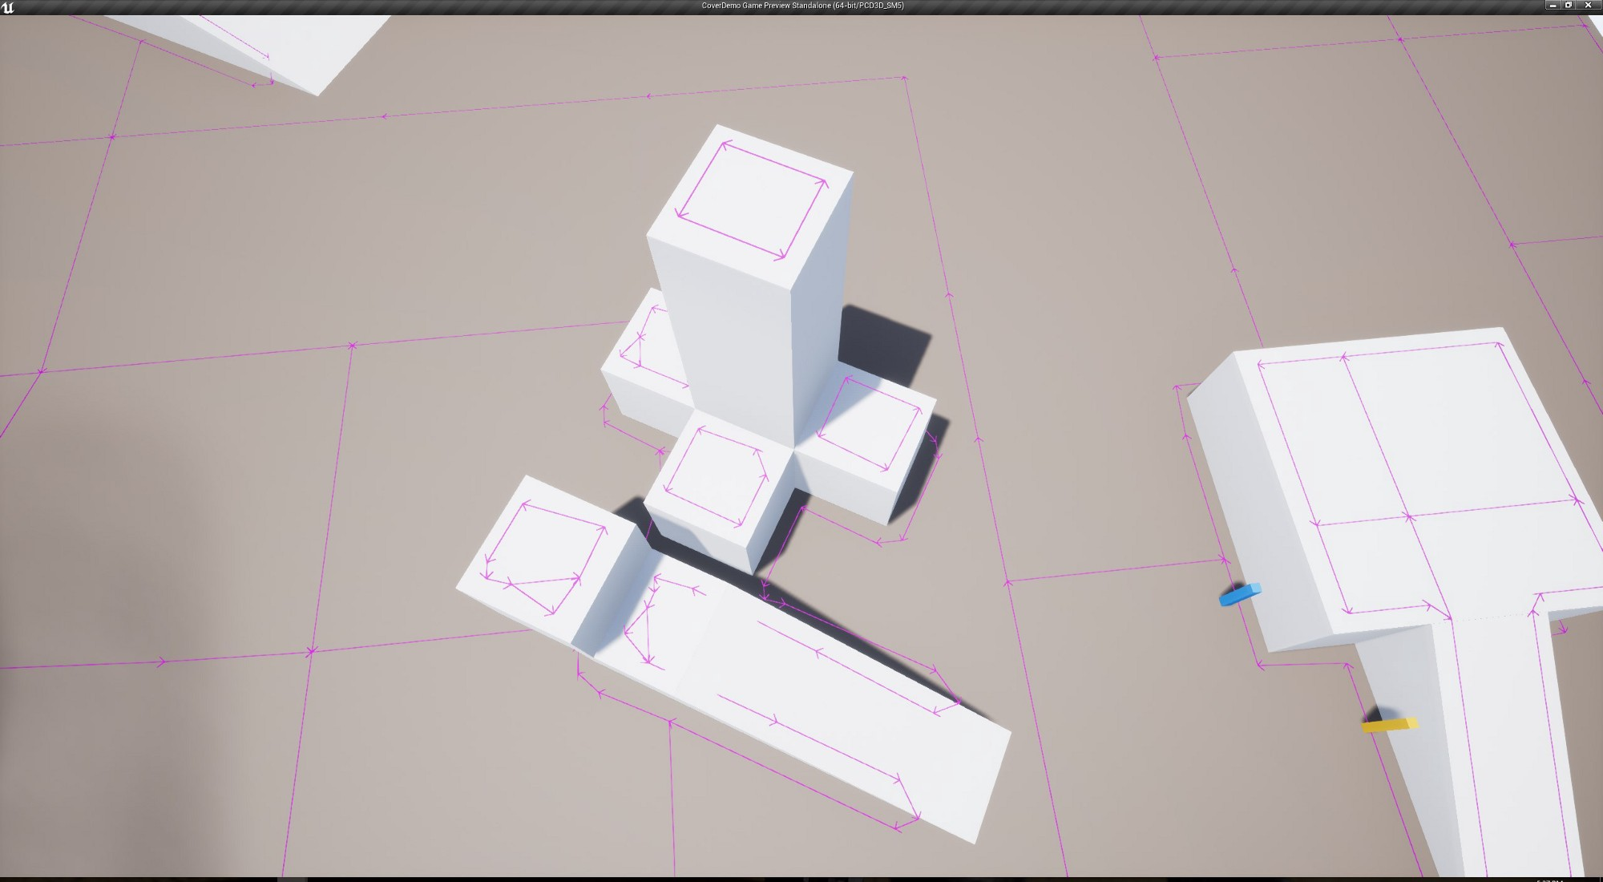
NAVMESH-BASED GENERATION
Overview
Edge detection

Slide 25
NAVMESH-BASED GENERATION
Overview
Edge detection
Point generation

Slide 26
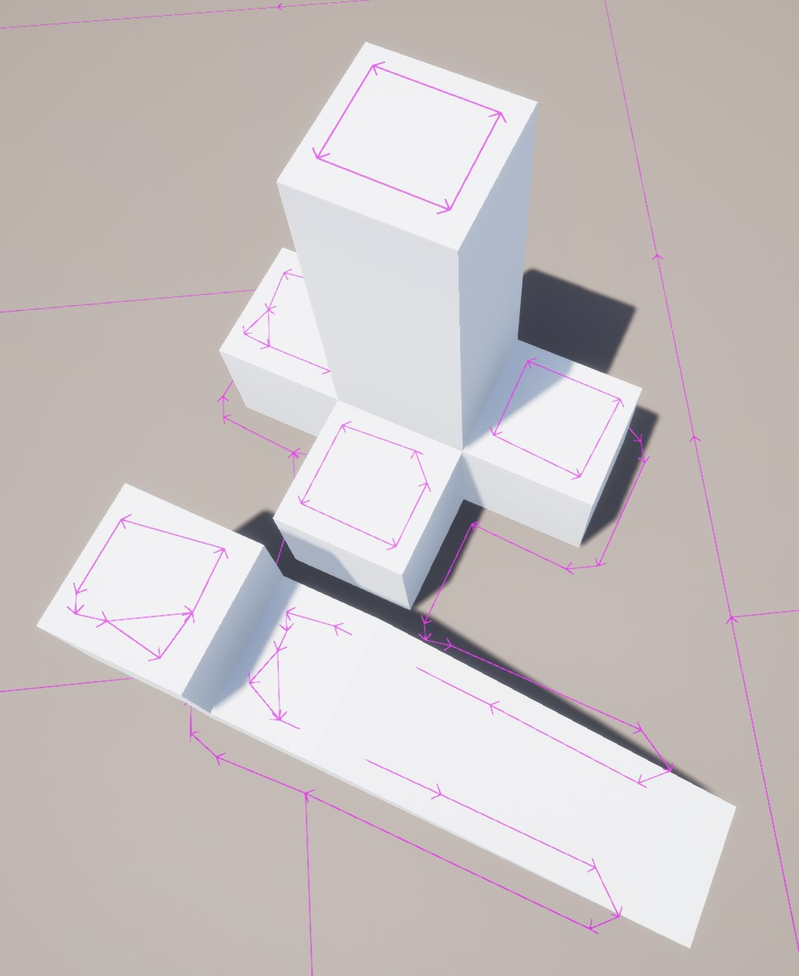
NAVMESH-BASED GENERATION
Steps
Get all the navmesh vertices

Slide 27
NAVMESH-BASED GENERATION
Steps
Get all the navmesh vertices … FRecastDebugGeometry navGeo; navdata->GetDebugGeometry(navGeo, tileIndex); TArray<FVector>& vertices = navGeo.NavMeshEdges; … NavMeshEdges are the vertices!

Slide 28
NAVMESH-BASED GENERATION
Steps
Get all the navmesh vertices
Take edge direction between two verts: (end - start).GetUnsafeNormal()

Slide 29
NAVMESH-BASED GENERATION
Steps
Get all the navmesh vertices
Take edge direction between two verts:
Subdivide edges

Slide 30
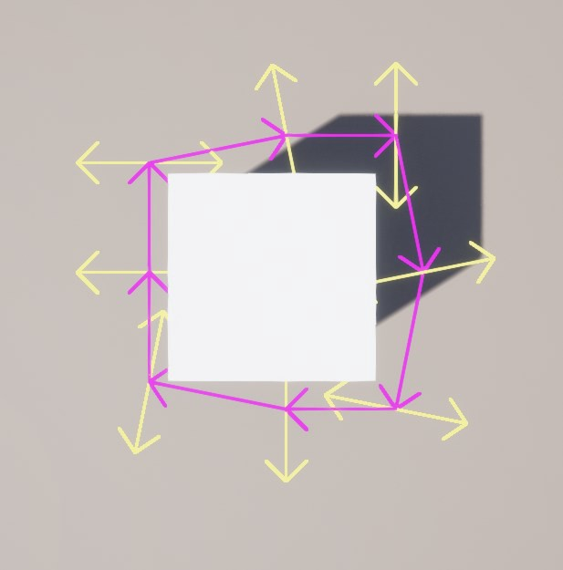
NAVMESH-BASED GENERATION
Steps
Get all the navmesh vertices
Take edge direction between two verts:
Subdivide edges
Cast a ray perpendicular to the edge in both directions (yellow arrows)

Slide 31
NAVMESH-BASED GENERATION
Steps
Get all the navmesh vertices
Take edge direction between two verts:
Subdivide edges
Cast a ray perpendicular to the edge in both directions (yellow arrows)
If a ray hits: we’ve found cover!

Slide 32
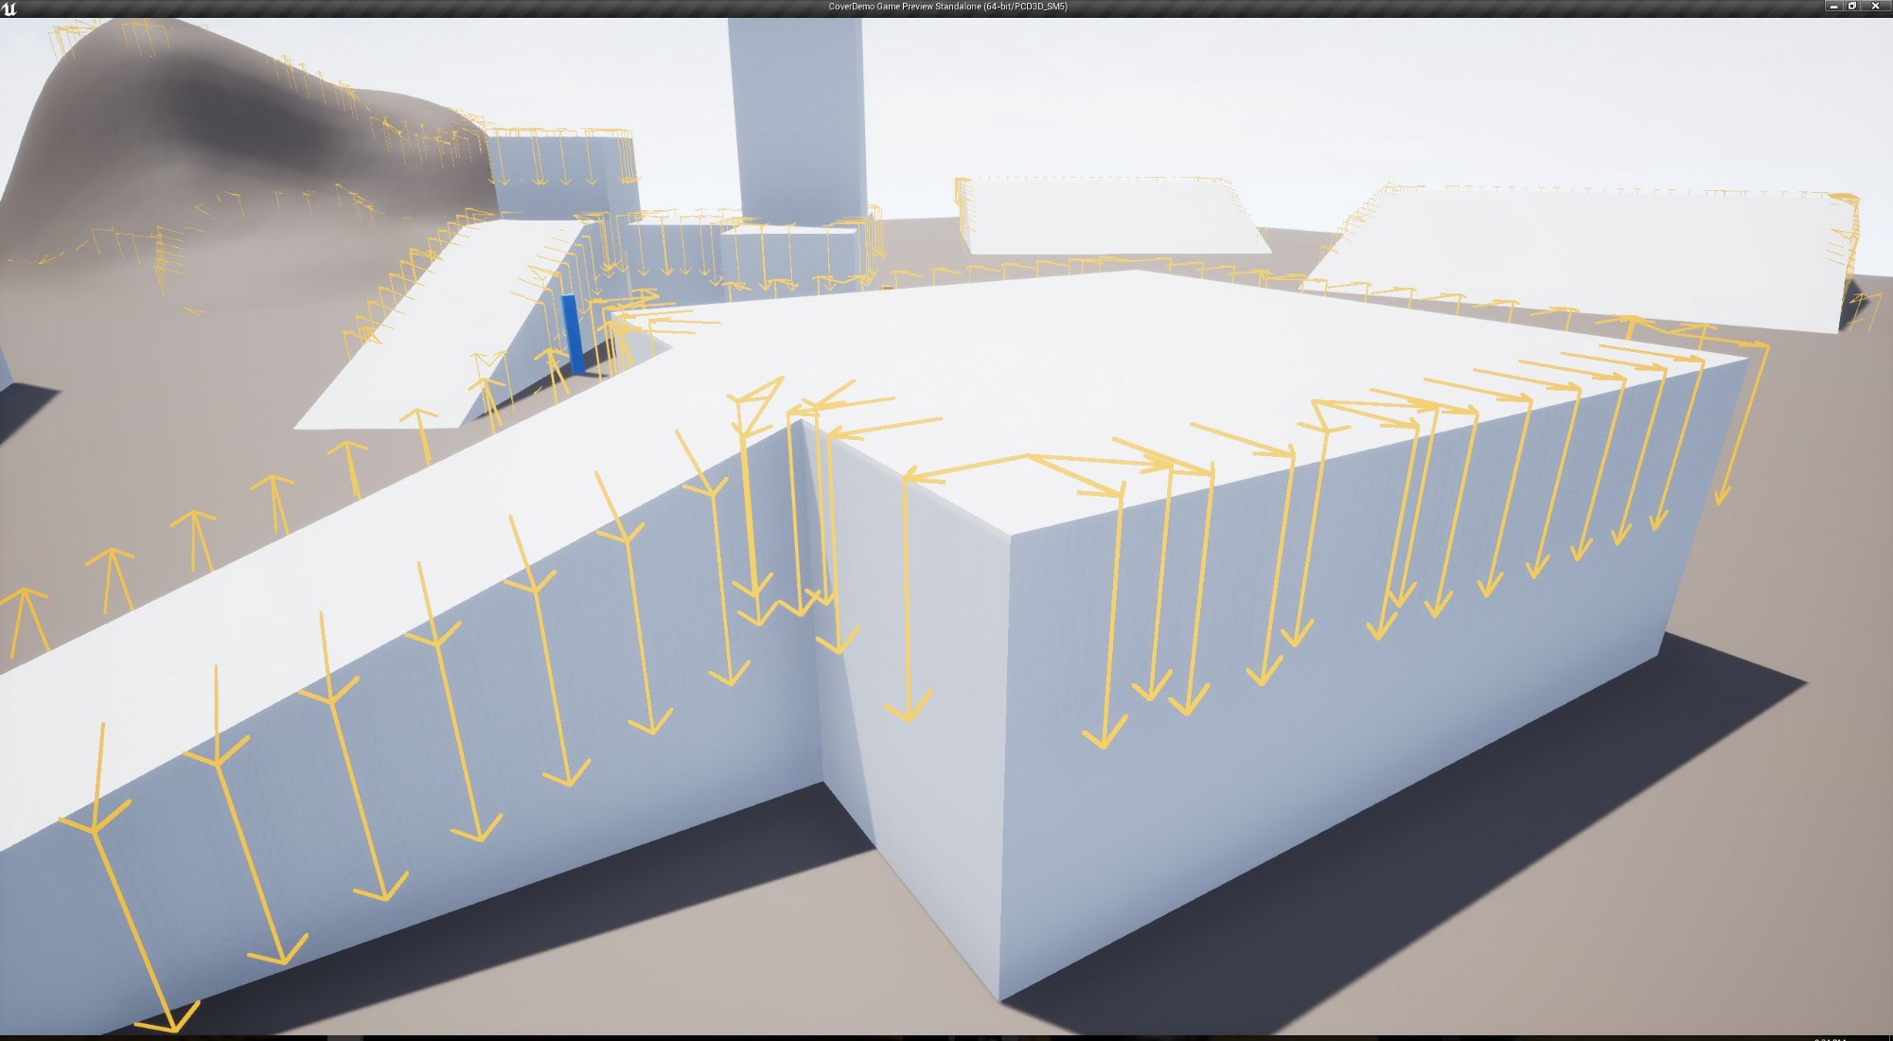
NAVMESH-BASED GENERATION
Steps
Get all the navmesh vertices
Take edge direction between two verts
Subdivide edges
Cast a ray perpendicular to the edge in both directions (yellow arrows)
If a ray hits: we’ve found cover!
[Optional] Ledge detection

Slide 33
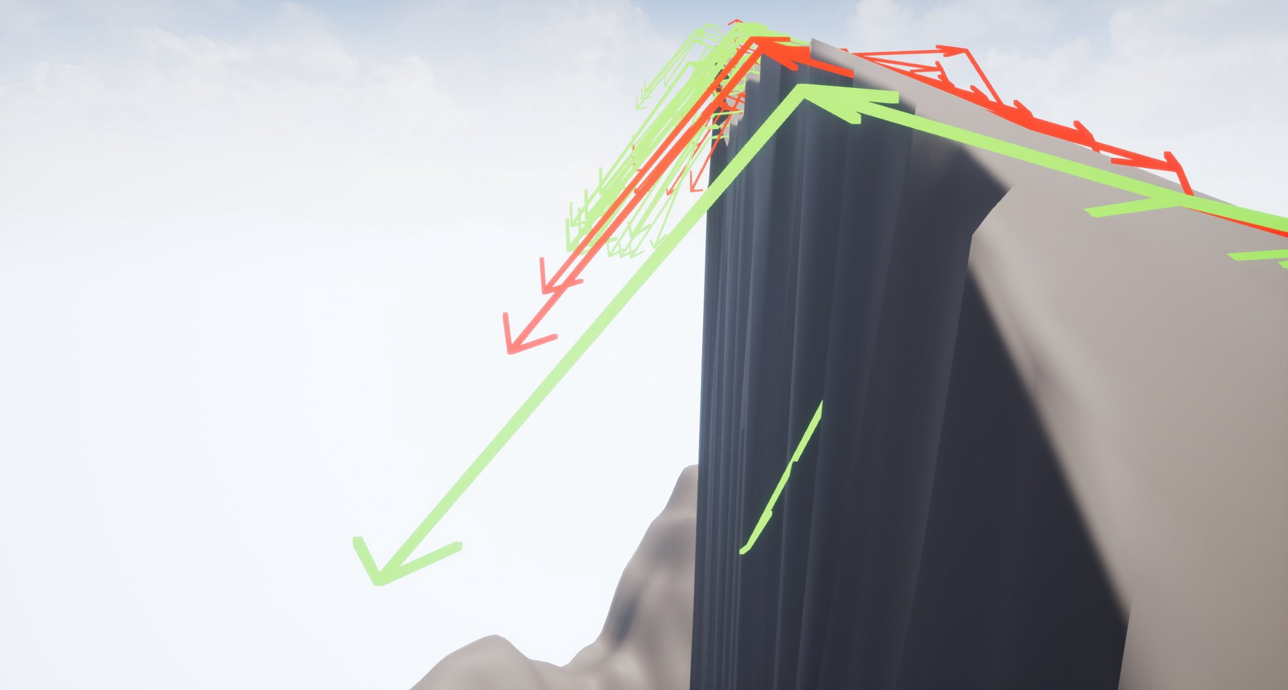
NAVMESH-BASED GENERATION
Steps
Get all the navmesh vertices
Take edge direction between two verts
Subdivide edges
Cast a ray perpendicular to the edge in both directions (yellow arrows)
If a ray hits: we’ve found cover!
[Optional] Ledge detection
[Optional] Slope tolerance

Slide 34
NAVMESH-BASED GENERATION
Ledge Detection
Cost: 4 more rays per vertex at most.
For each direction perpendicular to an edge:
1 ray to check if we hit cover
+
1 ray to check if there’s ample space below
1 ray to determine the cover object = 3 rays per vertex, total of 3 x 2 = 6 rays

Slide 35
NAVMESH-BASED GENERATION
Slope Tolerance
Cost: 2 more rays per vertex at most.
For each direction perpendicular to an edge:
1 ray to check if we hit cover
+
1 ray to check if there’s ample space below
1 ray at a slight angle if the above ray hit
1 ray to determine the cover object = 4 rays per vertex, total of 4 x 2 = 8 rays

Slide 36
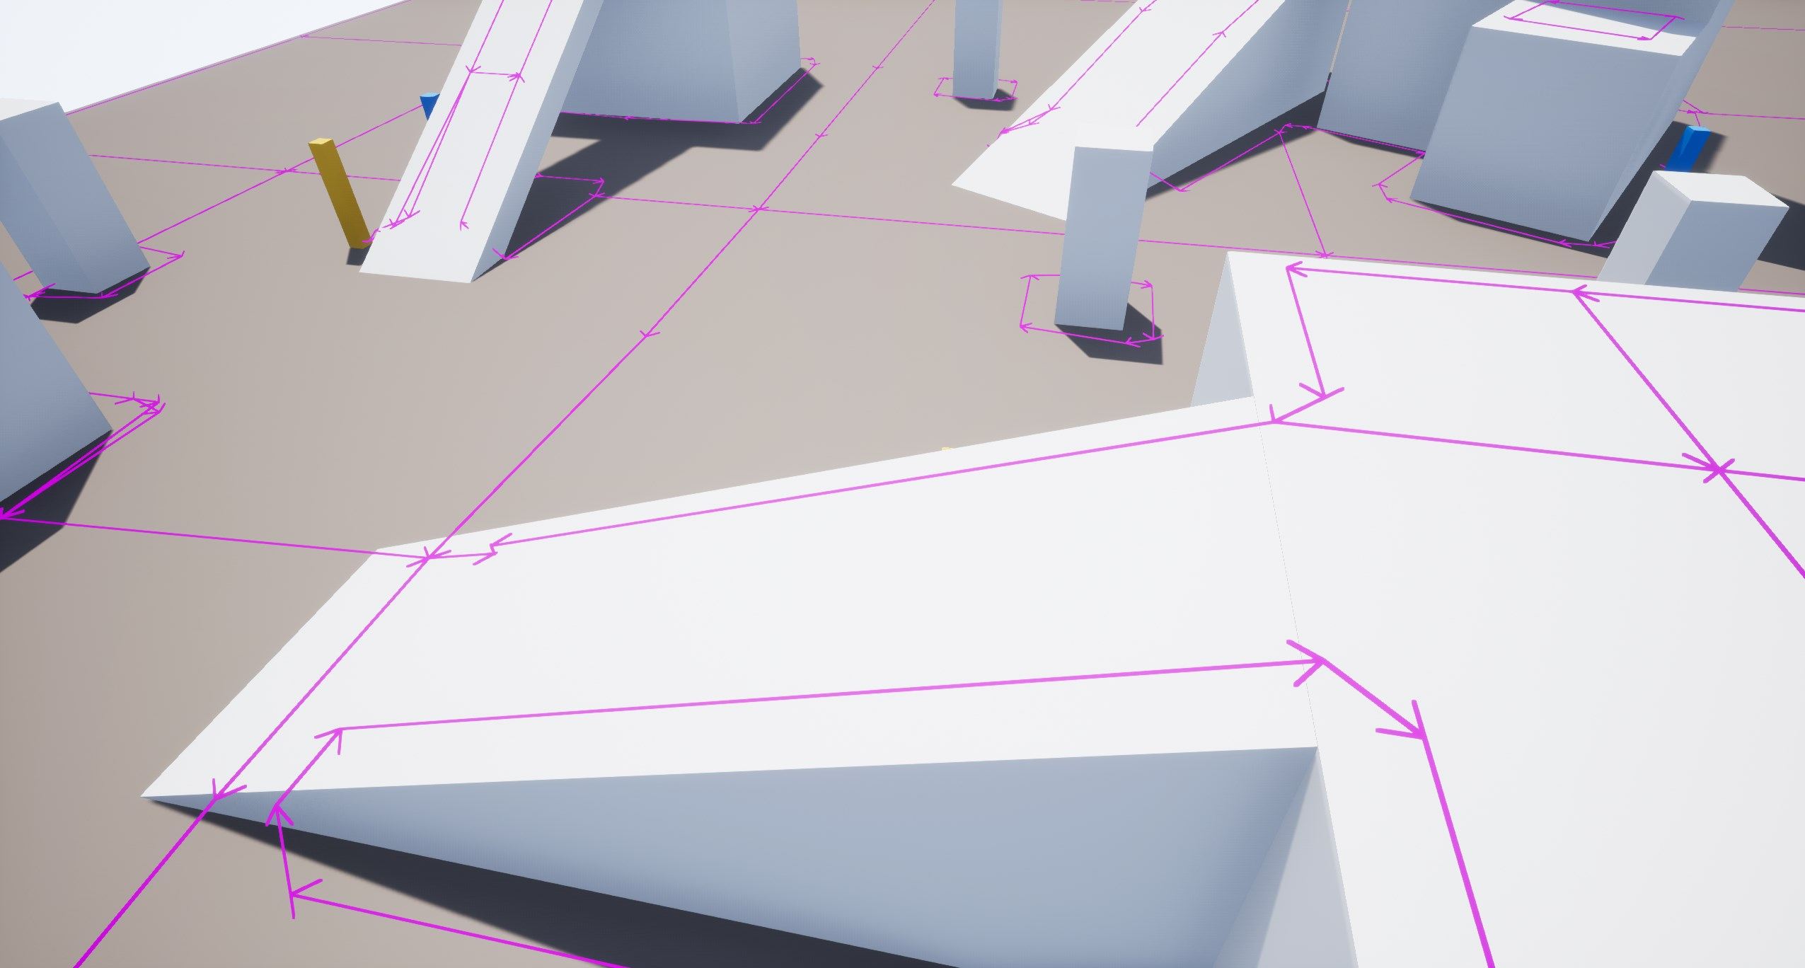
NAVMESH-BASED GENERATION
Advantages
Navmesh does most of the work for us
No need to scan objects on 3 axes
A lot fewer raycasts than with object scanning
Landscapes!

Slide 37
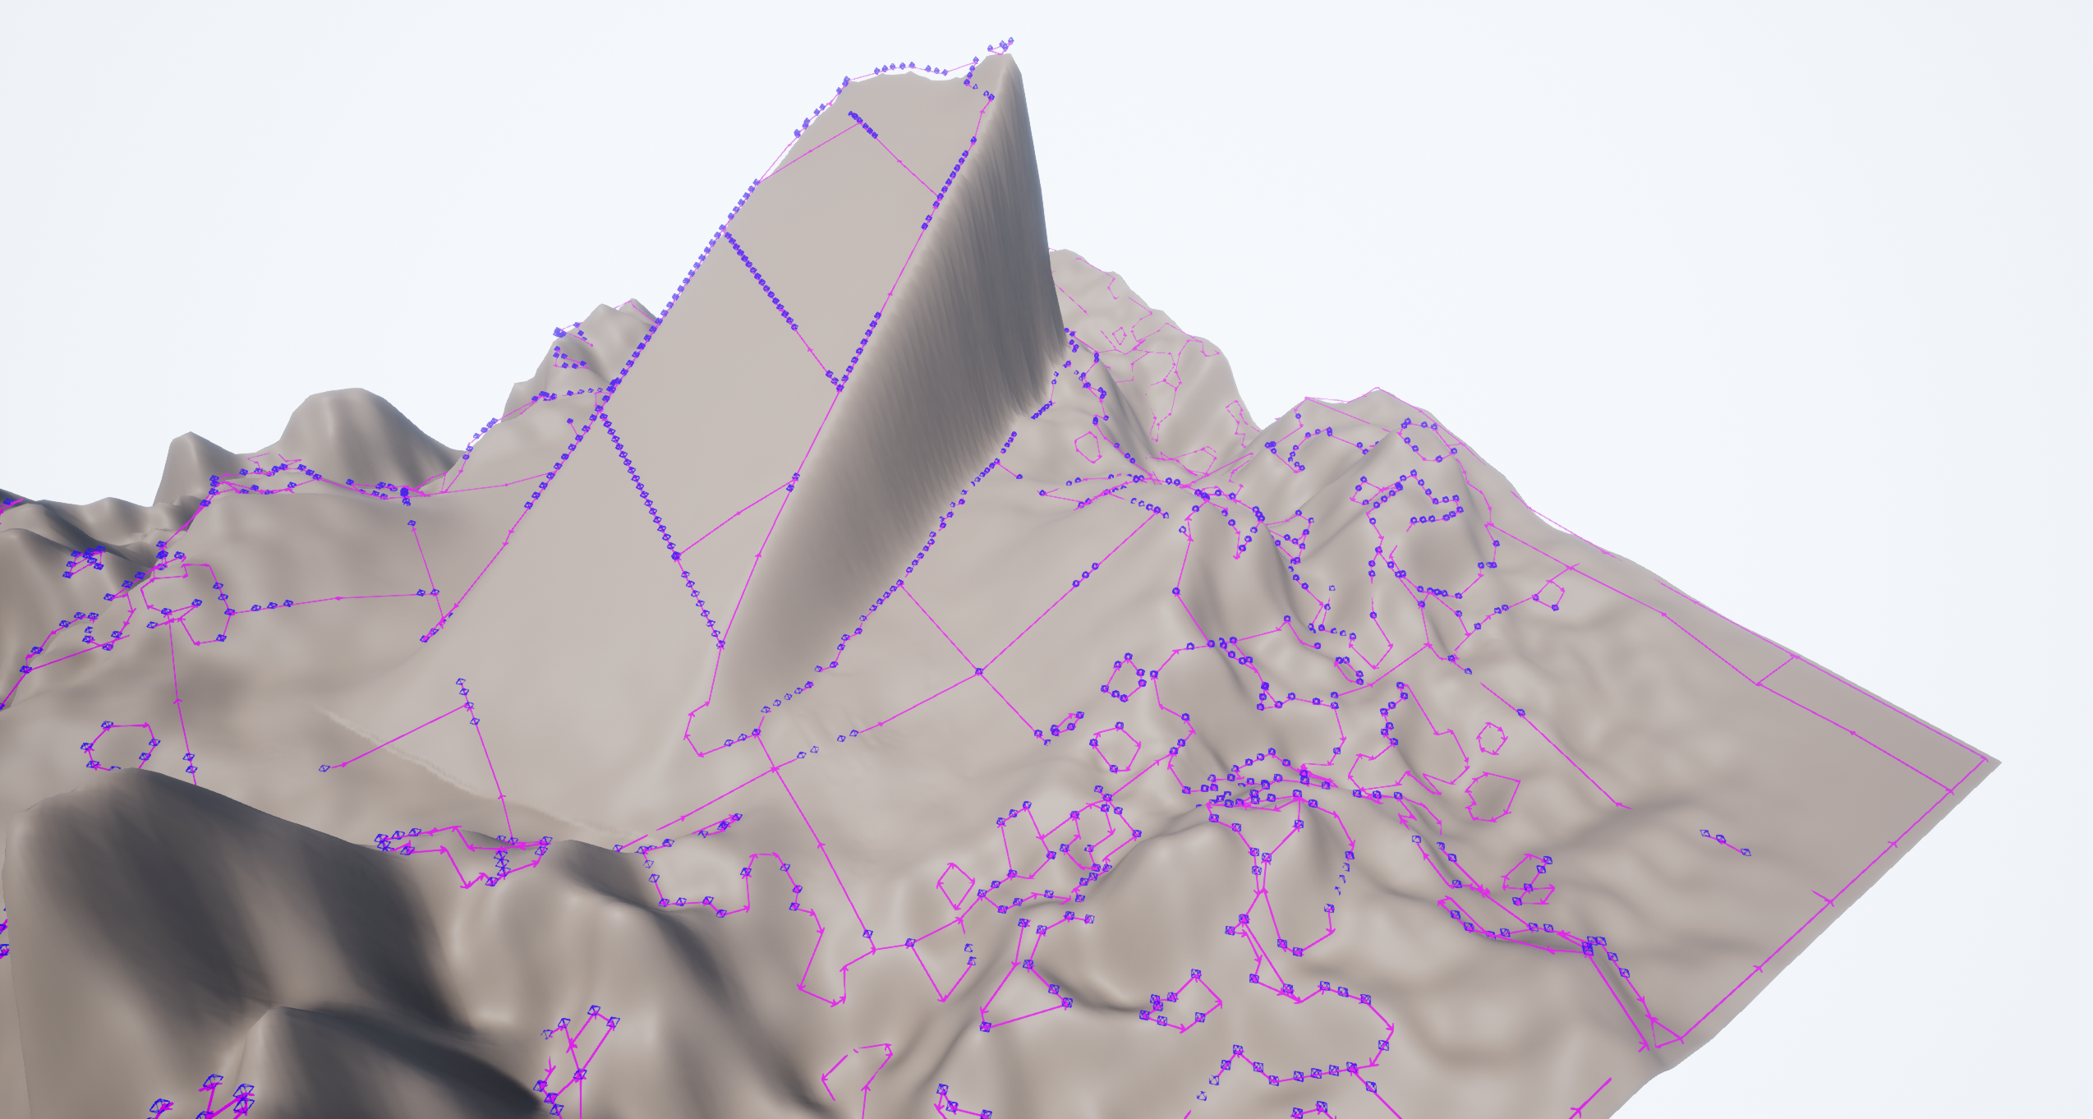
Landscapes

Slide 38
Tile boundaries

Slide 39
Tile boundaries
Relatively flat

Slide 40
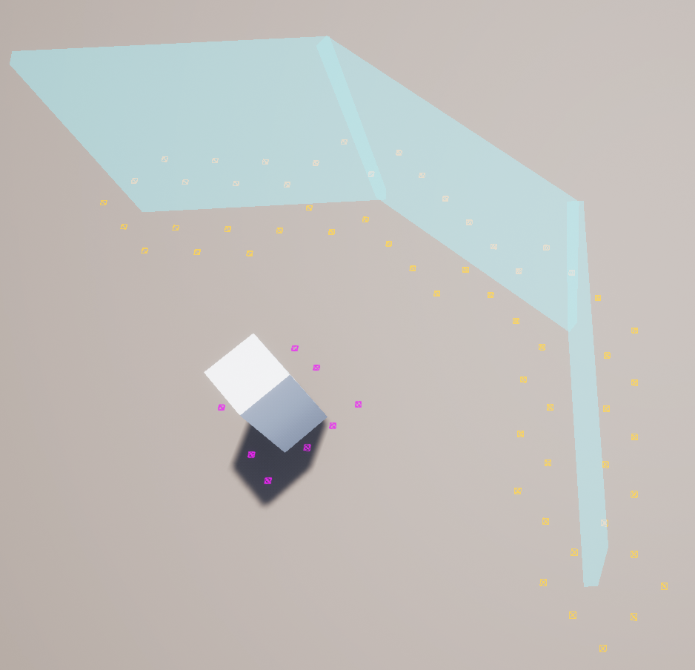
FORCE FIELDS (SHIELDS)
Traits
Don’t block movement
Don’t block visibility
Block bullets
Navmesh is unaware of them
Have to use 3D object scanning
Marked by a flag
Static (but don’t have to be if you’re brave)

Slide 41
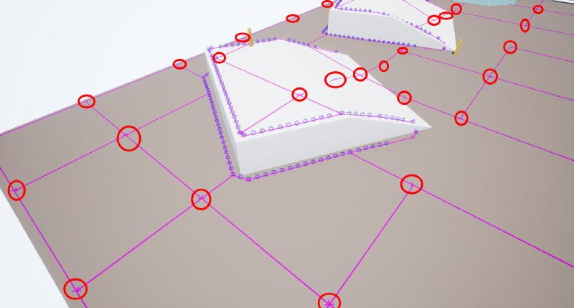
NAVMESH ERRORS
Navmesh Boundaries
Unnecessary edges on navmesh tile boundaries
Filter them out during generation
This is why we need raycasts vs. every navmesh vertex is a cover point

Slide 42
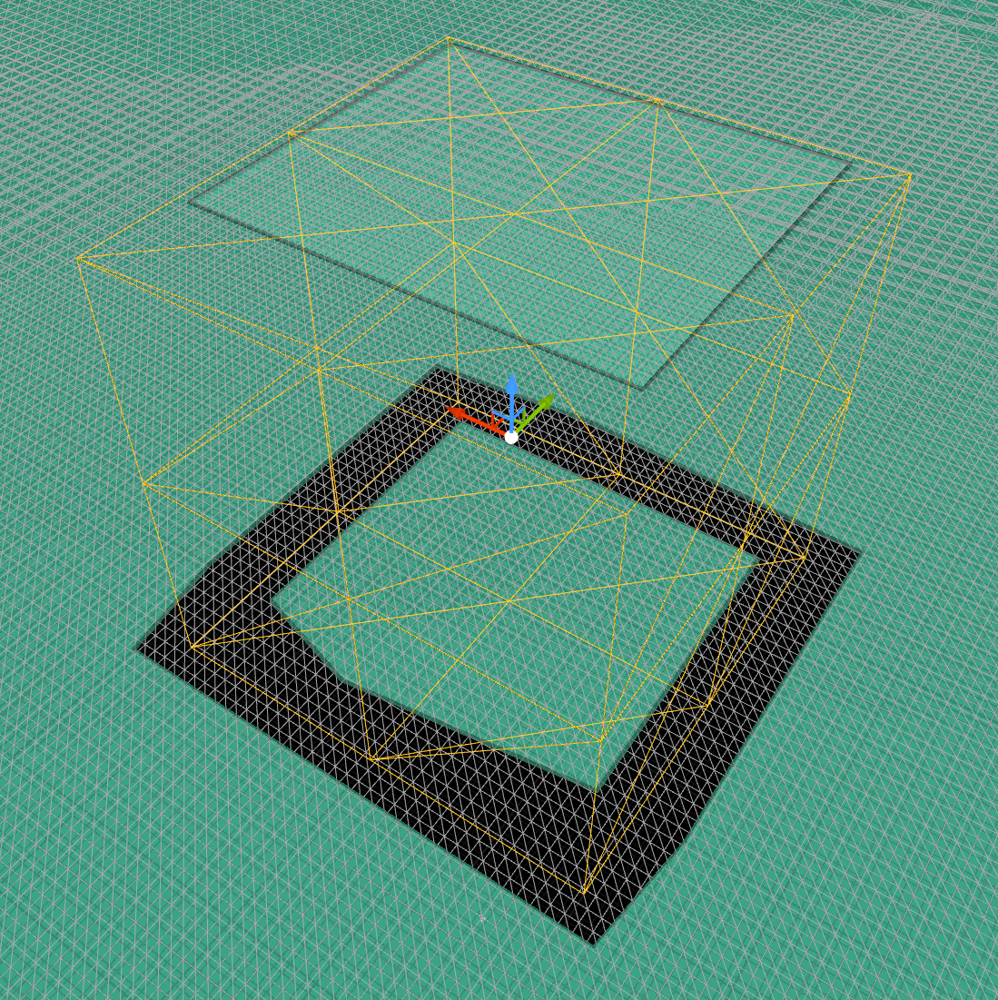
NAVMESH ERRORS
Navmesh Inside Objects
Recast does this by default
Extra cover points hit performance
Use nav modifier volumes
Manual process :-(

Slide 43
NAVMESH ERRORS
Navmesh Inside Objects
Recast does this by default
Extra cover points hit performance
Use nav modifier volumes
Manual process :-(

Slide 44
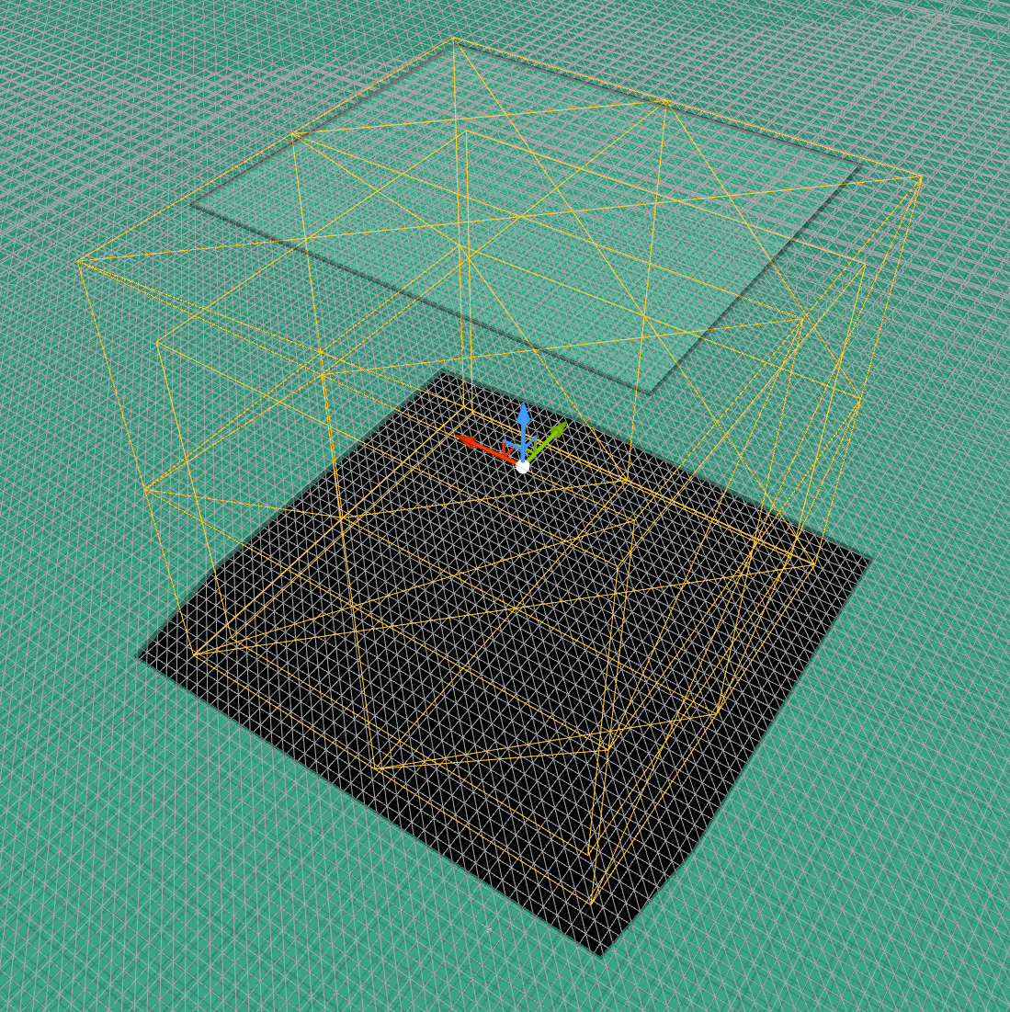
NAVMESH ERRORS
Navmesh Inside Objects
Recast does this by default
Extra cover points hit performance
Use nav modifier volumes
Manual process :-(

Slide 45
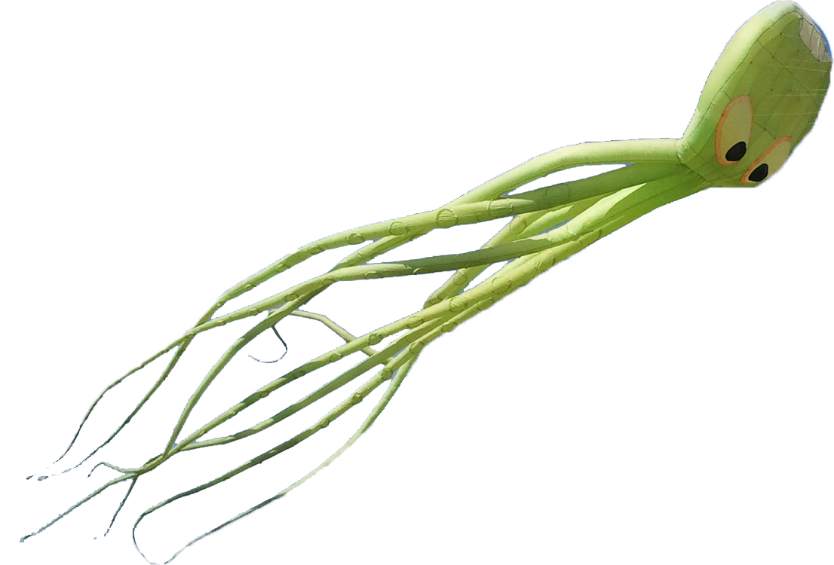
DATA PERSISTENCE
The Octree

Slide 46
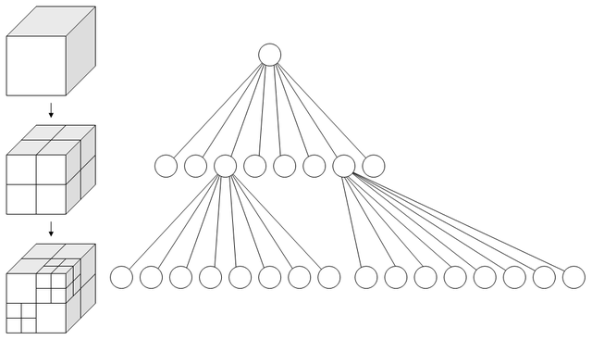
DATA PERSISTENCE
The Octree
Divides 3D space into regions
Divide cube into 8 smaller cubes, rinse & repeat
UE4 has got you covered
No documentation
Steal navmesh octree integration code from FNavigationOctree
Performance vs. 2D acceleration structure, e.g. TMap<FGridLocation, FCoverPoints>?
A more accurate and boring representation.

Slide 47
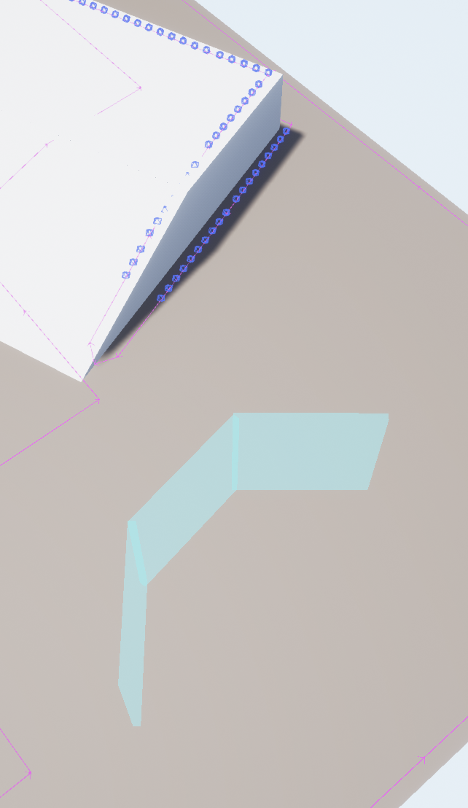
DATA PERSISTENCE
Cover Data
Location
Cover object
Is it taken?
Is it a shield?
Easily extensible: height, arc of coverage, health, type (wood, concrete), etc.

Slide 48
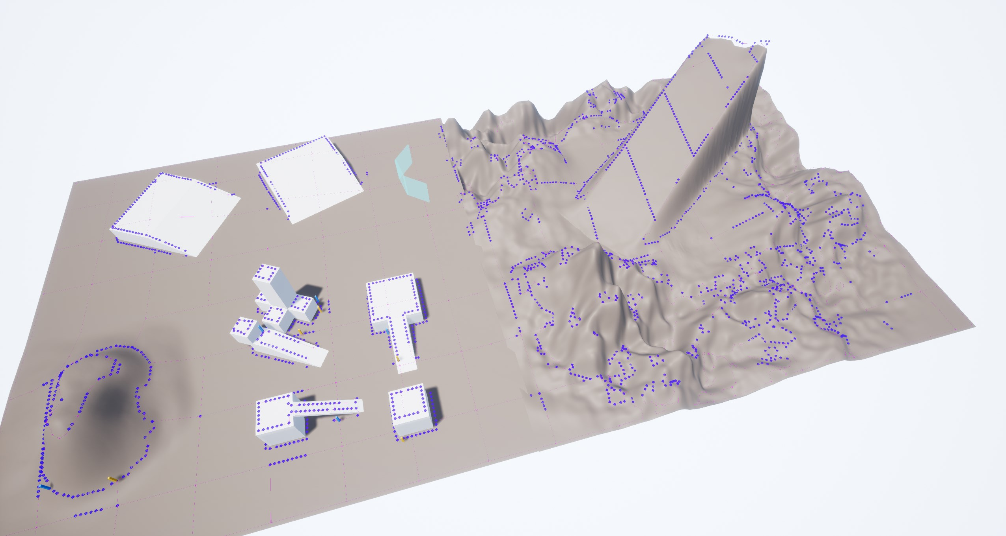
Generation Workflow

Slide 49
REAL-TIME UPDATES
Data Generation Workflow
Hook into Recast’s tile update events

Slide 50
REAL-TIME UPDATES
Data Generation Workflow
Hook into Recast’s tile update events
Subclass ARecastNavMesh, bind to OnNavigationGenerationFinishedDelegate

Slide 51
REAL-TIME UPDATES
Data Generation Workflow
Hook into Recast’s tile update events
Subclass ARecastNavMesh, bind to OnNavigationGenerationFinishedDelegate
Recast spams these, so buffer unique tiles every x ms and broadcast then (x = 0.2)

Slide 52
REAL-TIME UPDATES
Data Generation Workflow
Hook into Recast’s tile update events
Subclass ARecastNavMesh, bind to OnNavigationGenerationFinishedDelegate
Recast spams these, so buffer unique tiles every x ms and broadcast then (x = 0.2)
Called NavmeshTilesUpdatedBufferedDelegate in the sample project

Slide 53
REAL-TIME UPDATES
Data Generation Workflow
Hook into Recast’s tile update events
Subclass ARecastNavMesh, bind to OnNavigationGenerationFinishedDelegate
Recast spams these, so buffer unique tiles every x ms and broadcast then (x = 0.2)
Called NavmeshTilesUpdatedBufferedDelegate in the sample project
The cover system binds to this and launches async tasks

Slide 54
Navmesh
REAL-TIME UPDATES
Cover System
Data Generation Workflow
Hook into Recast’s tile update events
Subclass ARecastNavMesh, bind to OnNavigationGenerationFinishedDelegate
Recast spams these, so buffer unique tiles every x ms and broadcast then (x = 0.2)
Called NavmeshTilesUpdatedBufferedDelegate in the sample project
The cover system binds to this and launches async tasks
The tasks generate cover points
Worker
Worker
Worker
Worker
Octree

Slide 55
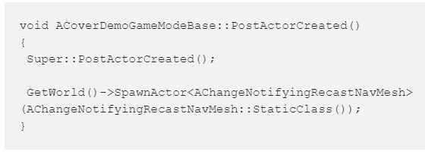
CONFIGURATION
General
Spawn our custom navmesh

Slide 56
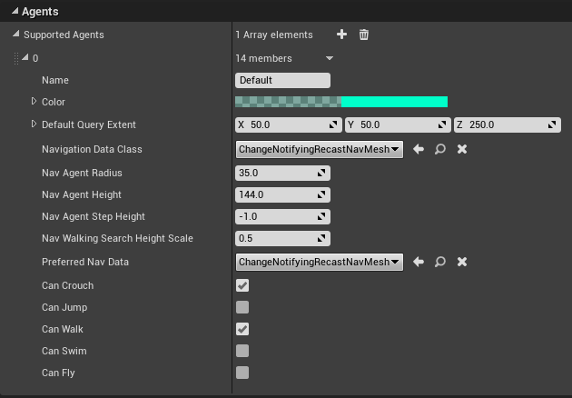
CONFIGURATION
General
Spawn our custom navmesh
Set nav data & preferred nav data class

Slide 57
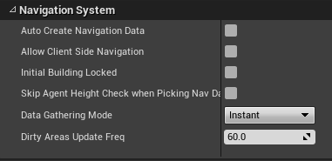
CONFIGURATION
General
Spawn our custom navmesh
Set nav data & preferred nav data class
Uncheck Auto Create Nav Data

Slide 58
CONFIGURATION
Collision
Don’t generate cover around pawns

Slide 59
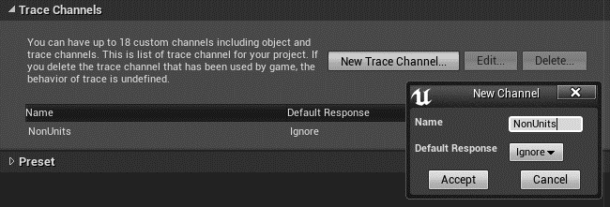
CONFIGURATION
Collision
Don’t generate cover around pawns
Create a custom trace channel NonUnits

Slide 60
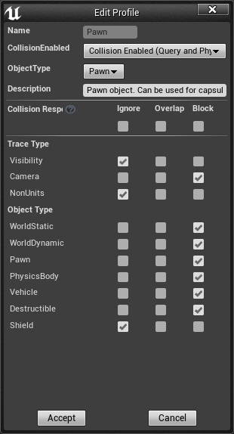
CONFIGURATION
Collision
Don’t generate cover around pawns
Create a custom trace channel NonUnits
Moving objects e.g. Pawn and Vehicle should be set to Ignore this

Slide 61
CONFIGURATION
Collision
Don’t generate cover around pawns
Create a custom trace channel NonUnits
Moving objects e.g. Pawn and Vehicle should be set to Ignore this
Create a custom object channel Shield

Slide 62
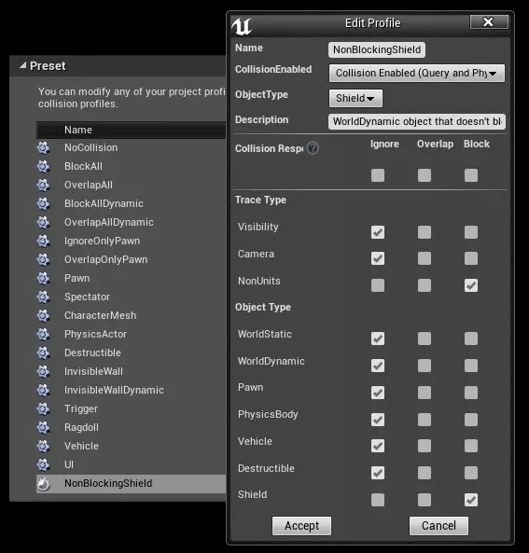
CONFIGURATION
Collision
Don’t generate cover around pawns
Create a custom trace channel NonUnits
Moving objects e.g. Pawn and Vehicle should be set to Ignore this
Create a custom object channel Shield
Create a custom collision preset NonBlockingShield

Slide 63
CONFIGURATION
Collision
Don’t generate cover around pawns
Create a custom trace channel NonUnits
Moving objects e.g. Pawn and Vehicle should be set to Ignore this
Create a custom object channel Shield
Create a custom collision preset NonBlockingShield
Only NonBlockingShield should be set to Block Shield

Slide 64
CONFIGURATION
Collision
Don’t generate cover around pawns
Create a custom trace channel NonUnits
Moving objects e.g. Pawn and Vehicle should be set to Ignore this
Create a custom object channel Shield
Create a custom collision preset NonBlockingShield
Only NonBlockingShield should be set to Block Shield
The 3D object scanner uses Shield

Slide 65
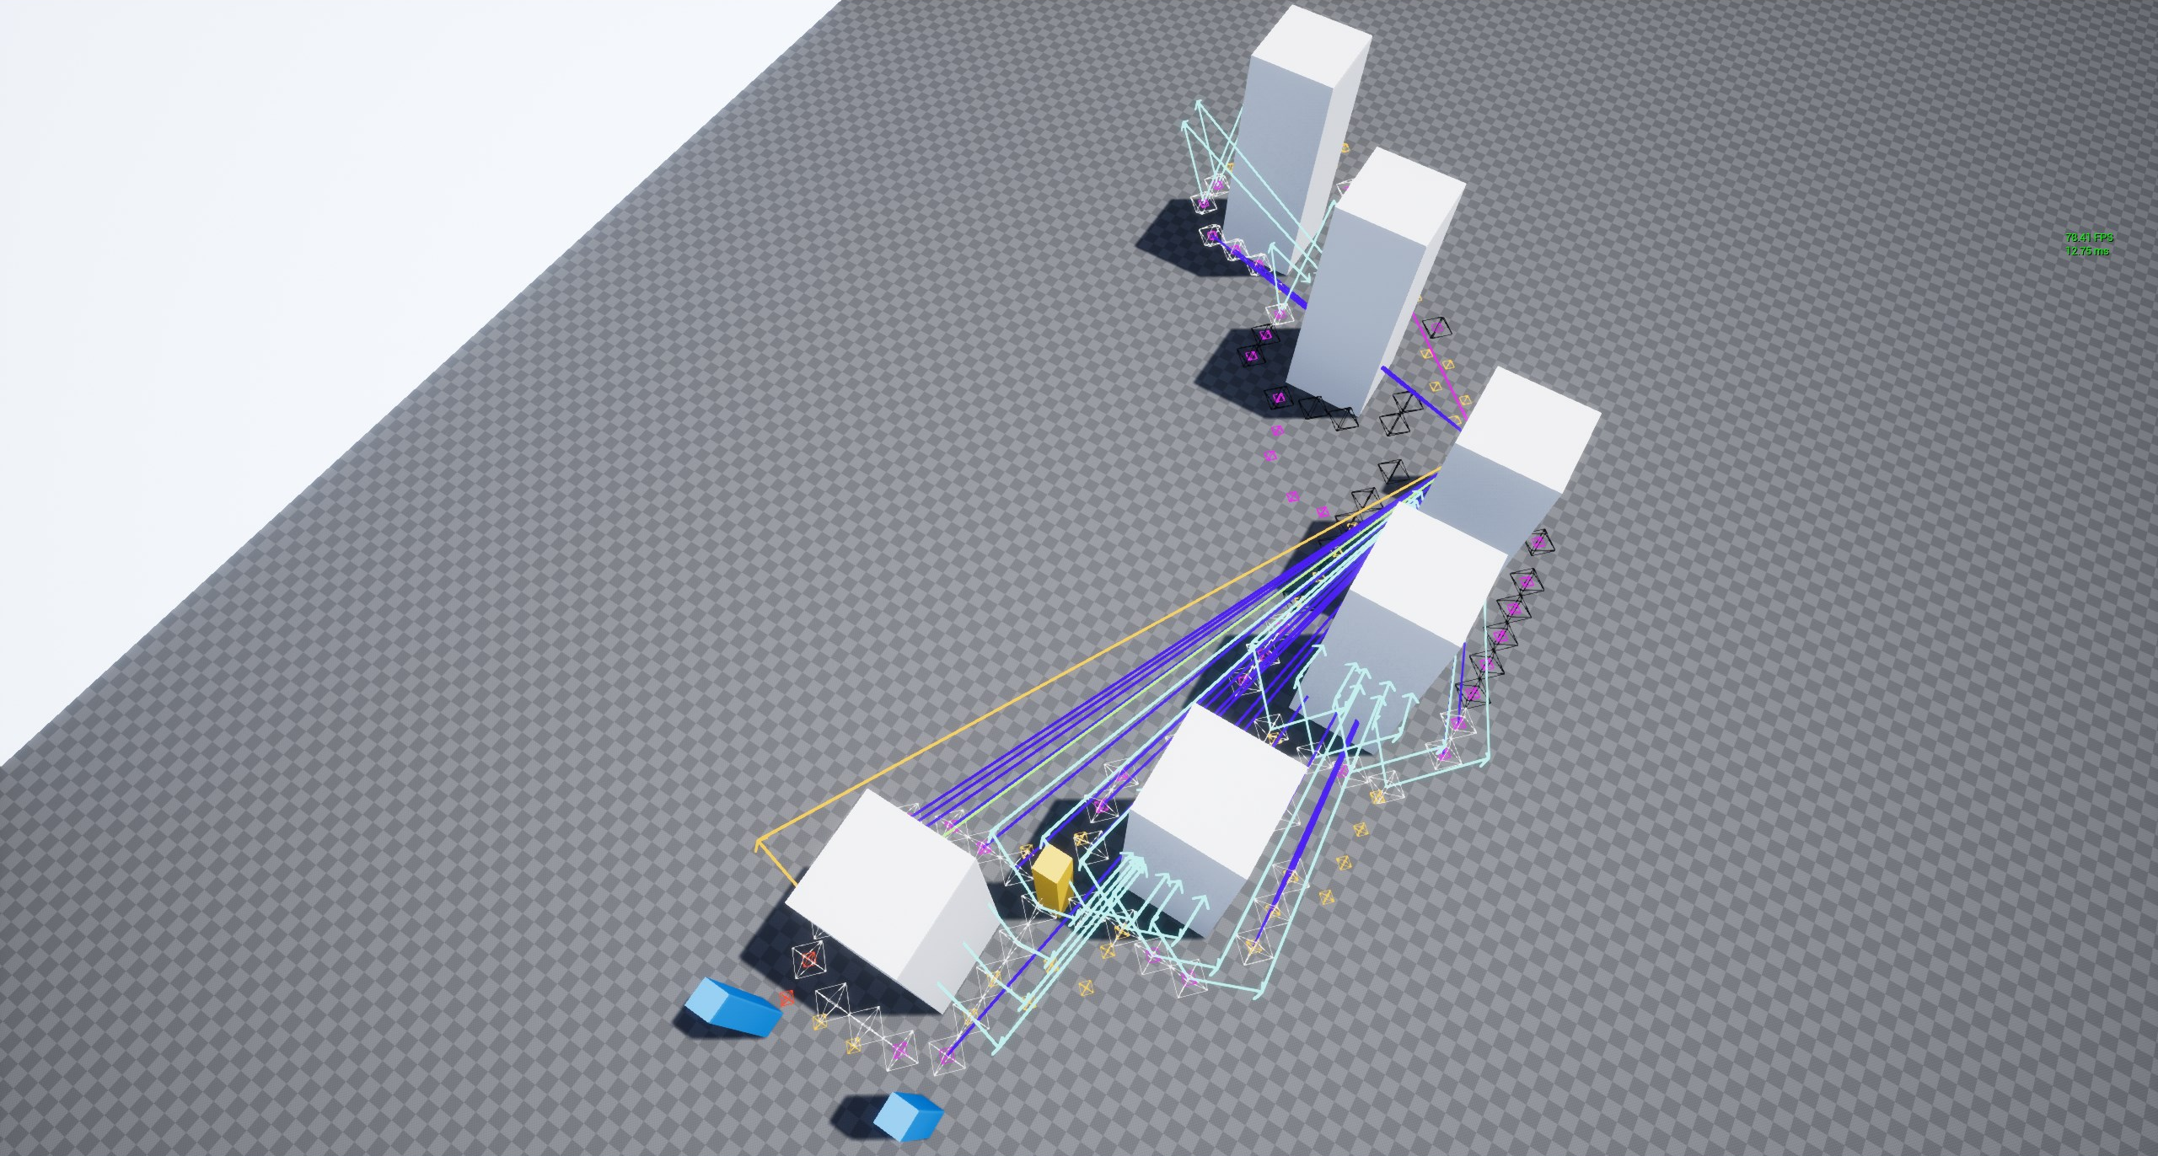
Finding Cover

Slide 66
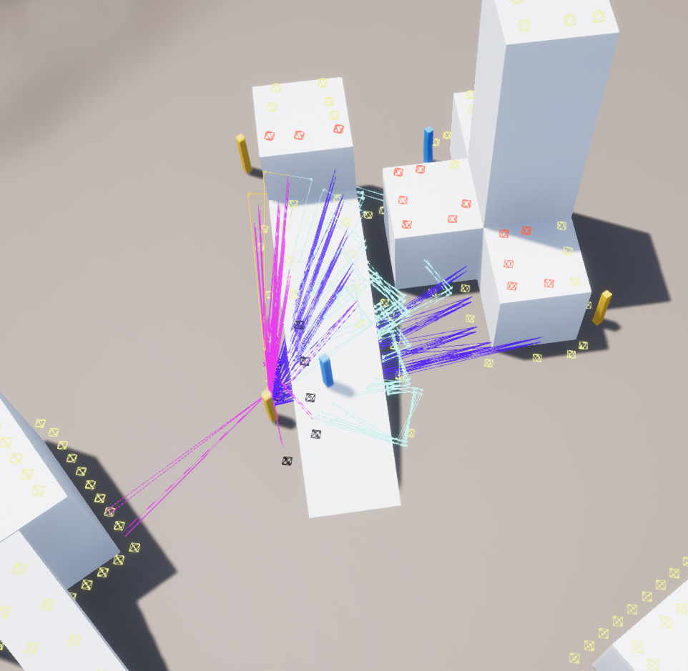
FINDING COVER
Standard Cover
Get cover points within a set distance from the target unit: min and max attack range

Slide 67
FINDING COVER
Standard Cover
Get cover points within a set distance from the target unit: min and max attack range
Query octree for points within AABB

Slide 68
FINDING COVER
Standard Cover
Get cover points within a set distance from the target unit: min and max attack range
Query octree for points within AABB
Optimal range: cull points that are too close

Slide 69
FINDING COVER
Standard Cover
Get cover points within a set distance from the target unit: min and max attack range
Query octree for points within AABB
Optimal range: cull points that are too close
Iterate over points until 1st point is found where:

Slide 70
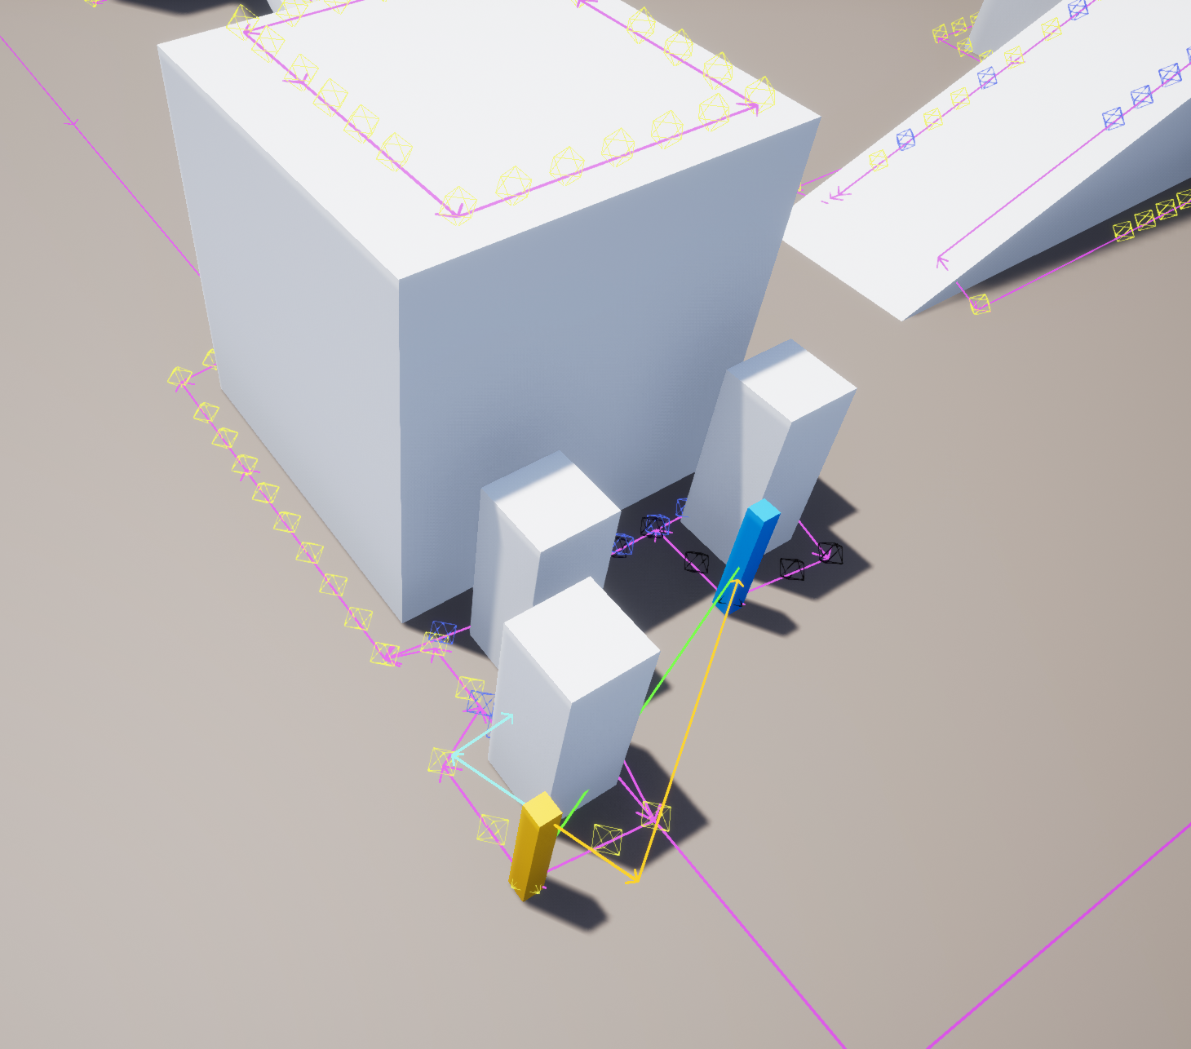
FINDING COVER
Standard Cover
Get cover points within a set distance from the target unit: min and max attack range
Query octree for points within AABB
Optimal range: cull points that are too close
Iterate over points until 1st point is found where:
No direct line of sight

Slide 71
FINDING COVER
Standard Cover
Get cover points within a set distance from the target unit: min and max attack range
Query octree for points within AABB
Optimal range: cull points that are too close
Iterate over points until 1st point is found where:
No direct line of sight
Line of sight by leaning out of cover

Slide 72
FINDING COVER
Standard Cover
Get cover points within a set distance from the target unit: min and max attack range
Query octree for points within AABB
Optimal range: cull points that are too close
Iterate over points until 1st point is found where:
No direct line of sight
Line of sight by leaning out of cover
Cover reachable via navmesh

Slide 73
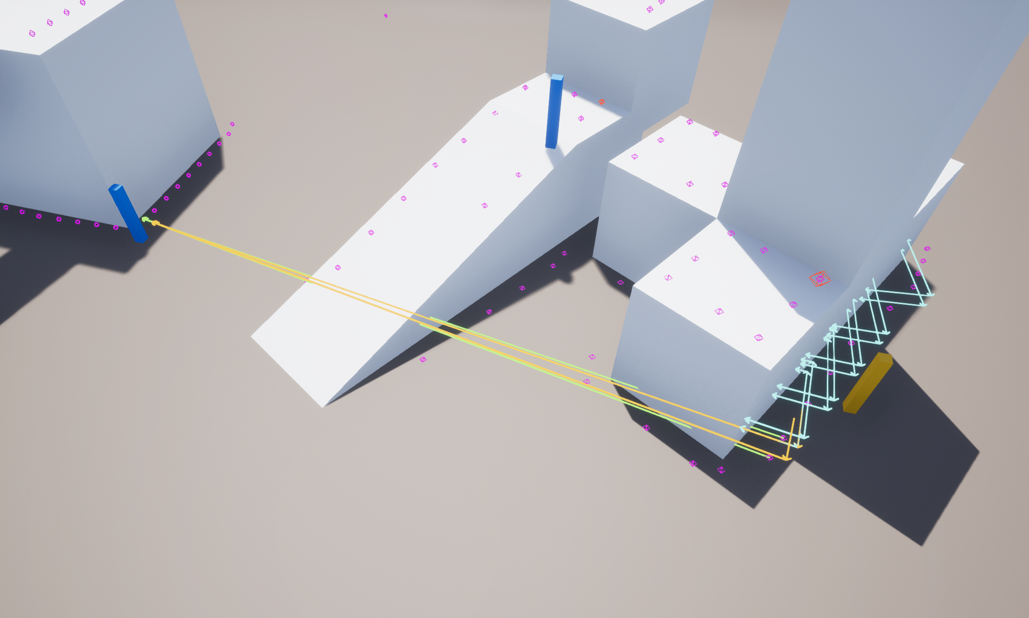
FINDING COVER
Standard Cover
Get cover points within a set distance from the target unit: min and max attack range
Query octree for points within AABB
Optimal range: cull points that are too close
Iterate over points until 1st point is found where:
No direct line of sight
Line of sight by leaning out of cover
Cover reachable via navmesh
Standing & crouched stances: 4 raycasts per cover point
Light blue arrows: can’t hit enemy
Yellow arrow: can hit enemy by leaning around the corner
Notes:
ygkjuygfjds

Slide 74
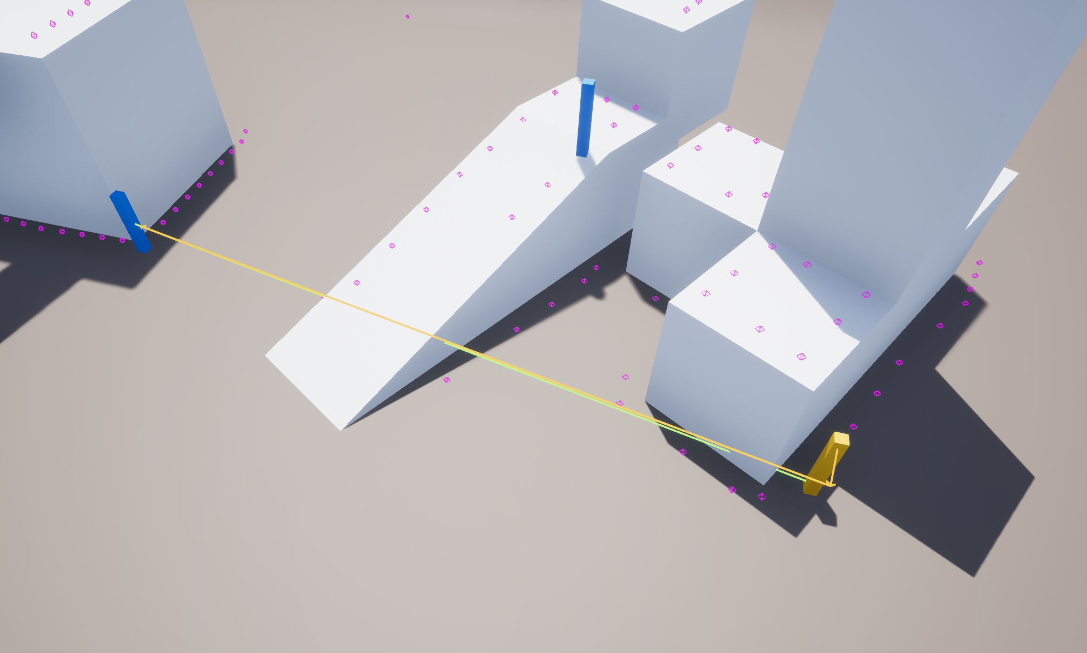
FINDING COVER
Standard Cover
Get cover points within a set distance from the target unit: min and max attack range
Query octree for points within AABB
Optimal range: cull points that are too close
Iterate over points until 1st point is found where:
No direct line of sight
Line of sight by leaning out of cover
Cover reachable via navmesh
Standing & crouched stances: 4 raycasts per cover point
Light blue arrows: can’t hit enemy
Yellow arrow: can hit enemy by leaning around the corner

Slide 75
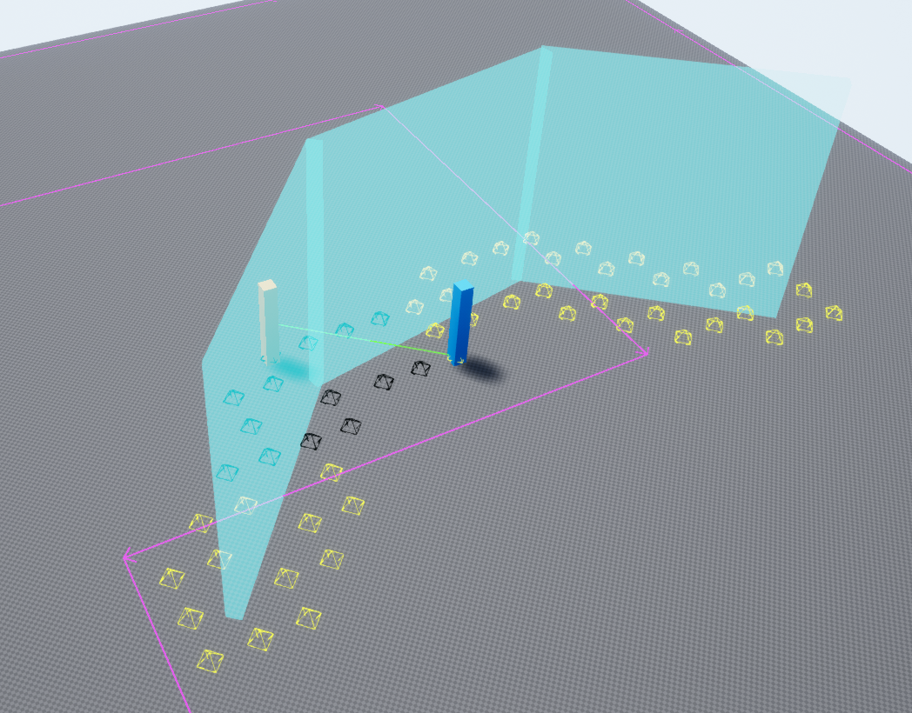
FINDING COVER
Shields
Only requirement: direct line of sight
Uses NonBlockShield collision preset

Slide 76
FINDING COVER
AI
Units should reserve cover points

Slide 77
FINDING COVER
AI
Units should reserve cover points
Use UBTService or UBTTask

Slide 78
FINDING COVER
AI
Units should reserve cover points
Use UBTService or UBTTask
Use AIController::MoveTo

Slide 79
STATS
Types of Stats
Time spent finding cover
Time spent generating cover
Number of active generation tasks
Total number of calls to FindCover()
Total time spent finding cover in the game
Total number of cover generation calls (edge-walking and 3d object scanning)
Total time spent generating cover (includes both methods)

Slide 80
PROFILING
It’s easy to profile with custom stats!
Launch game
stat startfile
stat stopfile
Windows => Developer Tools => Session Frontend

Slide 81
PROFILING

Slide 82
DEMO PROJECT
Source Code
http://github.com/GlassBeaver/CoverSystem
Fully functional
MIT license
Upgraded to run on UE 4.22
PRs welcome!

Slide 83
FUTURE
Ideas
Cover indicators
Generate cover at design-time
Save cover points in level
Designer editing (add, move, remove, exclude)
EQS integration

Slide 84
LOOKING FOR COLLABORATORS!
Roles
VFX Artists (UE4)
Technical Artists (UE4)
Hard-Surface Modelers
david@glassbeaver.com

