Slide 1
Solo Indie Game Dev on a Budget
with Unreal Engine 4
David Nadaski
Glass Beaver Studios
david@glassbeaver.com

Slide 2
HŌRU
Don't build bases - build entire battlefields.

Slide 3
Tools
Modeling & Animation
Texturing
Image Editing
3D-Coat
Substance Painter
Photoshop
Maya LT
Substance Designer
Lightroom
Blender
Substance Player
Paint.net
Houdini
MeshLab
Video & Sound
Misc.
World Machine
SpeedTree
OBS Studio
PuTTY
DaVinci Resolve
Discord
Reaper
Intel GPA
SourceTree
green: free

Slide 4
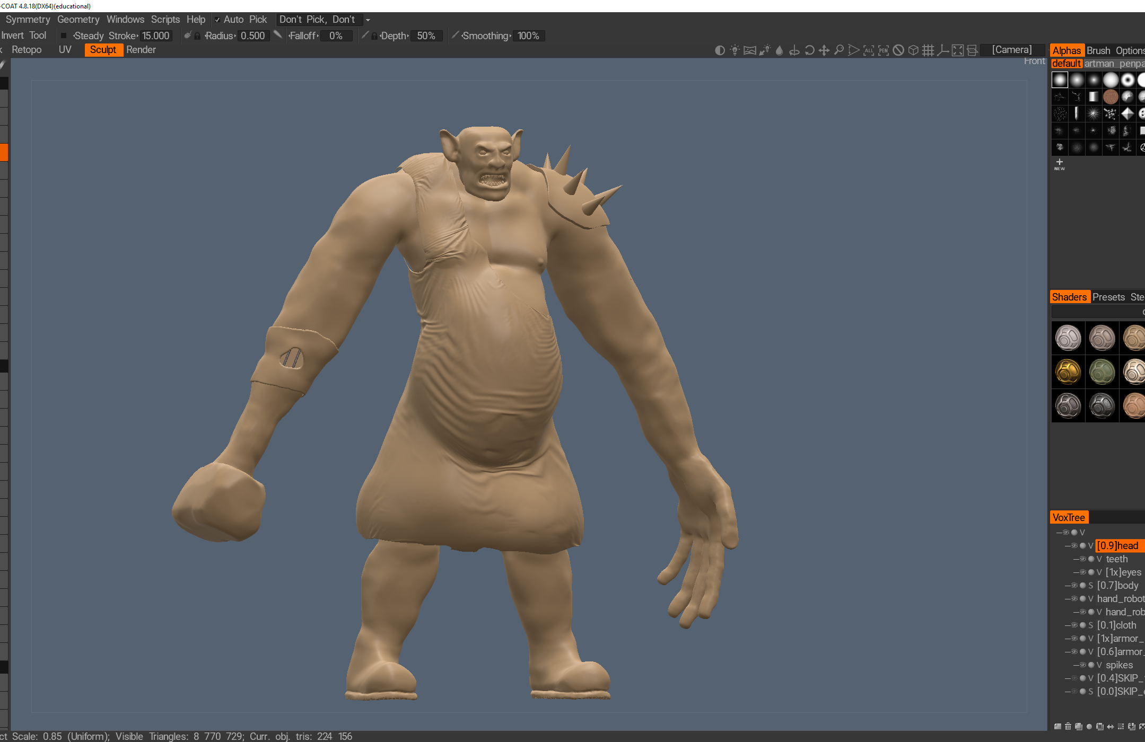
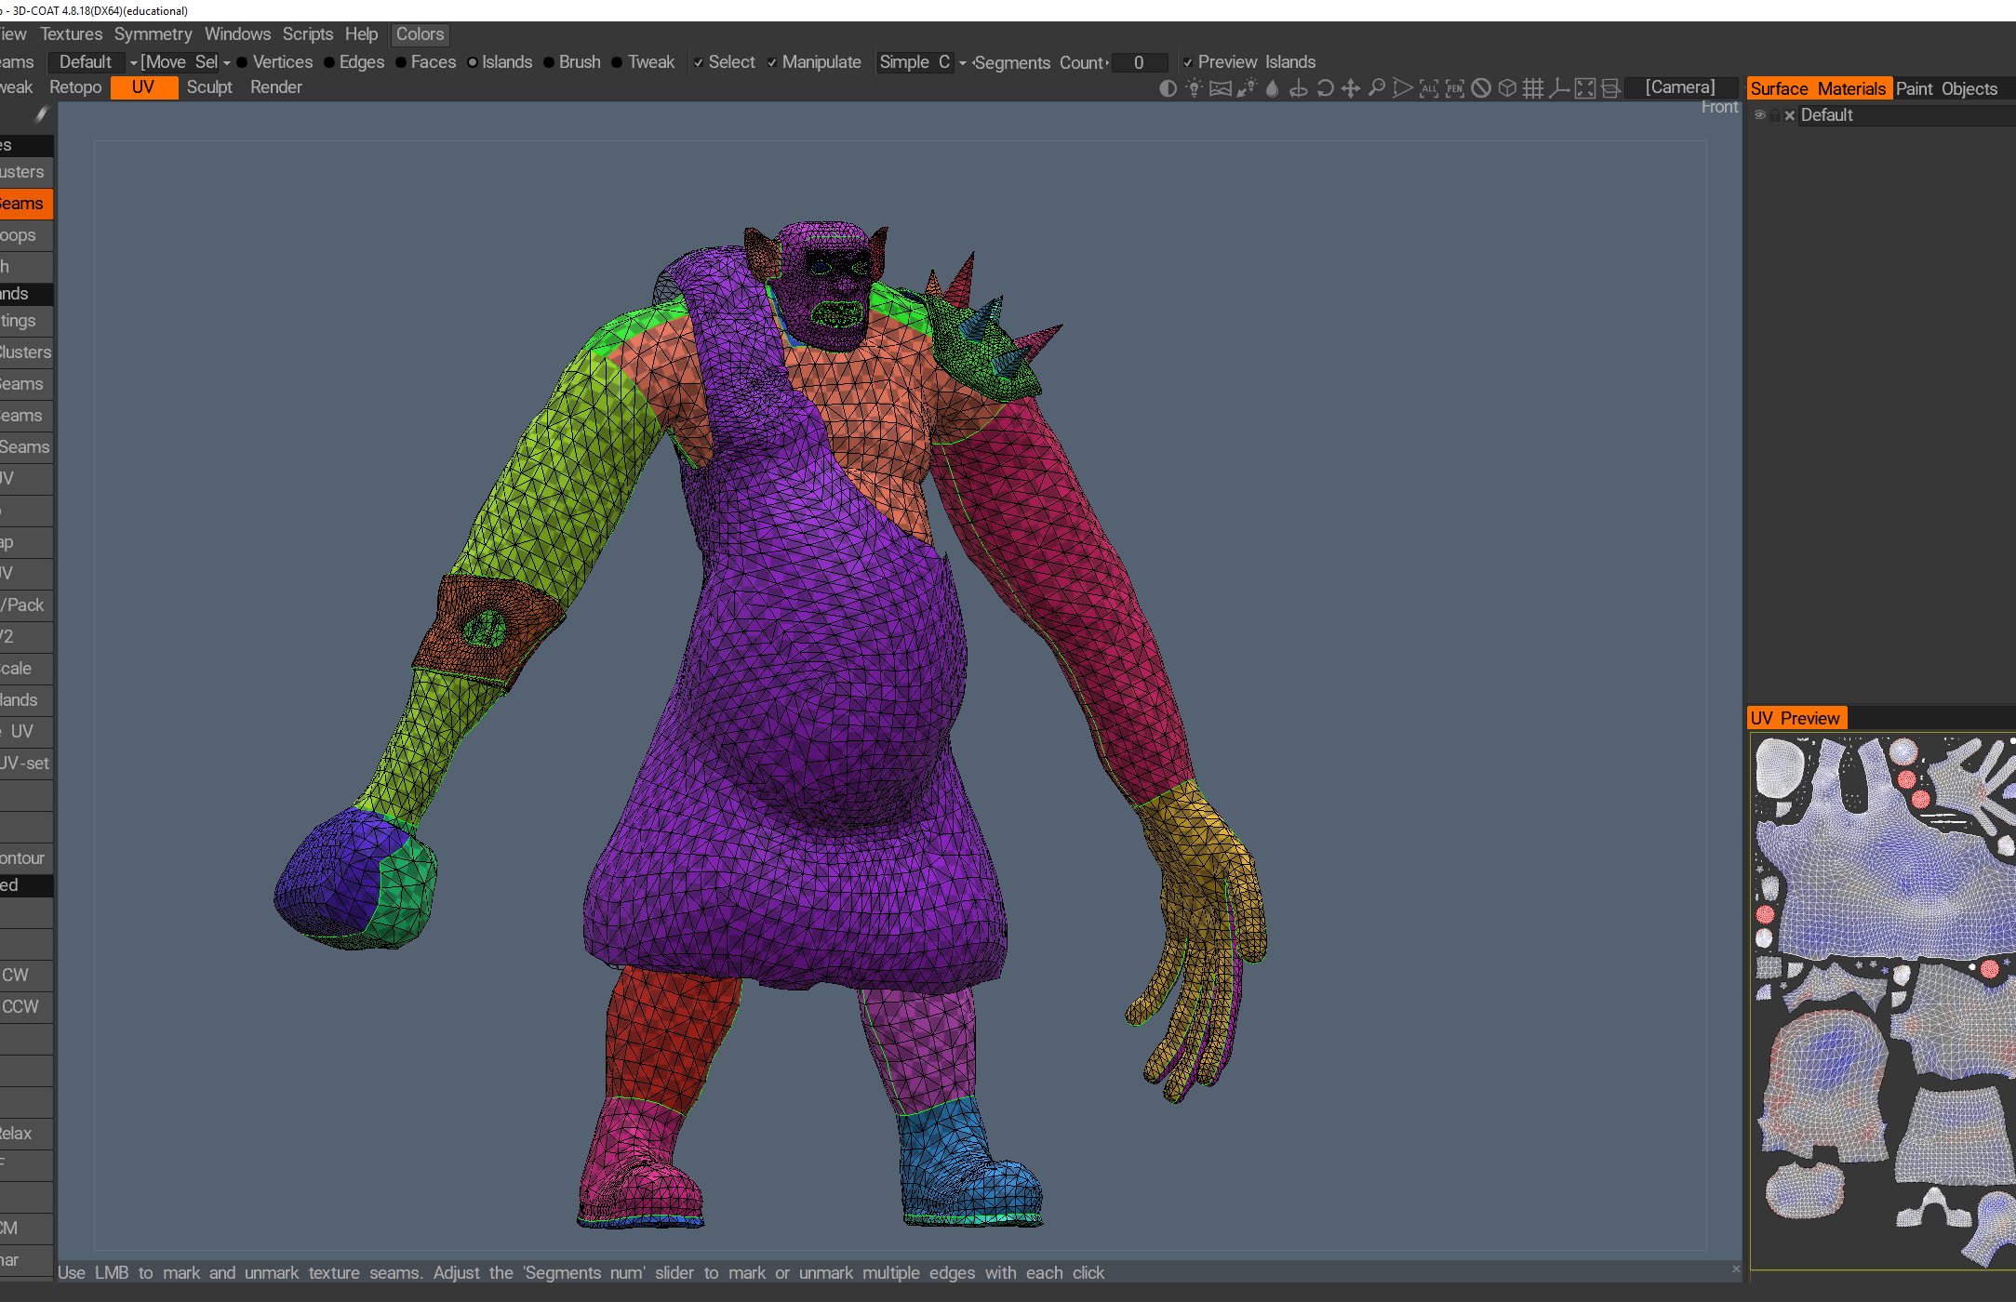
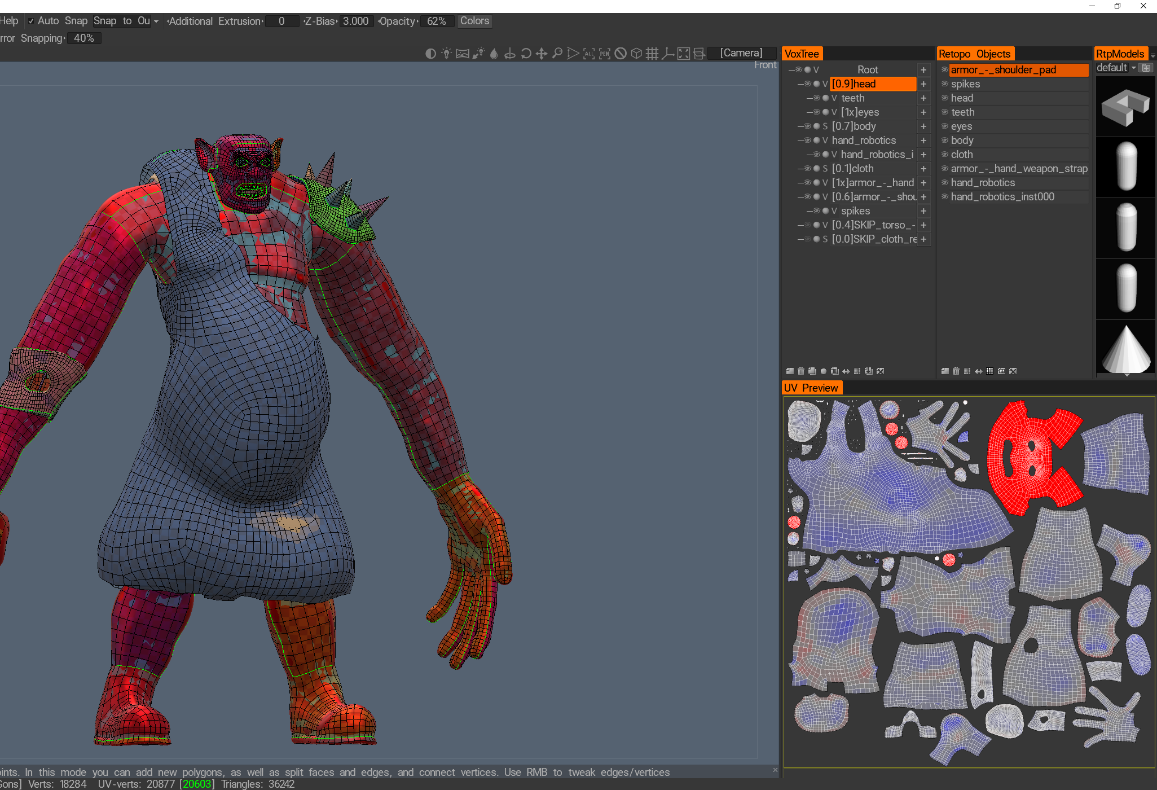
3D-Coat
Voxel-based sculpting
Fantastic for retopology
Great for doing Uvs
Cheaper than Zbrush
Get Amateur, upgrade later
€90

Slide 5
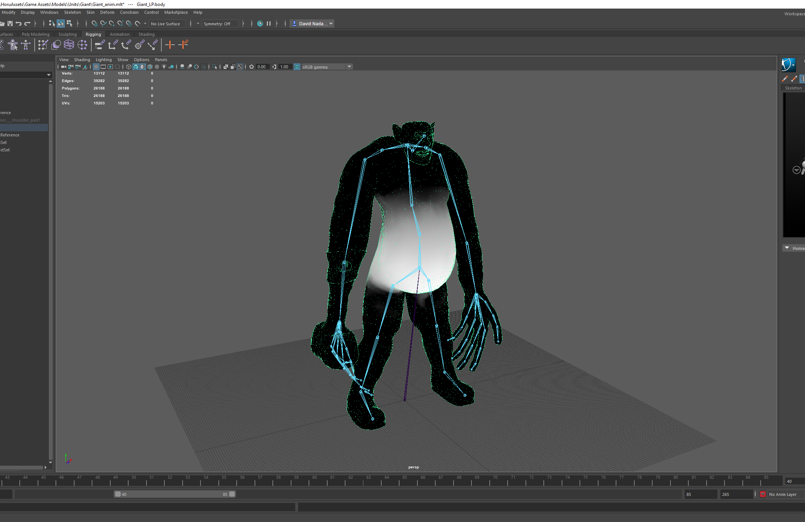
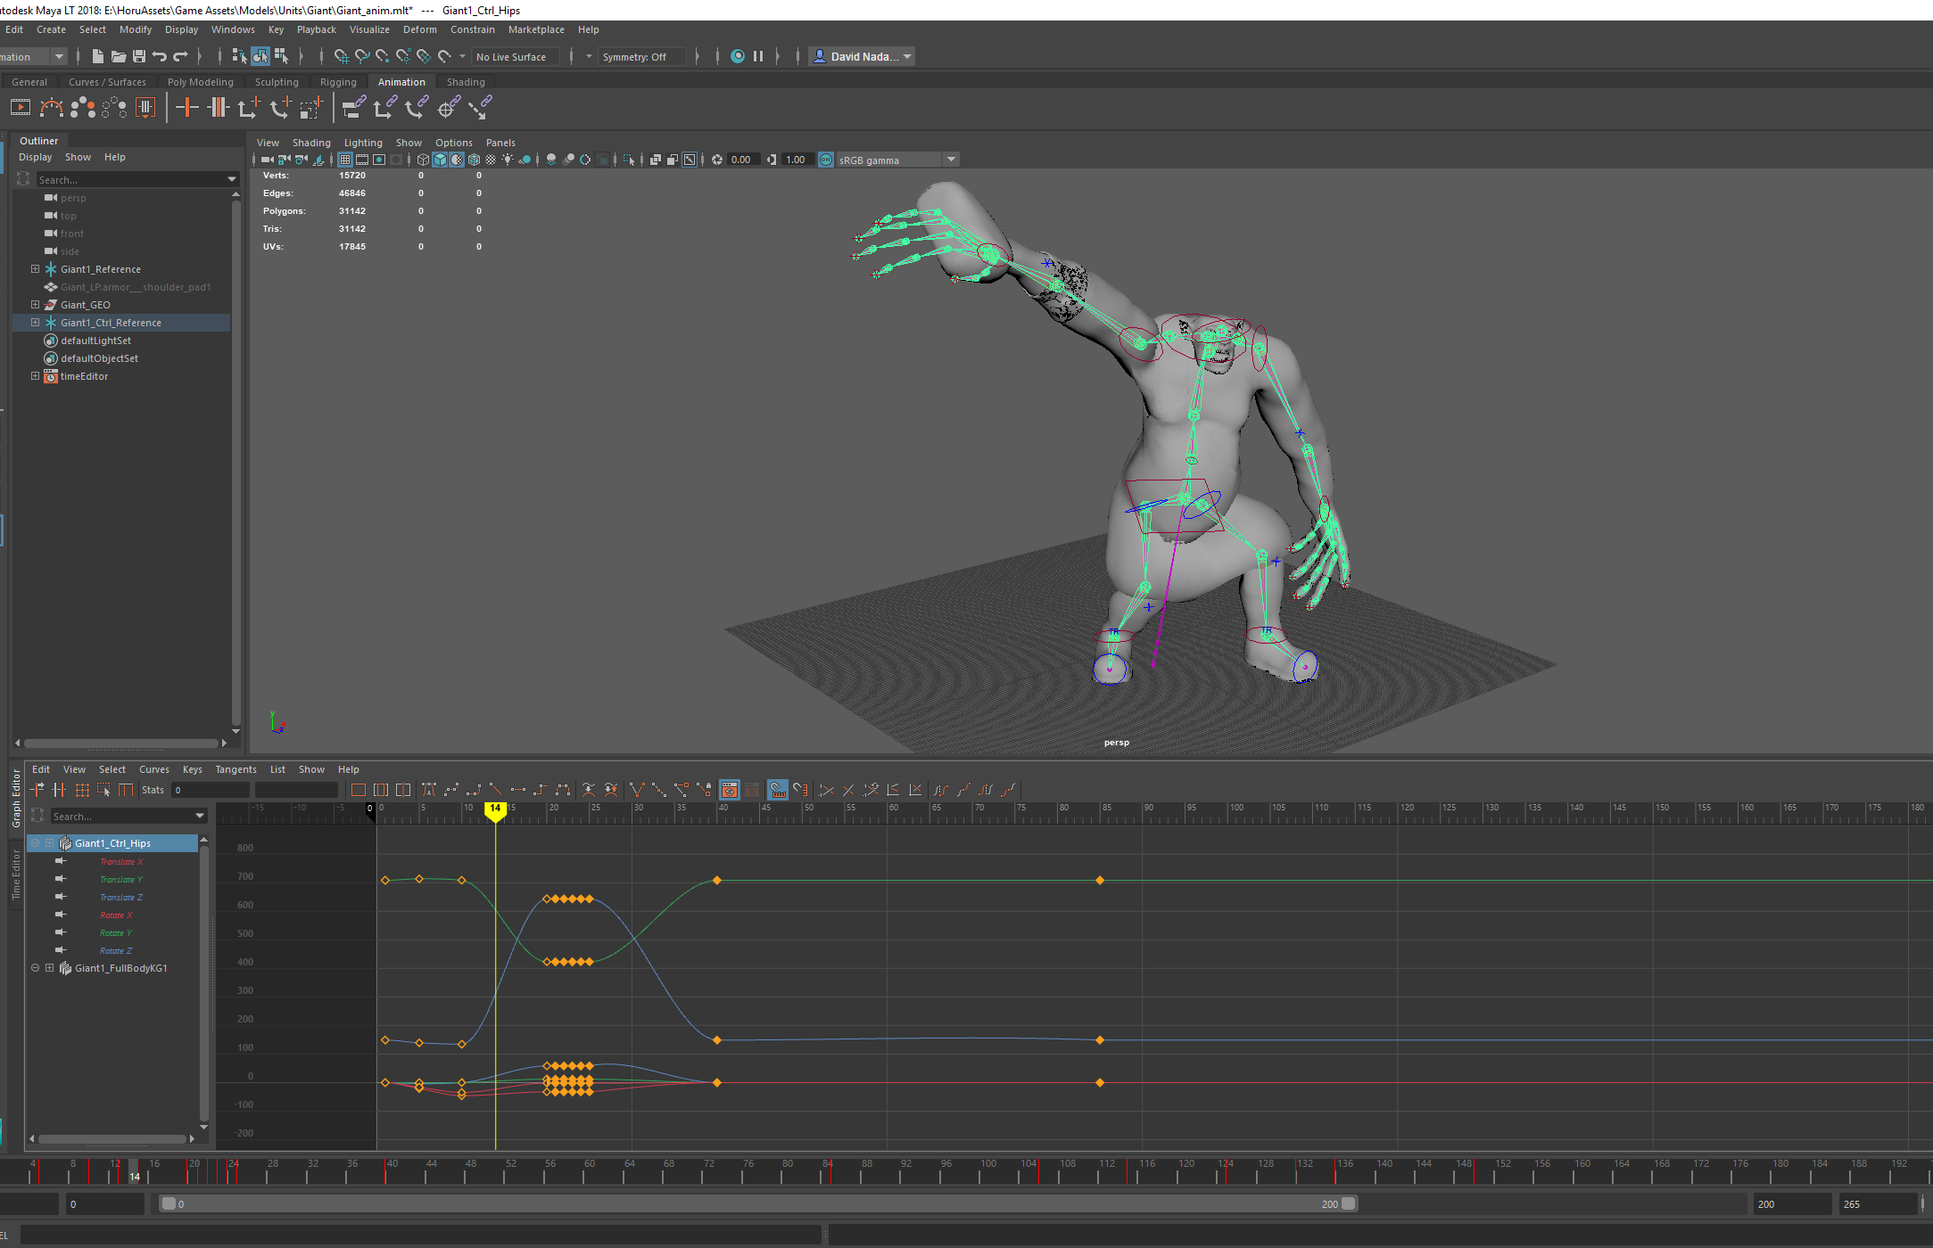
Maya LT
About 1/10 the price of Maya
Does everything but render
Rigging, skinning, animation
HumanIK
LODs
Hard-surface modeling
Decimation
Very capable UV editor
€30 (sub)

Slide 6
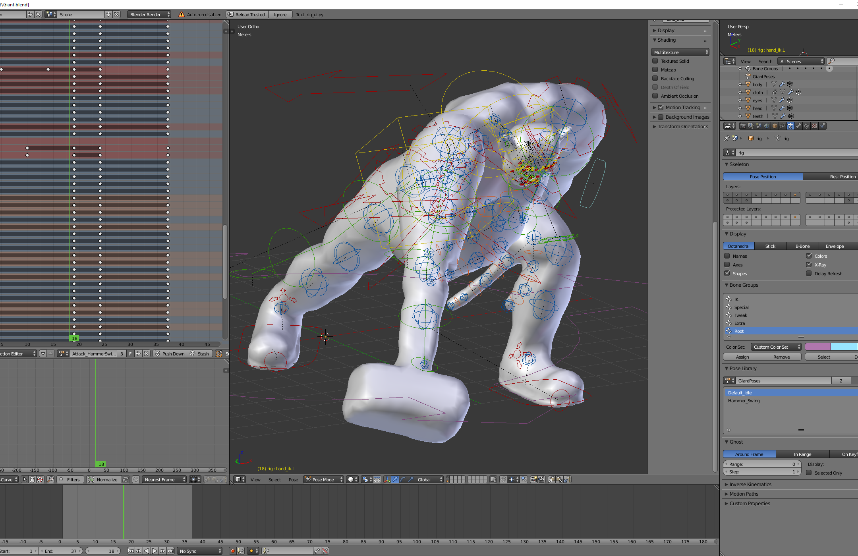
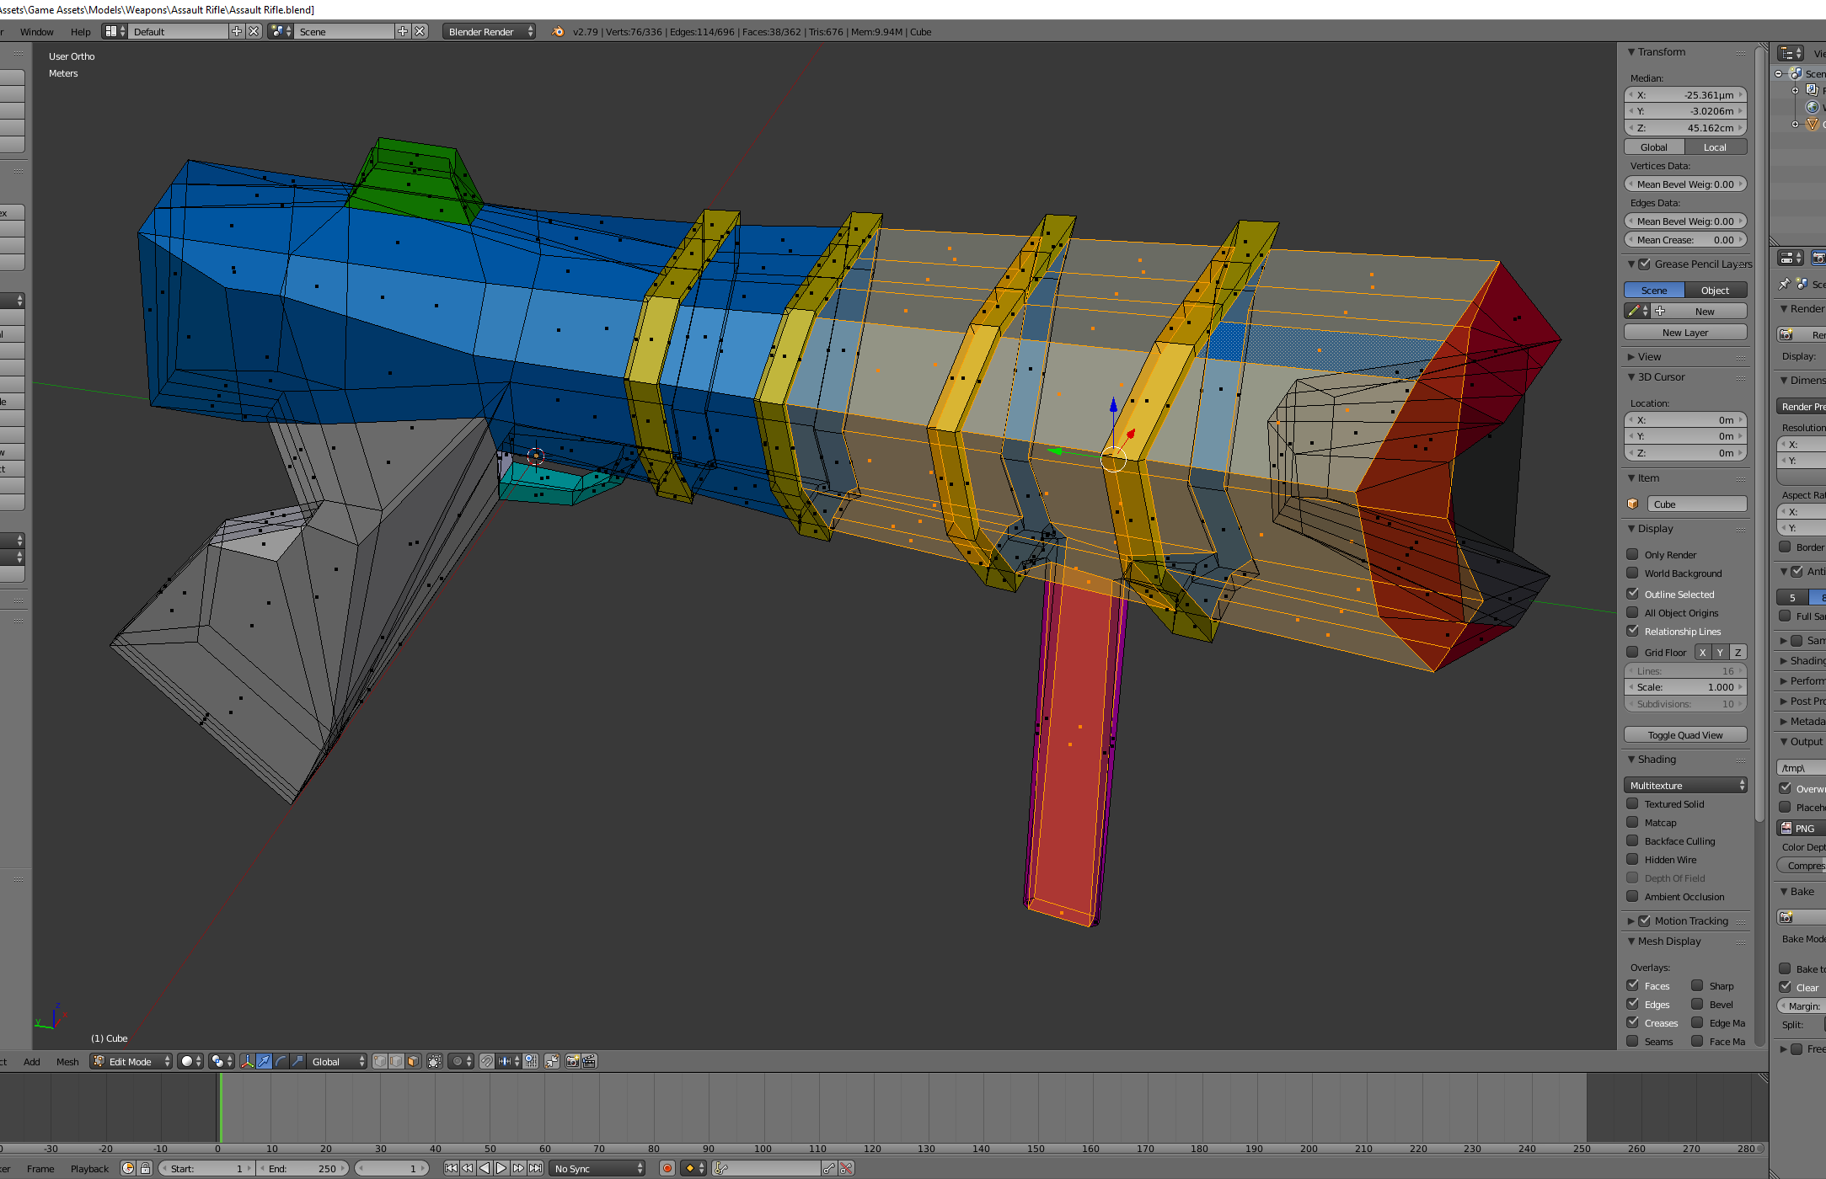
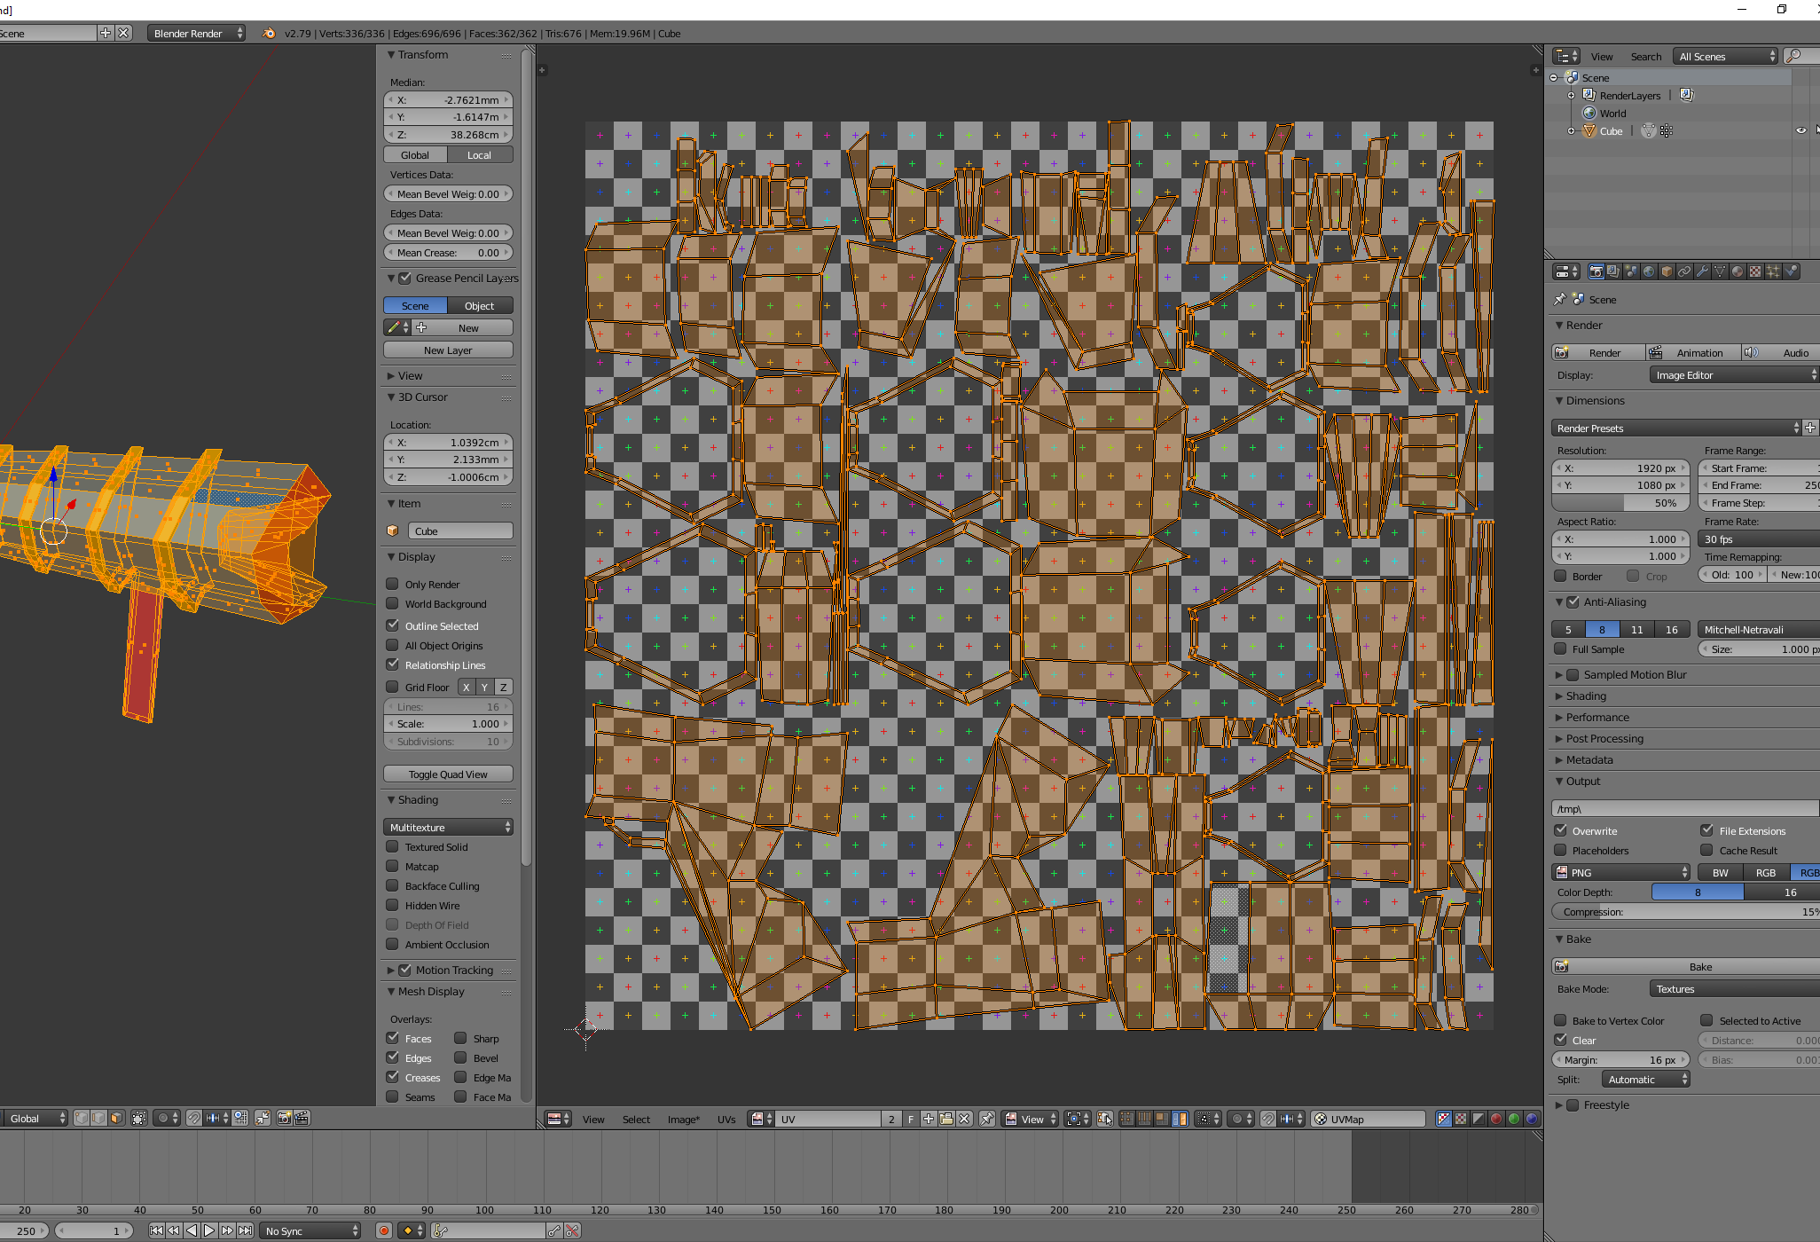
Blender
Completely free
Lots of plugins (paid & free)
I use it for rendering via RenderMan (free)
Rigify / PitchiPoy didn’t work out for me
Free

Slide 7
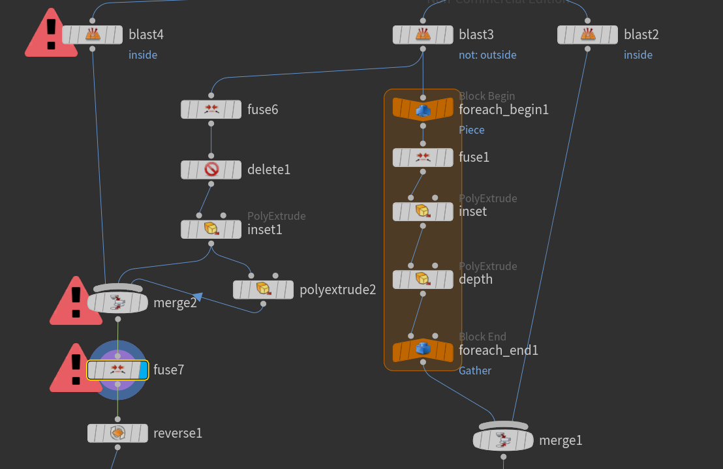
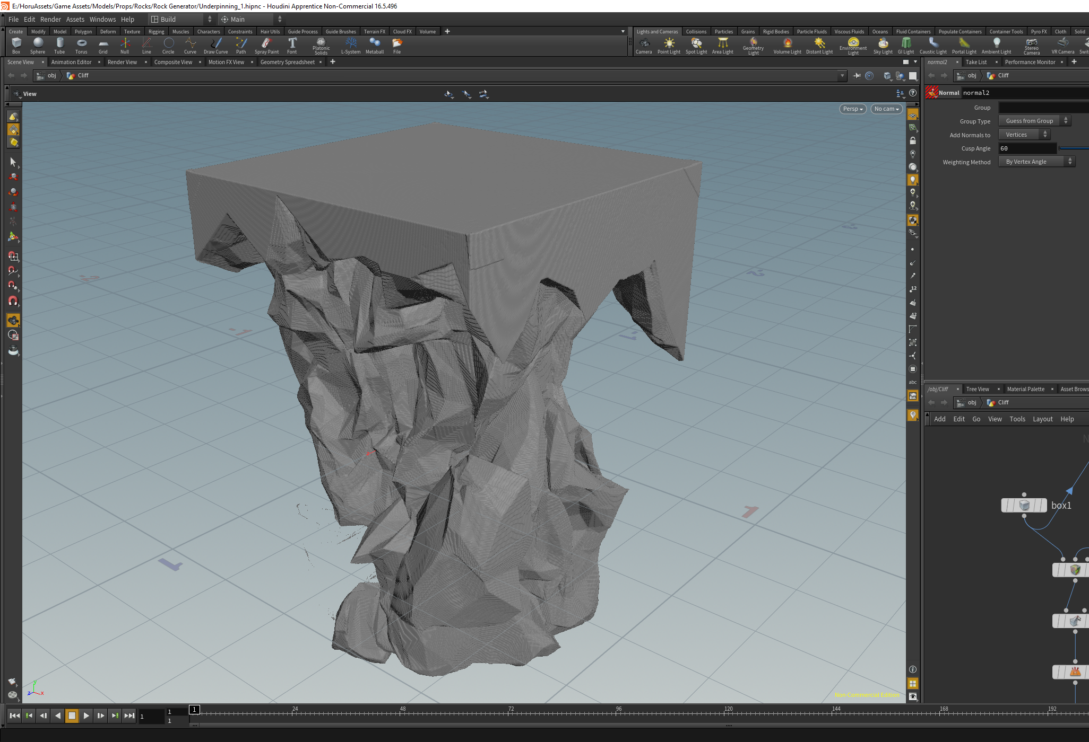
Houdini
Procedural modeling
(VFX)
UE4 integration for design-time generation
Apprentice edition is free (no UE4 integration)
Steep learning curve
Get Apprentice, upgrade later
Free

Slide 8
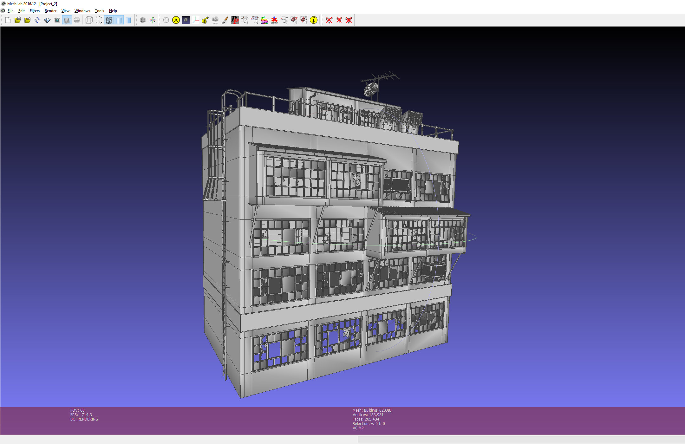
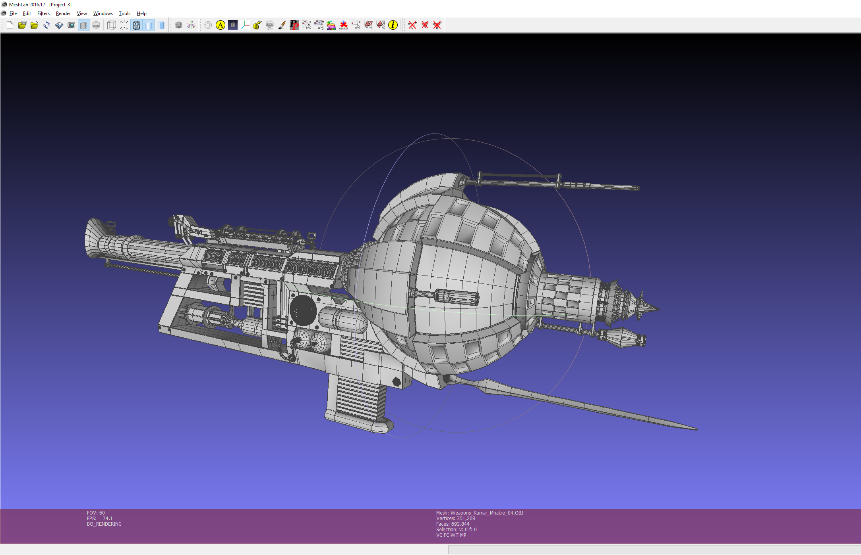
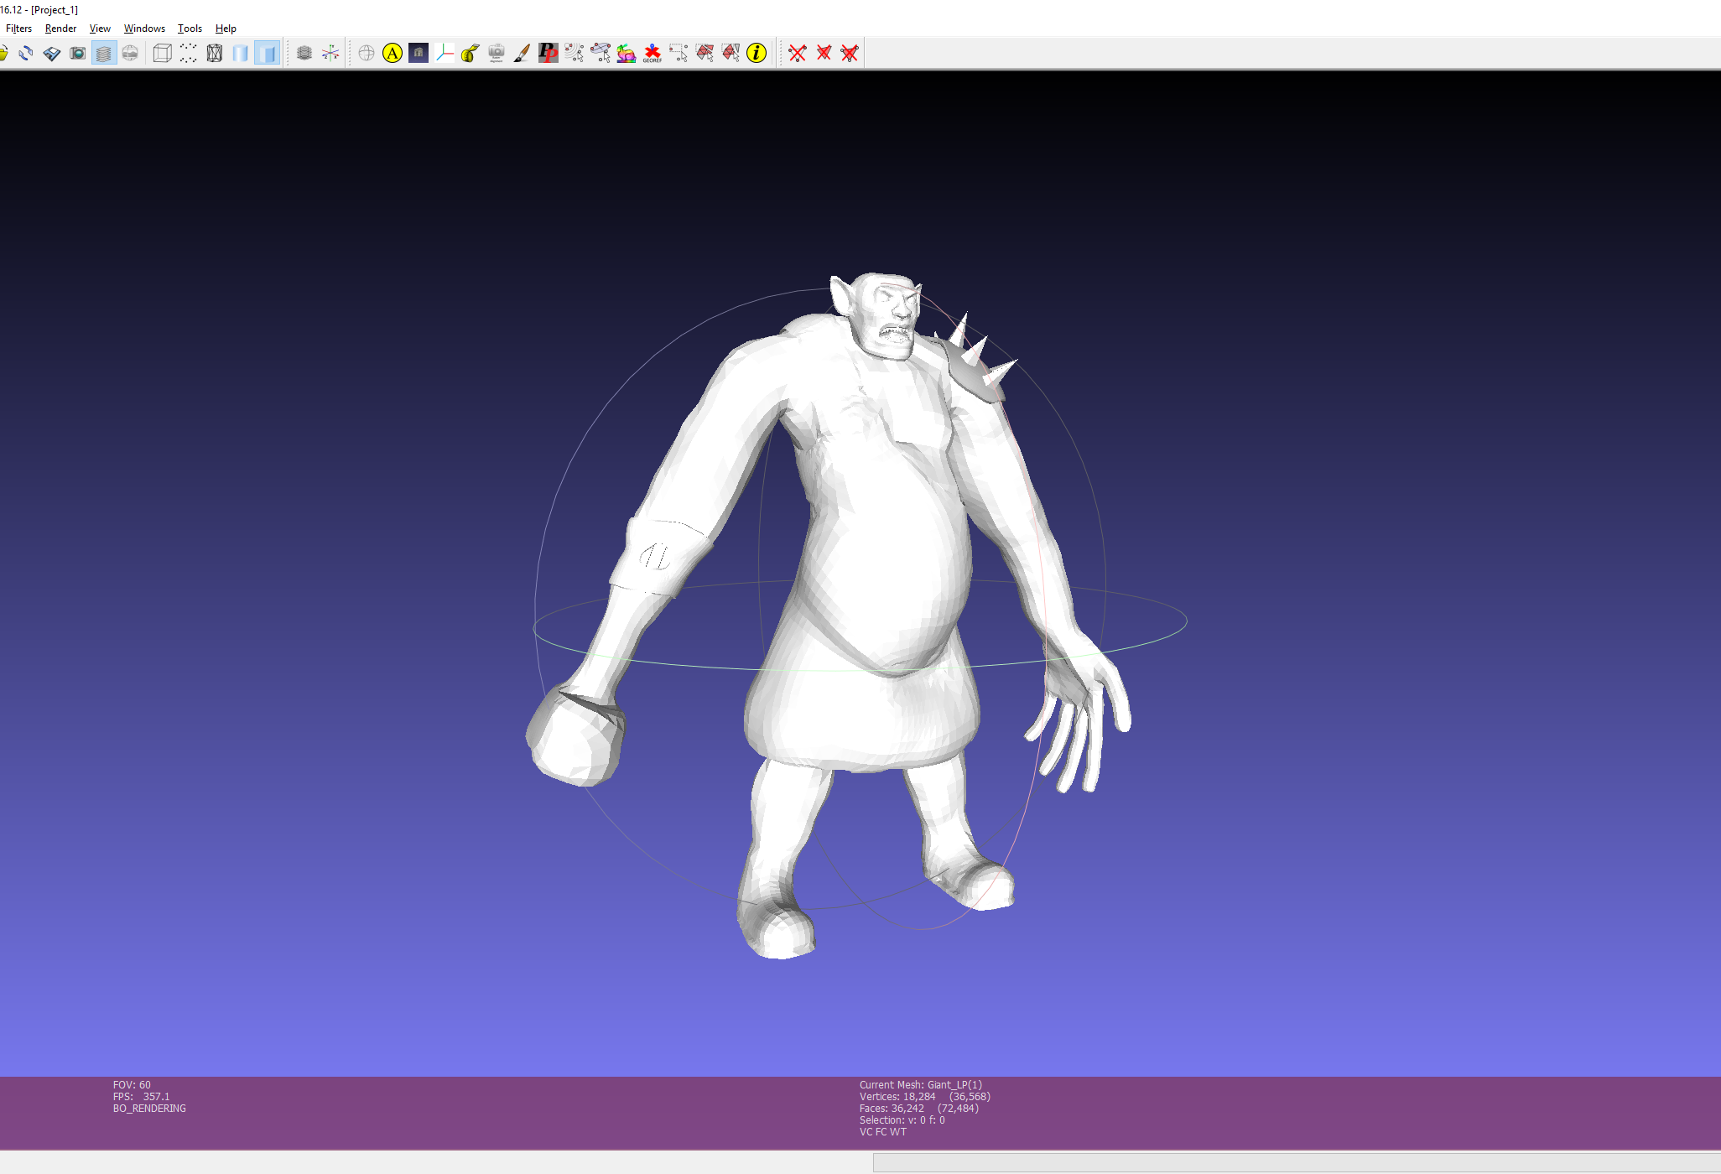
MeshLab
Quadric edge collapse decimation
Mesh cleanup: polys, normals, pivot point, alignment, etc.
Free

Slide 9
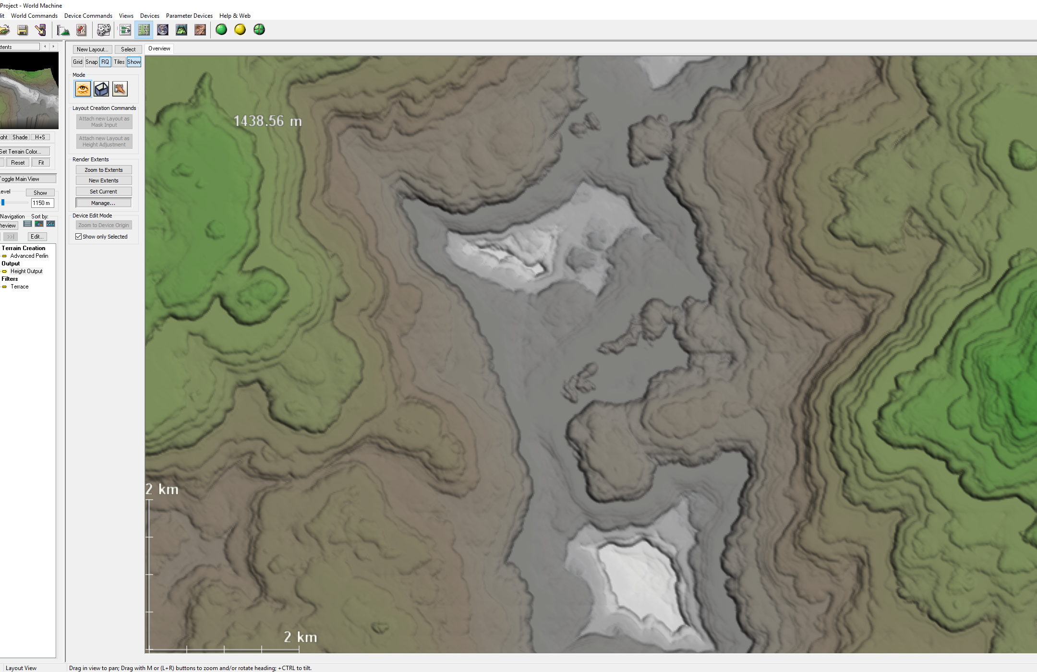
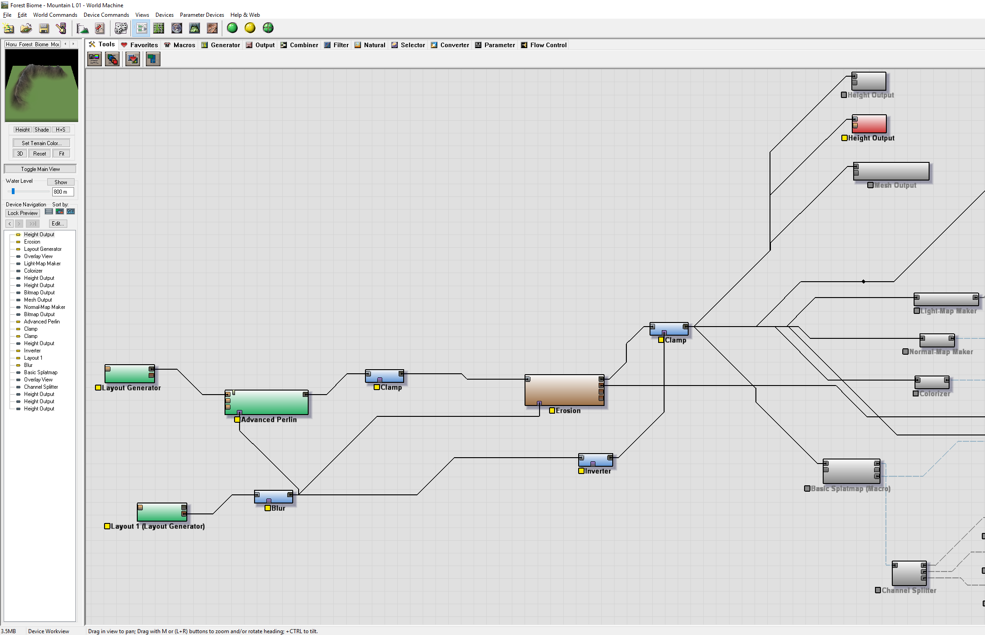
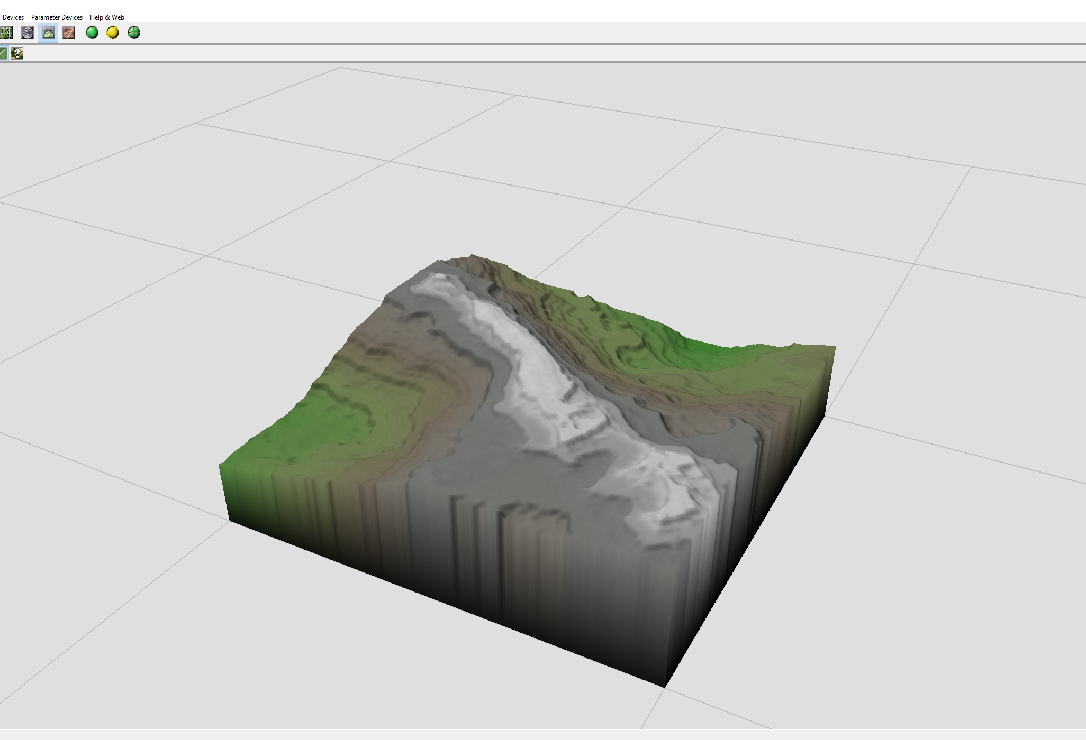
World Machine
Landscape generator
No need to model anything by hand
Great for open world games
Node-based editor
Very sophisticated plugins, e.g. GeoGlyph 2
Get Indie, upgrade later
€100

Slide 10
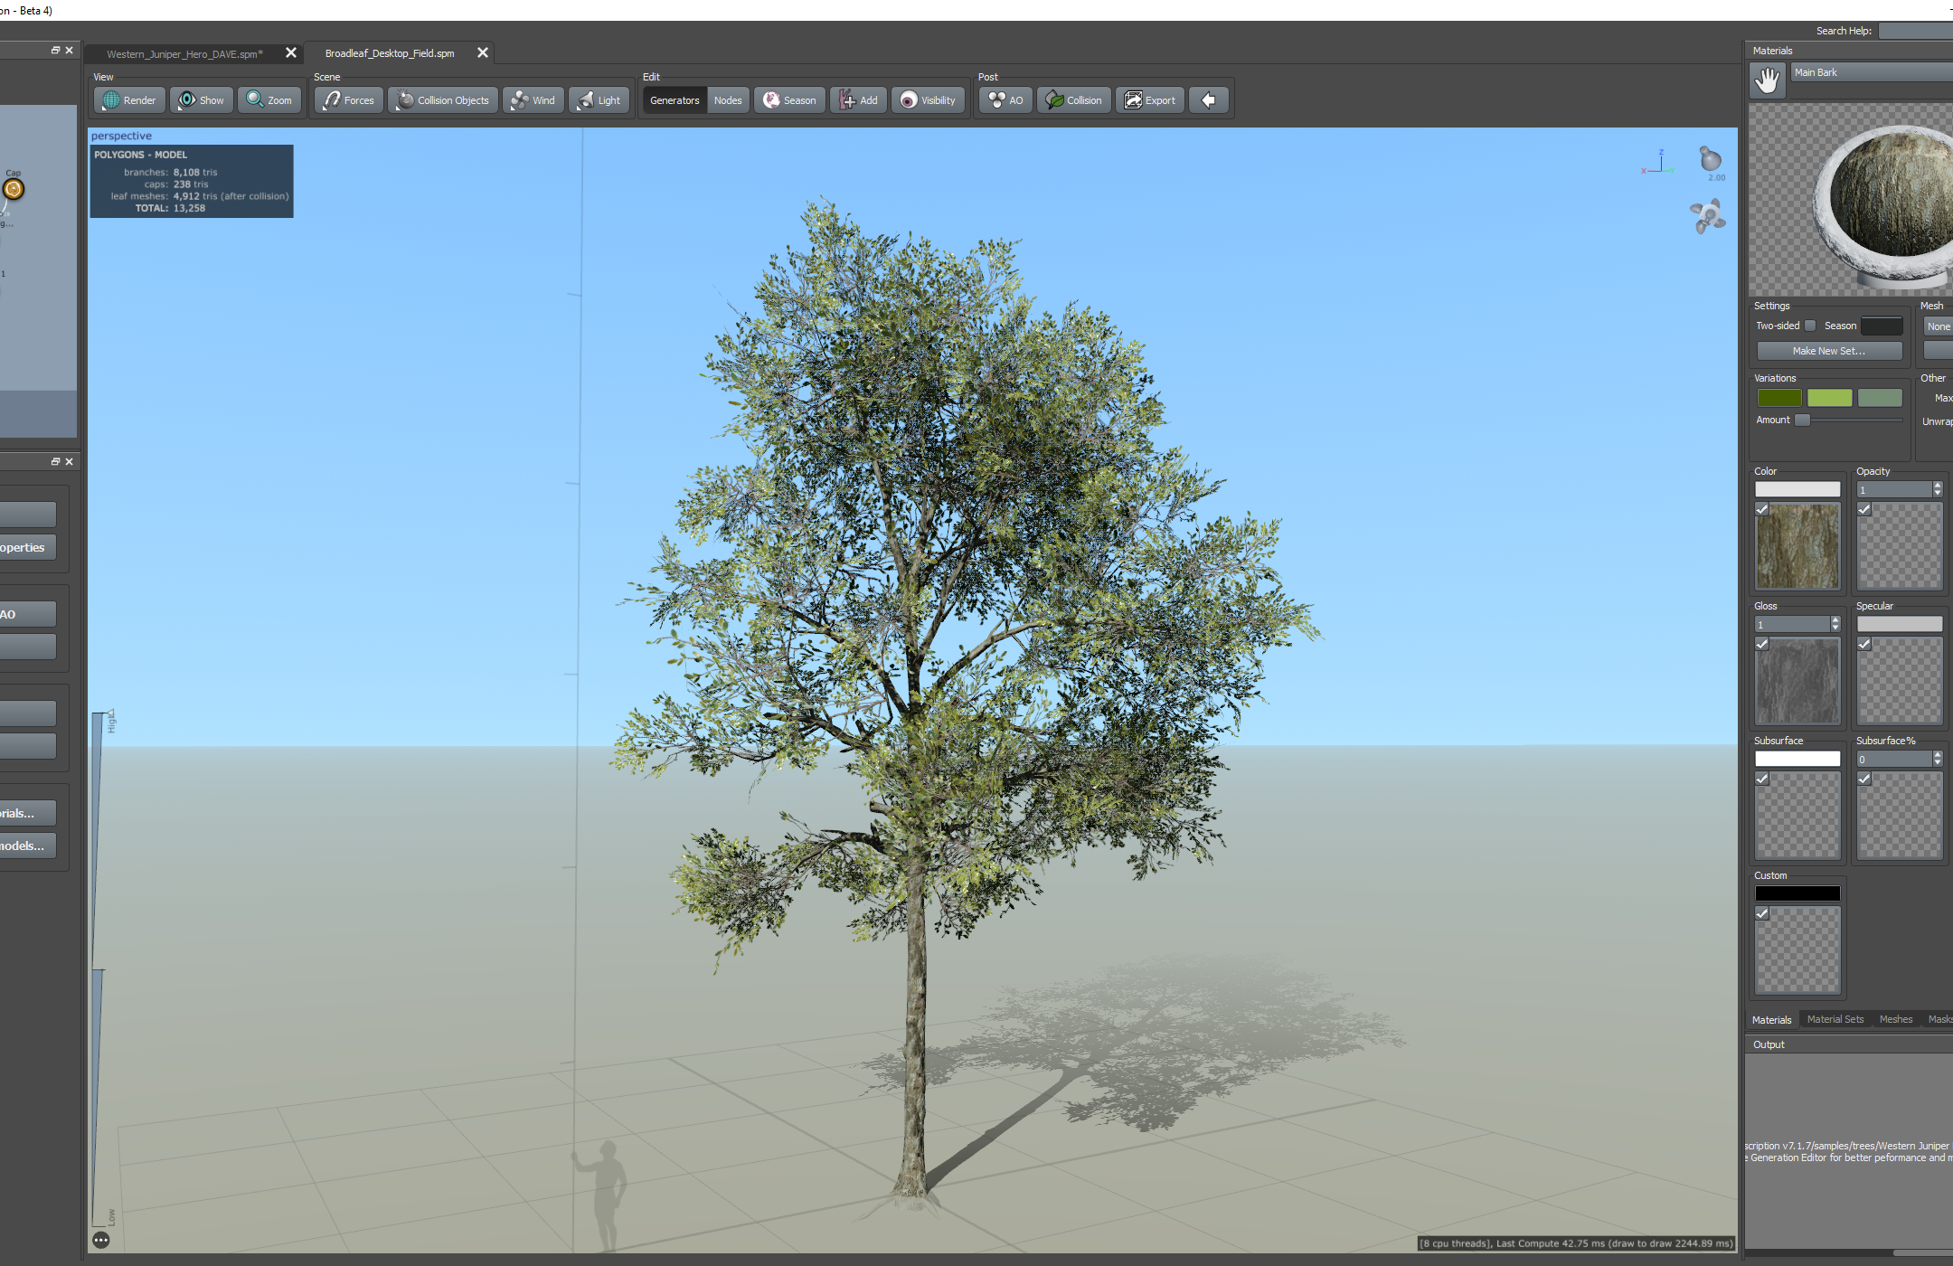
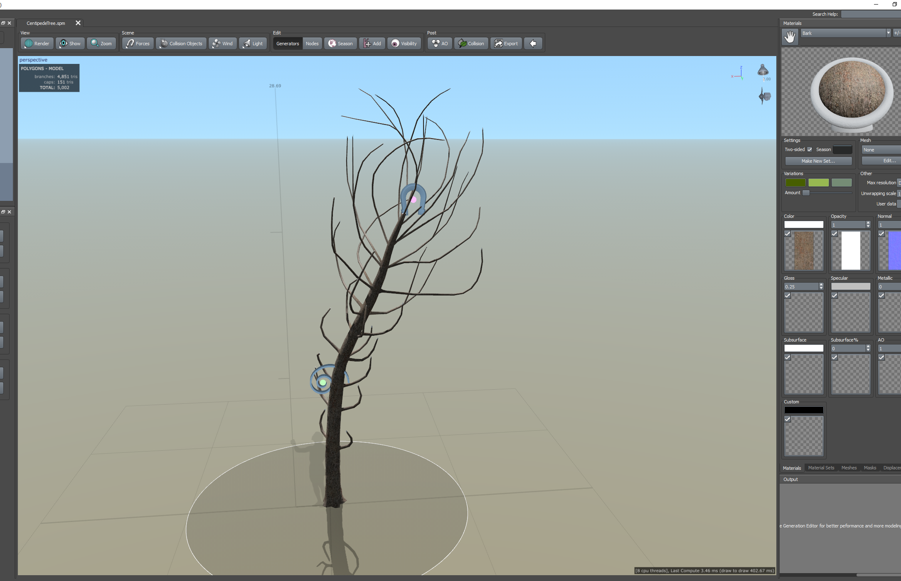
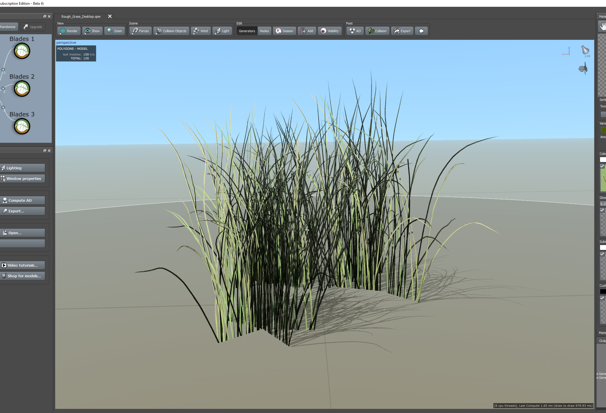
SpeedTree
Design trees, plants and foliage
Leader of its niche market
Used in movies as well
Games: Witcher 3, etc.
Free trees with subscription each month
€16 (sub)

Slide 11
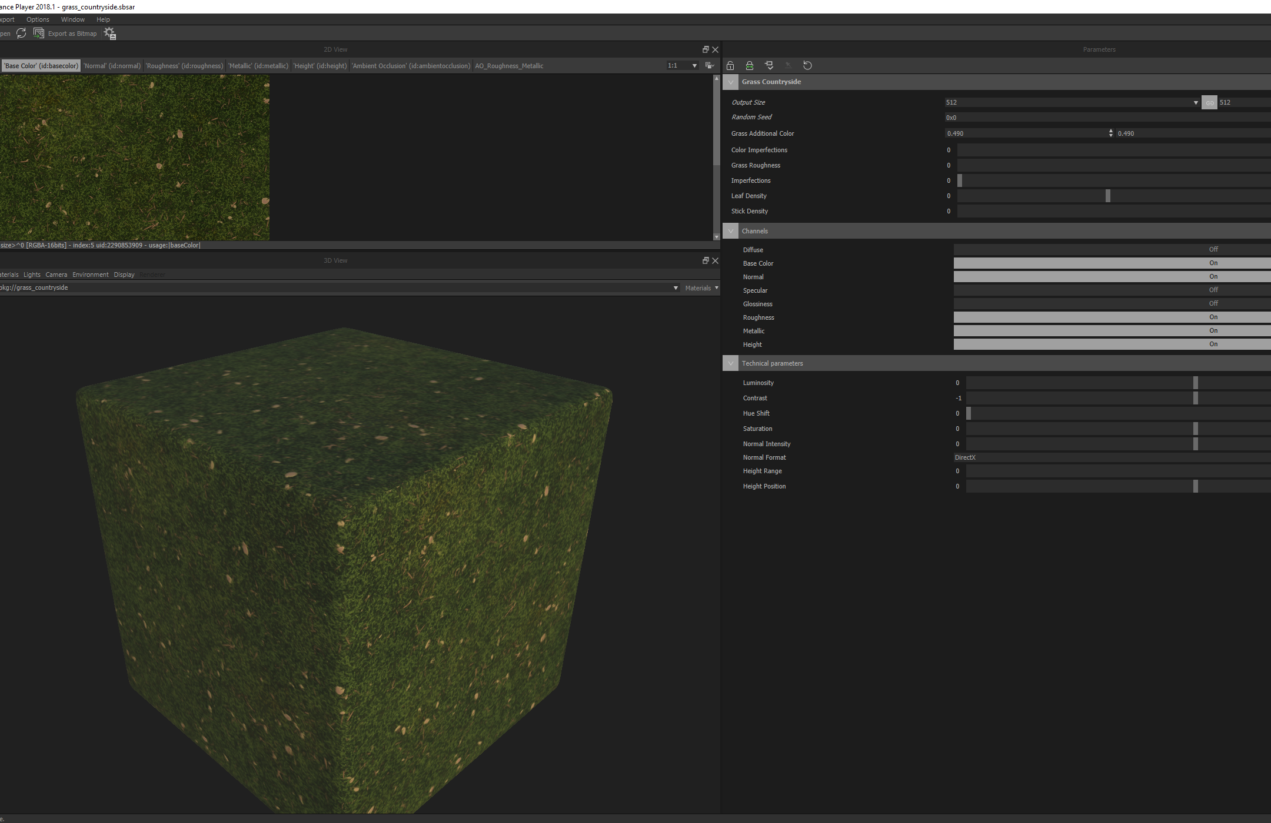
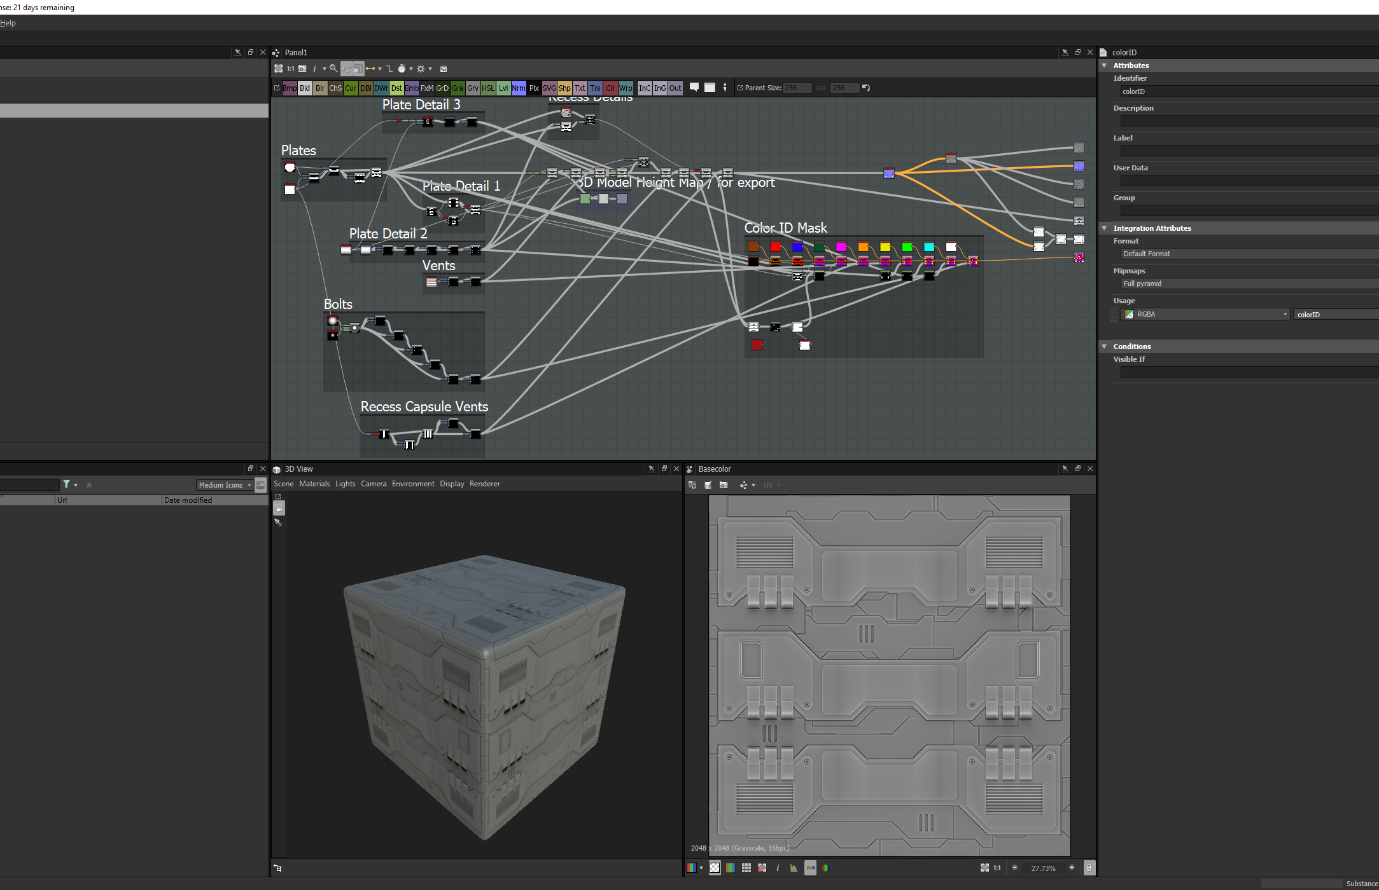
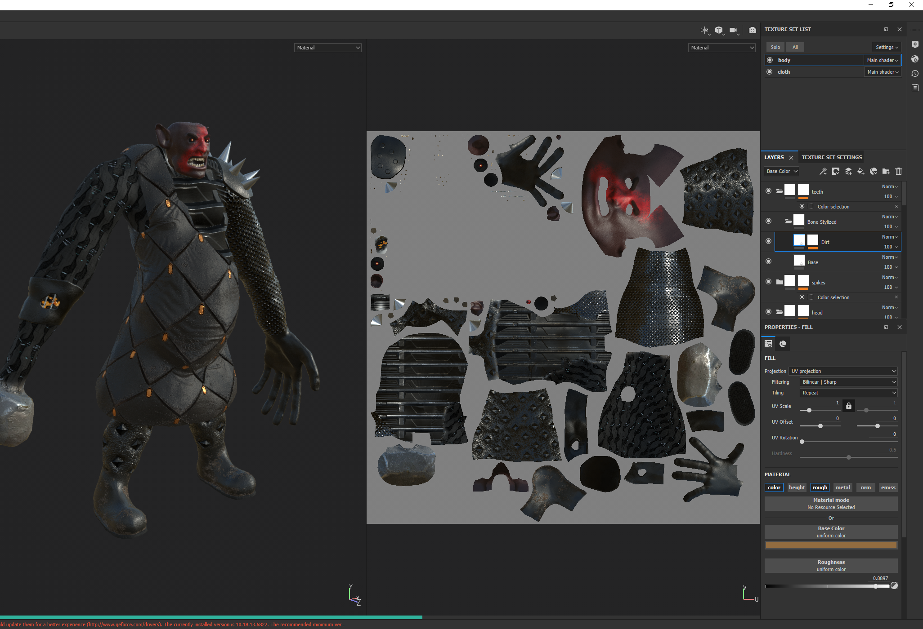
Substance Suite
Painter: layer-based texturing tools
Designer: procedural, PBR material design
B2M: generate textures from photos
Couldn't live without Painter
UE4 integration
High poly to low poly baking
Non-destructive workflows
Free, high quality materials every month
Perpetual edition after 12 months + €50
€21 (sub)

Slide 12
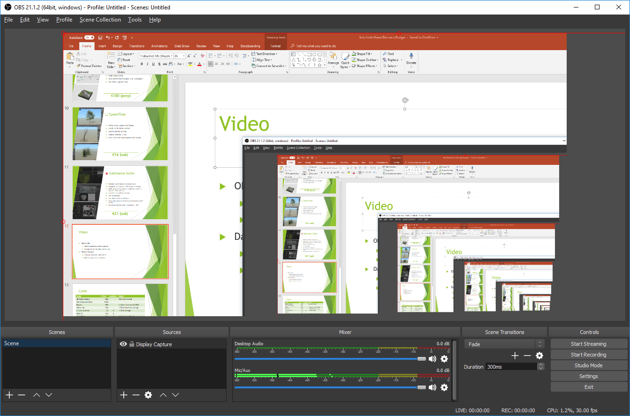
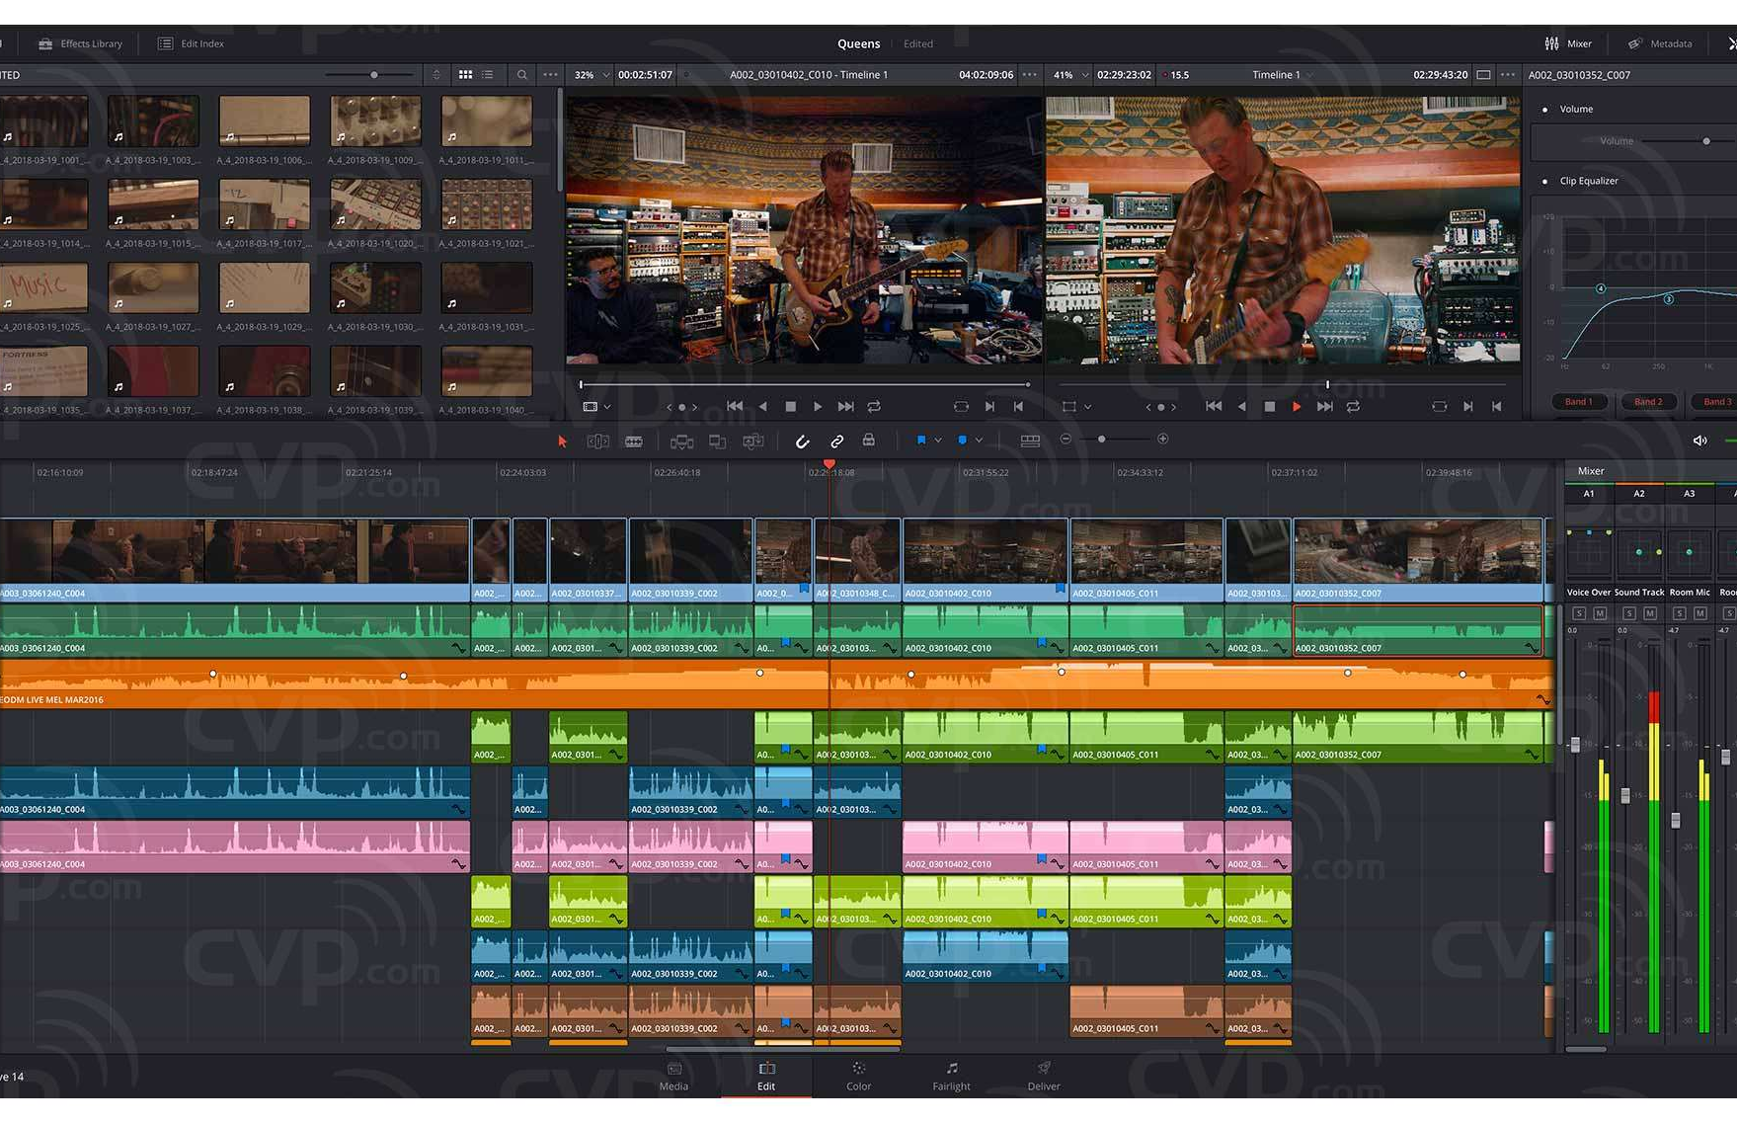
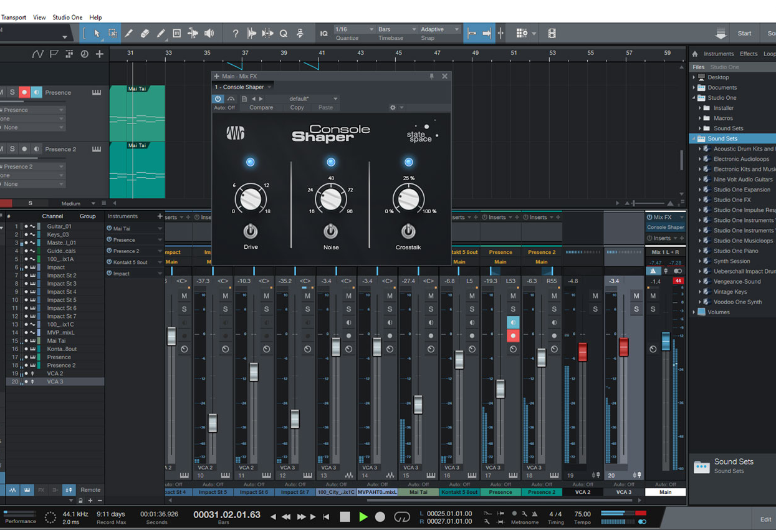
Video and Sound
OBS Studio
Record gameplay and/or yourself
Stream live on YouTube, Twitch, etc.
DaVinci Resolve
Free, professional video editor
Best-of-class color correction
Reaper
Supports VST plugins
Organizes all your SFX files in libraries
€60

Slide 13
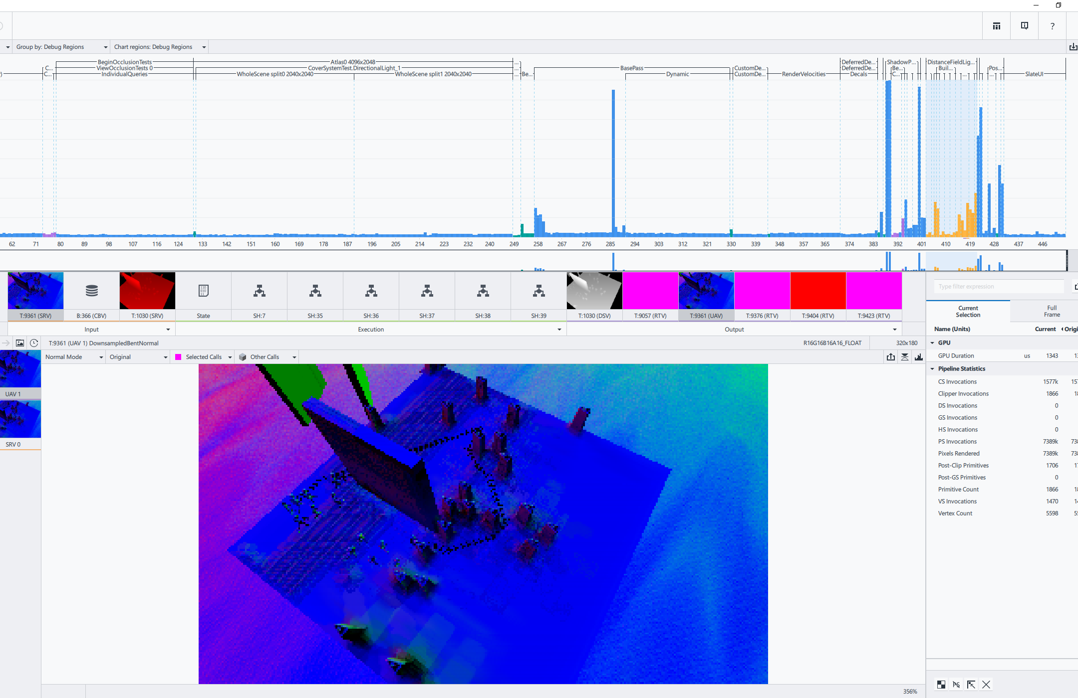
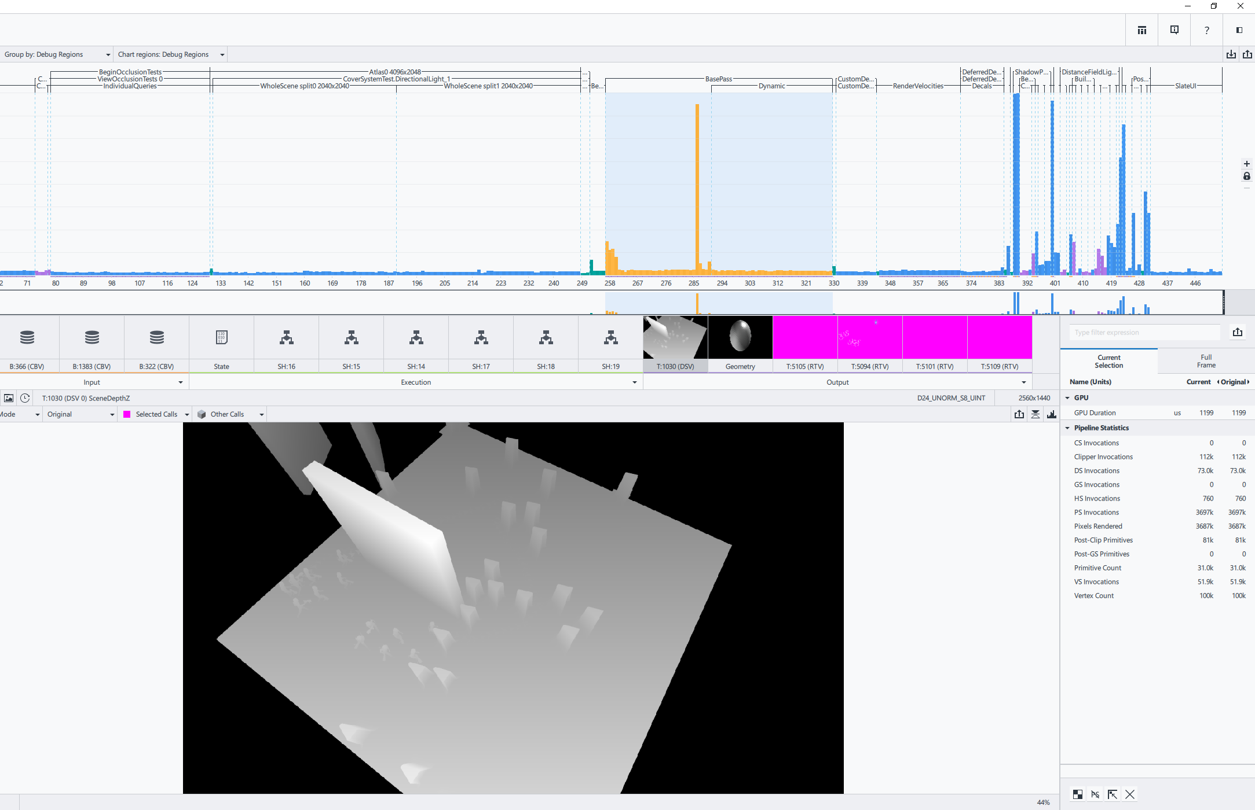
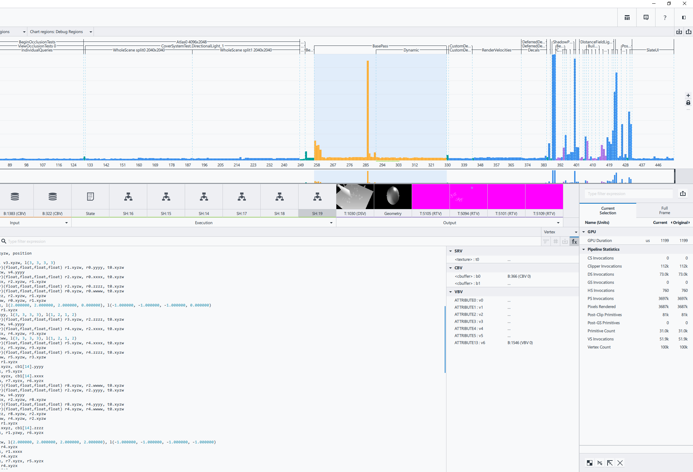
Intel GPA
Graphics profiler / debugger
Analyzes frames captured from your game
Track down performance per mesh
HLSL code view
More detailed than UE4’s internal graphics profiler
Another alternative is RenderDoc (also free)
Free

Slide 14
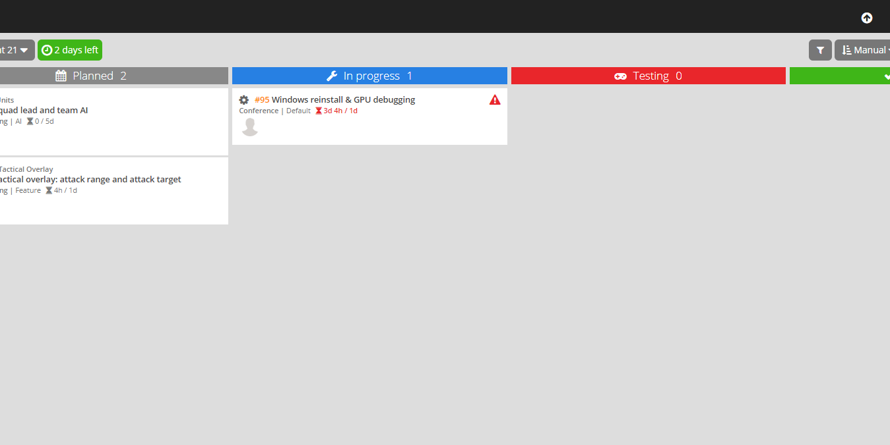
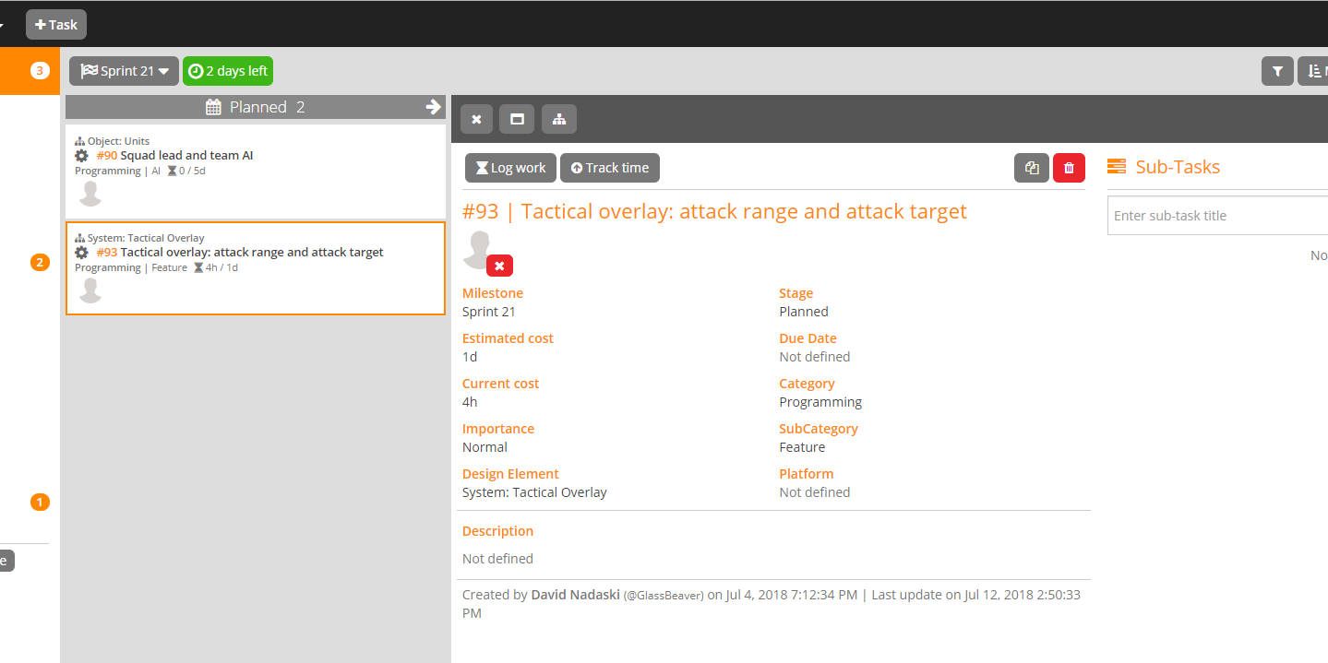
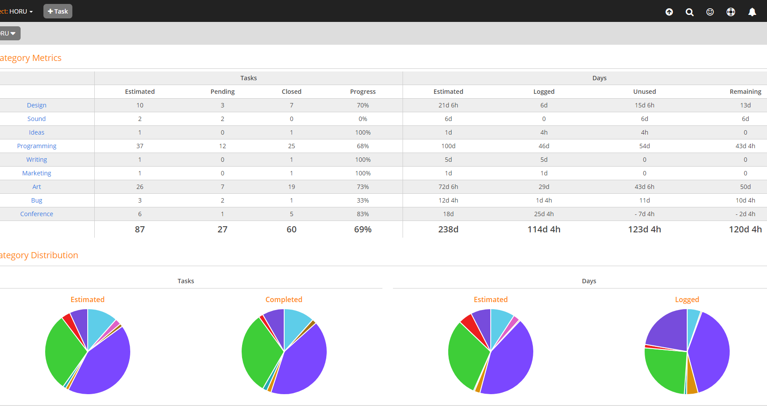
Project Management
Keep track of tasks and sprints
I use HacknPlan (free)
Alternatives
Free

Slide 15
Costs
Name | Price | Monthly? | Notes
3D-Coat Amateur | €90 |  | Non-commercial
World Machine Indie | €100
Reaper | €60 |  | Limited commercial $20k
Office 365 | €70 |  | 1 TB of OneDrive storage
G Suite Business | €8 | X | 1 TB of storage
Maya LT | €30 | X
SpeedTree | €16 | X
Substance Suite Indie | €21 | X | Limited commercial $100k
Photoshop & Lightroom | €12 | X
Linux server in US | €15 | X | Or as low as €1 in EU
One-Time
Monthly
1st Year
€320
€102
€1544

Slide 16
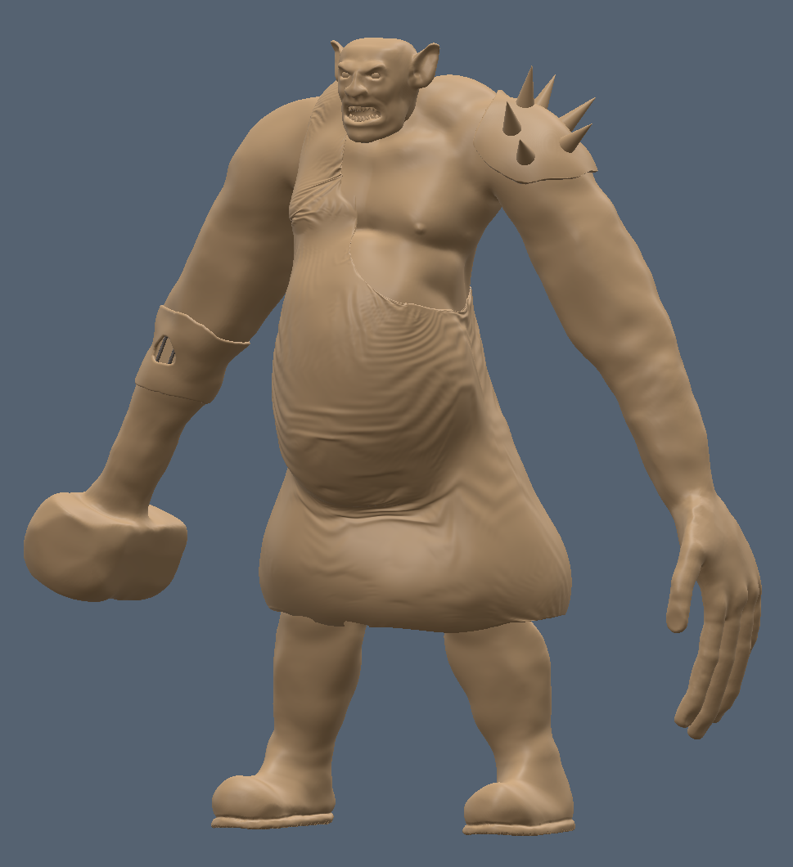
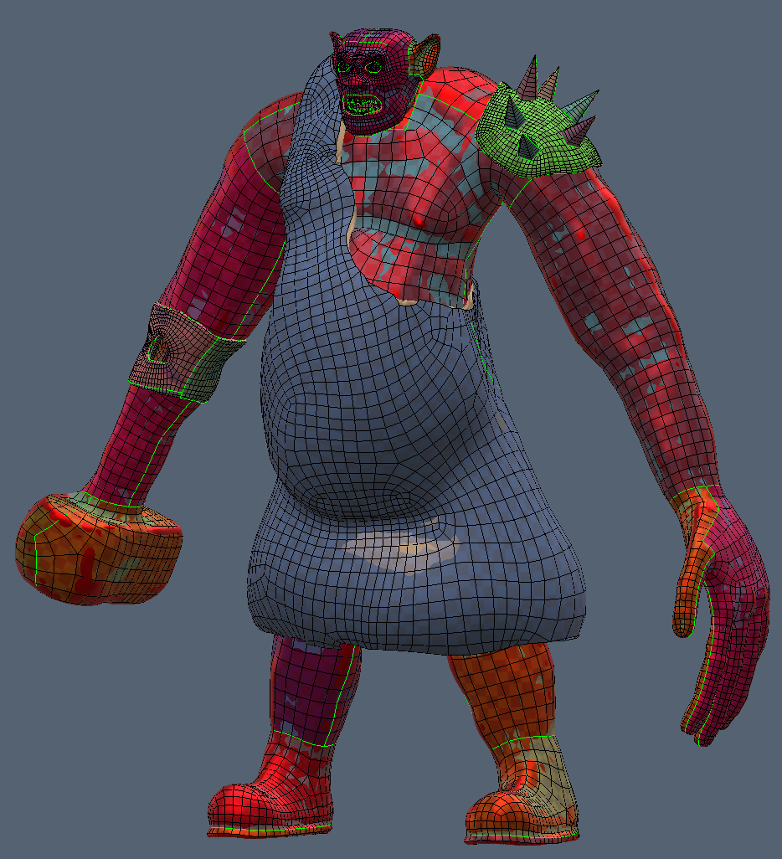
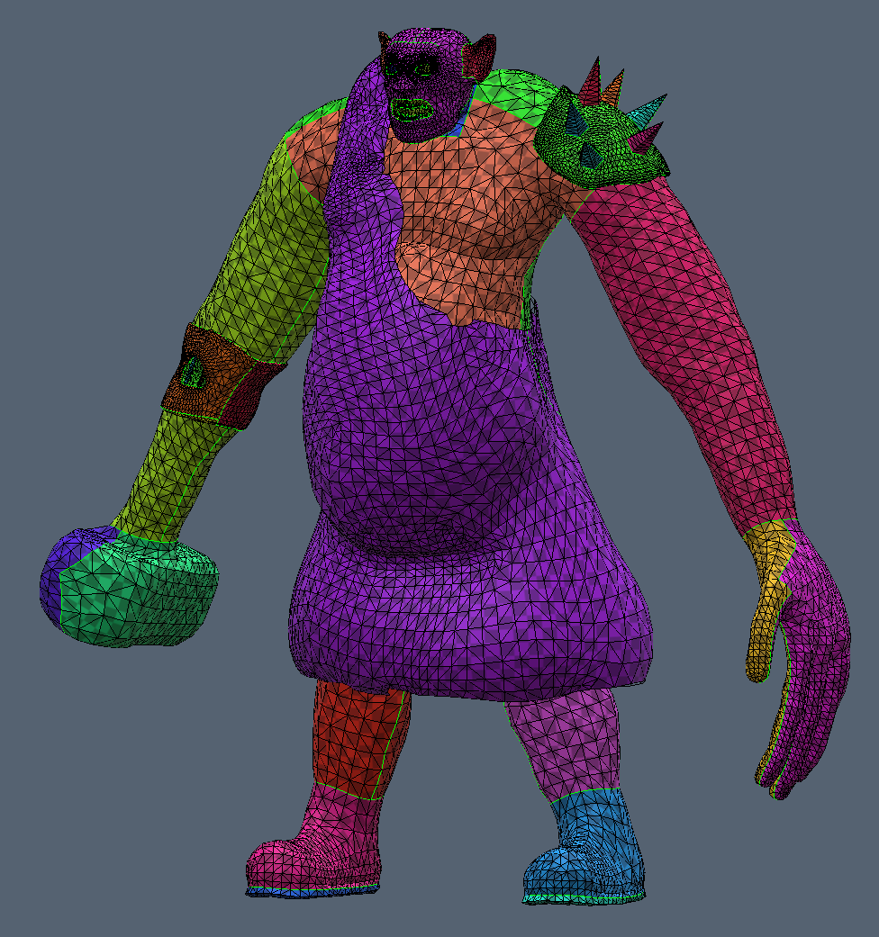
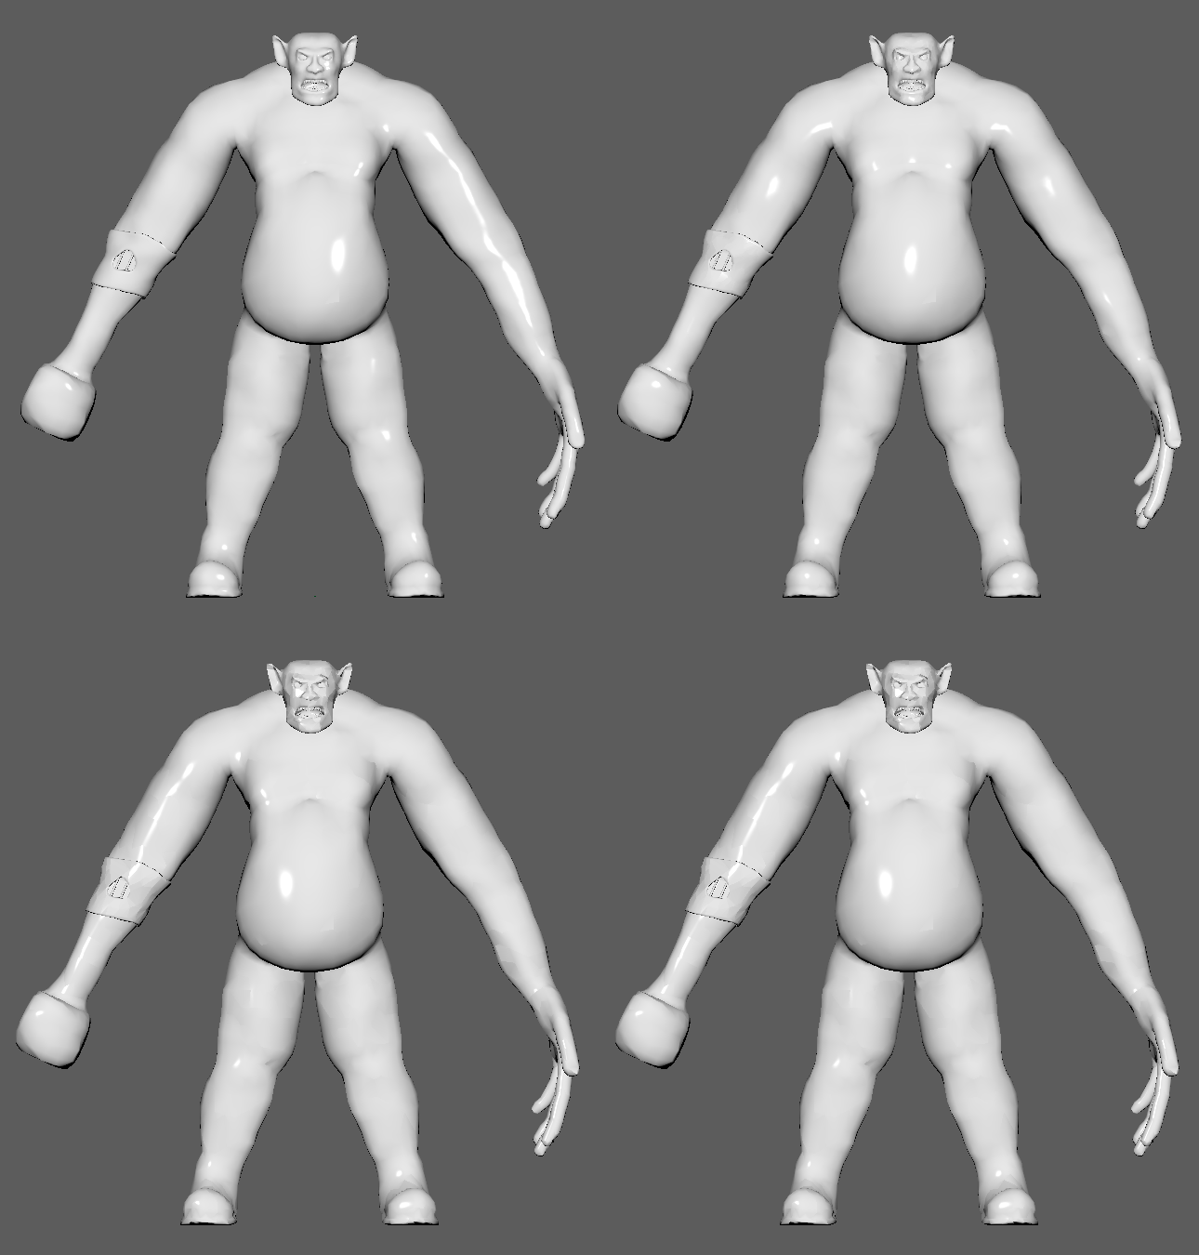
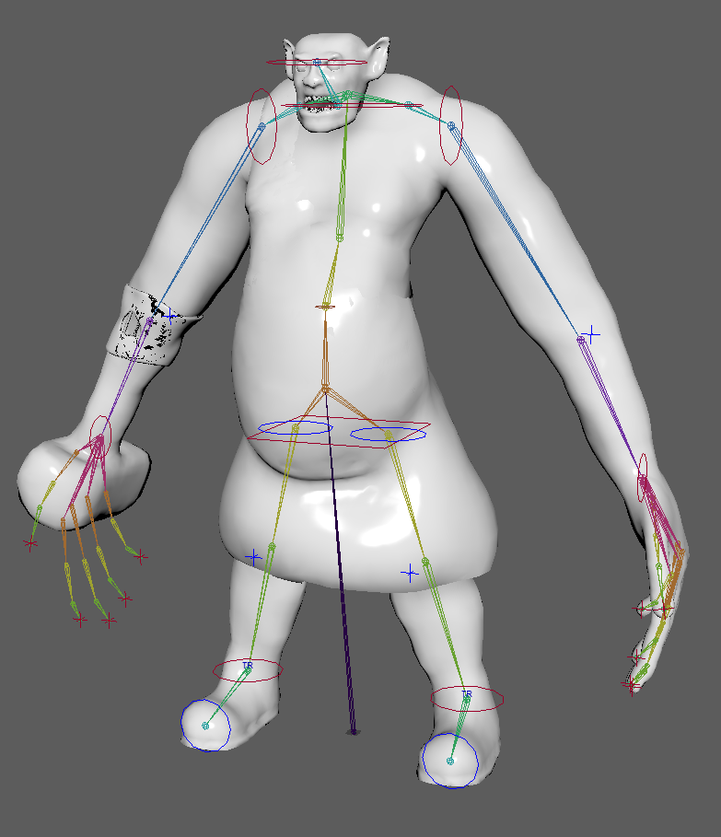
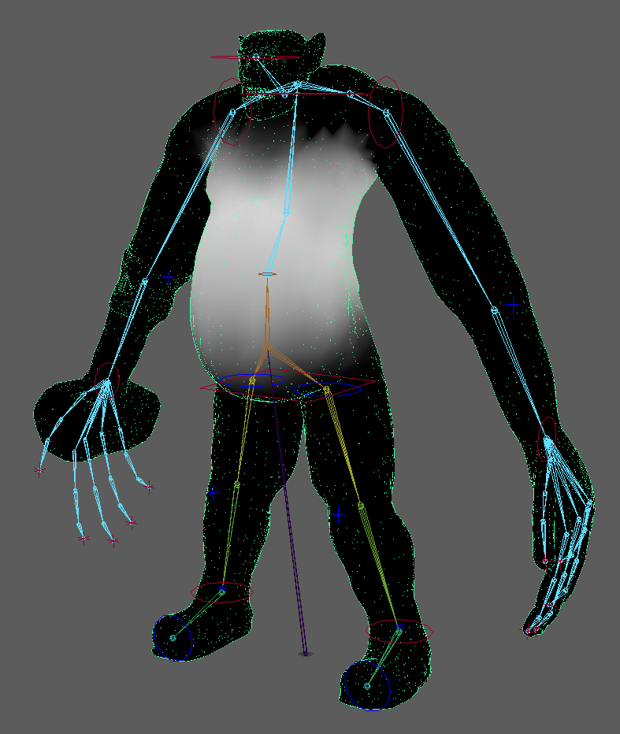
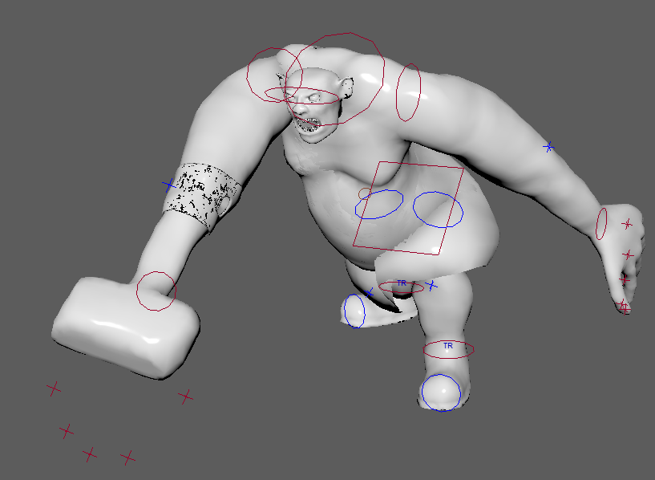
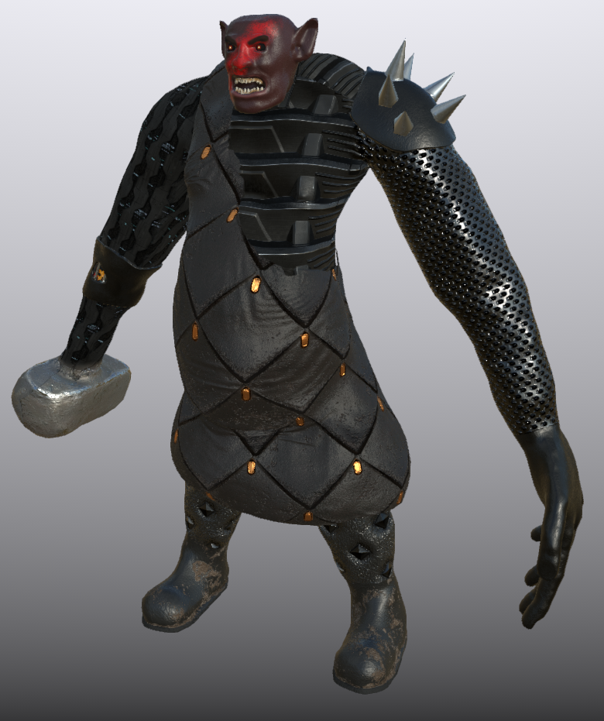
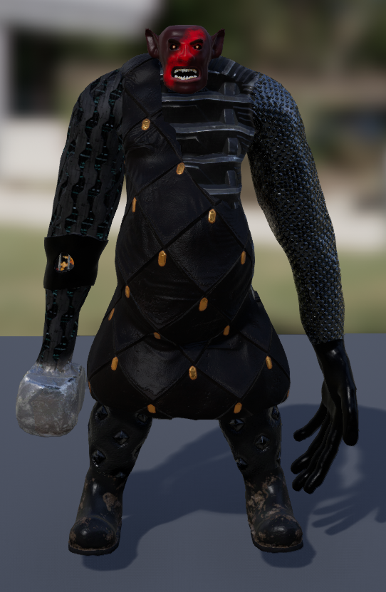
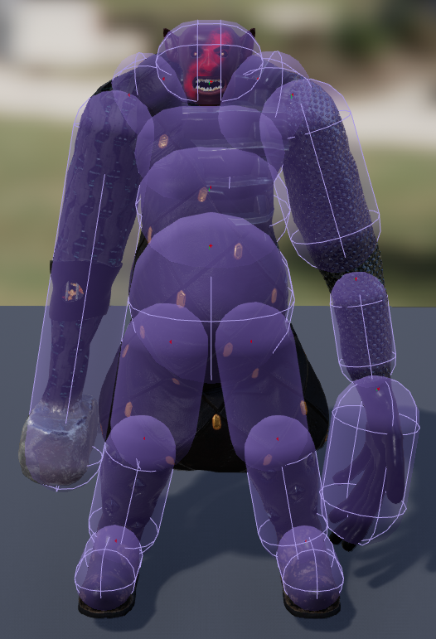
Character Pipeline
Sculpting
Retopology
UV
LOD
Rigging
Skinning
Animation
Texturing
UE4 Mesh
UE4 PHAT

Slide 17
Source Control
Git
Completely free
Might be more familiar
Use LFS for all the binary files, e.g. uasset
Perforce
Free for up to 5 users
It’s what most game studios use
Local vs. Remote Repository
Local is fast, safe and free
Put the repo in a OneDrive folder
Use OneDrive (and/or G Suite) for backups
Use Gitea and commit/push locally
Use remote when you’re in a team
OneDrive Backup

Slide 18
Online Presence
Set up a Linux server
Make a WordPress site for your game
It’s quick & easy
Get used to having a website early on
Self-host WordPress on your server – it’s free!
If in a team, host the VCS on the server
Try Aruba Cloud (EU) or Digital Ocean (US)
Aruba is dirt cheap, starting at €1/month

Slide 19
Challenges
Software overload
Write down techniques to retain know-how
Group tasks by tool
Discipline
Plan weekly sprints
Keeping regular hours
I usually work from 9PM to 5AM

Slide 20
THE END
Questions?

